Slide 1


safeguarding children: paedophile awareness
Nick Stoneman and Simon Moules

Slide 2
Did you know?
25 per cent of all rape victims are under 16 years old.
Cawson et al. (2000) Child maltreatment in the United Kingdom: a study of the prevalence of child abuse and neglect.

Slide 3
Introduction
What are the paedophile stereotypes?
What is a paedophile?
Types of paedophile
Targeting and grooming
What children may be told
Common traits and excuses
Research findings
Any questions?

Slide 4
Quiz
What is a paedophile?
What percentage are women?
Name three places where paedophiles will frequent?
What percentage of child abuse victims are abused by strangers?
What percentage of paedophiles were abused as a child?
What age do most paedophiles start their offending behaviour?
How many convicted paedophiles are there in the UK?

Slide 5
Describe a paedophile
Who are they, what do they look like and where can you find them?

Slide 6



Do they look like this?

Slide 7
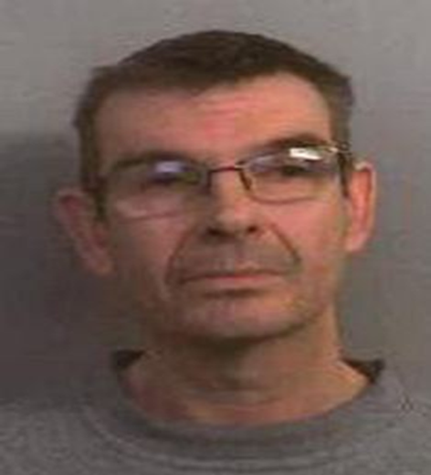
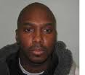
Or this?
Nigel Leat
Teacher
Convicted, 8 yr sentence 2011
Jason Hoyte
Church youth worker
Convicted, 9 yr sentence 2009

Slide 8
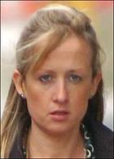
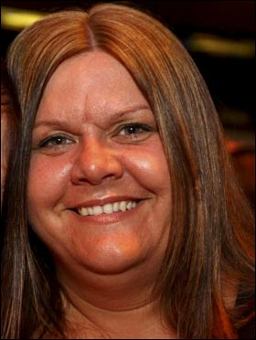
Or this?
Claire Lyte
Tennis coach
Convicted, 3 yr sentence 2007
Vanessa George
Nursery worker
Convicted, 7 yr sentence 2009

Slide 9

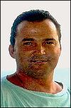

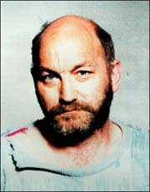
Roy Whiting
Stuart Campbell
Ian Huntley
Robert Black

Slide 10
Operation alpine…
Lincolnshire police force, which led the operation, said it was the biggest paedophile ring of its kind in the UK and that 132 children had been ‘safeguarded’ and a number of paedophiles had been removed from positions of trust, including jobs as teachers, doctors and youth workers.
Police Oracle June 2011

Slide 11
30 year old paedophile…
“We are wolves in sheep’s clothing...you’d be amazed at how easy it is to fool parents, adults and children...they just have no idea”.
Sanderson 2004

Slide 12
What is a PaedophilE?
An adult who fantasises about or actually engages in sexual activity with a child

Slide 13
Paedophile behaviour
Is NOT a medical illness, but the behaviour is addictive, therefore it cannot be cured, but may be controlled.

Slide 14
Categories of paedophile
FIXATED
Also known as invariant or obligatory
REGRESSIONAL
Also known as pseudo neurotic or situational

Slide 15
What are the differences?
FIXATED
Persons who only have relationships with children, including sexual relationships.
They have distorted perspectives over these relationships and rationalise any guilt which they may feel.
They have no interest in sex with adults.
They generally reside alone and have an isolated existence.

Slide 16
What are the differences?
REGRESSIONAL
Persons who do have relationships with adults, but on occasions, will have sexual relationships with children.
They enjoy the relationships with the children, although they may experience guilt.
Will offend when the opportunity arises and under their sway of emotions and personal stressors, such as financial, emotional or social.

Slide 17
Do not forget…
Stress is no excuse or defence to abuse:
“Regressional paedophiles are fully perverted towards children”.
Glasser 1989

Slide 18
History of offending
Few friends
Married
Interest in teenage girls
Marital problems
Academic qualifications
History of offending
Few friends
Common law marriage
Interest in teenage girls
Marital problems
Academic qualifications

Slide 19
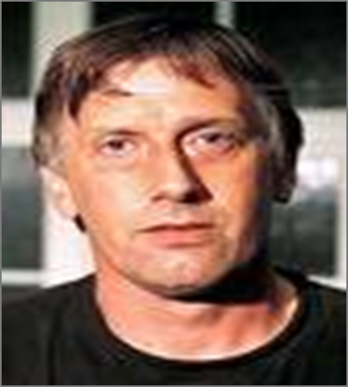
Abused as a child
Child abuse convictions
Loner
No qualifications
Parents divorced
Odd job builder
Abused as a child
Child abuse convictions
Loner
No qualifications
Fostered at birth
Delivery driver

Slide 20
According to a U.S. study on 2429 adult male paedophile sex offenders, only 7% identified themselves as fixated; indicating that most offenders are regressional.
Approximately 95% of all the child sexual abuse incidents, subject of the study, were committed by 88% of the fixated paedophiles.
Hall MD et al; A Profile of Pedophilia: Definition, Characteristics of Offenders, Recidivism, Treatment Outcomes, and Forensic Issues 2007.

Slide 21
“For far too long child grooming has been a hidden issue, with dangerous perpetrators targeting vulnerable girls and boys in the shadows of our society”.
Enver Solomon of The Children's Society
BBC News June 2011

Slide 22
Abuse process
Target
Groom
Abuse

Slide 23
Targeting
Victim is selected long before the abuse occurs.
Victim more likely to be emotionally/physically lonely, easily led, too trusting or described as vulnerable.
Perpetrator fantasises and masturbates to a mental picture of the child.
Perpetrator will create casual and informal meetings with the child.

Slide 24
Targeting
Meets and gains the trust of the child’s family or carers, becomes a family friend.
Visits to the perpetrators home are openly made with the child’s family.
Has parental consent to be alone with the child, babysitting or taking child out.
If met with resistance the perpetrator moves on and the entire process starts again.

Slide 25
Grooming
The child will be made to feel special, by receiving positive attention or material goods.
Communication of child is trivialised and distorted, suggests to parents that the child lies, which will be a foundation to his defence if caught.
Controls the child and punishes dependence on anyone other than himself.

Slide 26
Grooming
Gains the trust of the child by allowing actions and behaviour not accepted by parents (smoking, drinking, etc.).
Perpetrator states he is lonely and reveals ‘personal secrets’ about himself, so the child believes they are a special friend.

Slide 27
Grooming
Manages to draw the child emotionally from their parents, by taking advantage of their needs, personality and character.
Engenders secrecy so the child will tell abuser information regarding themselves and their family.

Slide 28
Abuse
Boundary violation commences by hugging when greeting and tickling, which the child accepts to eventually sexual touching.
Conversations become eroticised and physical fondling is reciprocated.

Slide 29
Regarding Hoyte “He never used violence, he was a nice person. He would make me feel special but subconsciously I knew it was wrong.”
New Christian Music co.uk
Regarding Leat “..friendly, affectionate, keen to get involved and a passionate teacher.”
This is Bristol June 2011

Slide 30
Children may be told…
Your parents are not interested in you.
Do not tell your friends about us, as they will be jealous.
I will sort all your problems, as I am always here for you.
Your parents do not love you, like I do.

Slide 31
To maintain silence children may be told…
Nobody, including your parents, will believe you.
They will hate you.
They will punish you.
You will be taken into care and never see your parents again.
You are responsible for what happened.
You enjoyed it, if you had not, you would have stopped it.

Slide 32
Ray Wyre
“They thought sex offenders were one-offs and wouldn’t do it again; they didn’t understand that it’s a lifelong pattern of behaviour.....”
Sunday Times June 2008

Slide 33
Common traits found in fixated paedophiles
Molest large numbers of children.
Uses child erotic material.
Uses child abusive images.
If he has friends they may be paedophiles.
Poor relationships with peers.
Lives alone or with parents or mother.
Will have preference to children of a particular age range.
Over 25 years of age, yet has no dating pattern with men or women.
Presents himself to be a nice man.
Uses positions of authority to seduce.

Slide 34
May have pictures and decorations in home that appeal to children.
Selects vulnerable children, physically and emotionally neglected.
May be associated with or belong to a children’s organisation.
Describes children as clean, pure, innocent, rosebud, angel, cherub or princess.
Enjoys photographing children.
May prefer limited sexual involvement.
Knows how to talk to children and more especially knows how to listen.
Suffered perceived child abuse.
Interest began in adolescence.

Slide 35
What excuses may they give for their behaviour?
Incident is a one off and out of character… they are likely to have committed numerous other offences!!
Abuse is part of normal adolescent development and the child needed to be taught correctly.
They were intoxicated by alcohol or drugs.
The child wanted the sexual experience and they enjoyed it.
They were suffering from stress.

Slide 36
It was an accident.
They were abused as a child, so they will do it to others.
Its natural and does not cause any harm.
Its being going on since the year dot so what’s the problem.
They do it in other cultures.
Their partner doesn’t want sex anymore, so having sex with the child keeps the family together.

Slide 37
Research
48% of the paedophiles found their victims through babysitting.
30% of the paedophiles had each committed offences against 10 to 450 victims, 70% had between 1 to 10 victims.
66% of paedophiles are known to the child, 34% are strangers.
Kidscape 2008

Slide 39
“There are about 110,000 convicted paedophiles in this country, the majority of whom have been offending for six years or more before they are convicted for the first time.”
Times Online August 2008

Slide 40
Research conducted over 20 years suggested that most offenders commenced abusing in their adolescence, average age 14 years.
50% of target group had committed 380 offences by time they reached adulthood.
NSPCC 2007

Slide 41
How many paedophiles were abused as children?
30 percent of paedophiles were sexually abused themselves as children
Abel 1987
Psychiatric News May 19, 2006 Volume 41 Number 10 Page 37

Slide 42
Female paedophiles
“Between 5% and 10% of abuse against pre-pubescent children in the UK is committed by females, but only about 5% is thought to involve a woman acting alone”.
Professor Kevin Browne 2009

Slide 43
“Some believe that society's different attitude to women offenders is reflected in the language of the media reporting it. They point out that teachers ‘seduce’ pupils if they are female but ‘sexually assault’ if male”.

Slide 44
Recidivism
Intra familial abusers of girls have the lowest level of re-conviction ranging from 4 – 10%.
Extra familial abusers of girls, 10 – 29%.
Gibbens 1978
Extra familial abuser of boys, 13 – 50%.
Furby at al 1989

Slide 45
“Paedophiles are long term recidivists. The oldest in the clinic are in their eighties. Burglars, car thieves and brawlers all appear to give up in their thirties but paedophiles just keep on offending”.
Glaser 2002 New Statesman
“With sex crimes we have a 100% rate of recidivism. Not a single paedophile, not a single sexual maniac changes his way in prison”.
Vinogradov 2008 Russian Times

Slide 46
Chemical castration
Evidence from Scandinavia suggests rates of reoffending have been cut to five per cent from more than 40 per cent.
By contrast, the Australian government rejected calls to introduce chemical castration on the basis there was no proof it worked.
Daily Telegraph 26 August 2008

Slide 47
Knowledge check
What is a paedophile?
An adult who is emotionally and/or sexually attracted to pre pubescent children
What percentage are women?
5% alone and another 5% in collusion with a man
Name three places where paedophiles will frequent?
Parks, amusement arcades, schools

Slide 48
What percentage of child abuse victims are abused by strangers?
34% are strangers
What percentage of paedophiles were abused as a child?
Around 30%
What age do most paedophiles start their offending behaviour?
14 years old
How many convicted paedophiles are there in the UK?
110,000

Slide 49

“There is now at present, no perfect system of identifying or diagnosing paedophiles that has been accepted by everyone as foolproof”.
Lowenstein 2001

Slide 50

Any questions?

