Slide 1
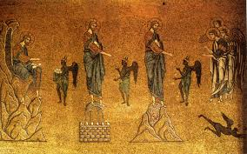
Looking Forward
~ “Looking forward to Easter” ~
Monday 22nd February 2021
Brentwood Diocese Education Service

Slide 2
~ The Year of St Joseph ~
In June 2019 Pope Francis announced that the theme for the next World Youth Day, in Lisbon in 2022* : “Mary arose and went with haste”. Let’s consider what we ourselves should hasten to do!
In this season of Lent what are you doing to follow Jesus’ command to
REPENT!
Lent is a time when we prepare for the Easter Season
when Jesus died and rose again.
We are looking forward to the Death and Resurrection of our Saviour by saying sorry and asking for forgiveness.
It is also a time for doing something positive for others.
BDES
* now moved to 2023 due to Covid 19

Slide 3
Preparing for World Youth Day 2023
“However far you may wander, he is always there, the Risen One. He calls you and he waits for you to return to him and start over again.”
- Pope Francis to the young people of the world
BDES

Slide 4
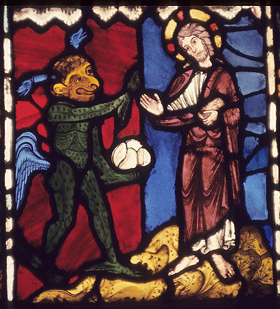
The Synoptic Problem
Gospel Reading
21st February 2021 :
The Gospel of Mark tells us that:
“The kingdom of God
is at hand.
Repent
and believe in the Gospel .”
BDES

Slide 5
Reflect
Saying Sorry
Saying sorry is a way of letting someone know you are aware that you might have caused them distress; it is in fact letting them know that you care enough about them to try to make things right.
This small act of Christian compassion and charity is usually a really pleasant thing.
Reconciliation and forgiveness are important parts of any relationship, even our relationship with God. Being able to admit your shortcomings, or acknowledge that your actions and words hurt someone (even if you didn’t mean to), isn’t always easy and might take an act of courage. Likewise, offering forgiveness can sometimes be painful and challenging. Yet, this is what our God does for us and what He calls us to do for others.
When have you needed to say sorry to others and to God?
BDES

Slide 6
Reflect
… on repentance …
“As Lent is the time for greater love, listen to Jesus’ thirst… ‘Repent and believe’ Jesus tells us.
What are we to repent? Our indifference, our hardness of heart. What are we to believe? Jesus thirsts even now, in your heart and in the poor — He knows your weakness.
He wants only your love, wants only the chance to love you.”
- St. Mother Teresa of Calcutta
BDES

Slide 7
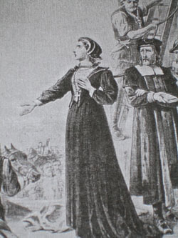
St Anne Line,
Feast day :
February 27th
Anne Line was born in Essex .
She was the daughter of William Heigham, but when she married a Catholic, Roger Line her father disowned her.
Roger was imprisoned for being a Catholic and was exiled and died in 1594 in Flanders, Belgium.
Anne stayed in England where she hid Catholic priests in a London safe house. In doing this she helped the Jesuit, Father John Gerard, until her arrest.
Anne was hanged at Tyburn, London on February 27, 1601.
Pope Paul VI canonized Anne Line in 1970 as one of the Forty Martyrs of England and Wales.
BDES

Slide 8
Prayer
CAFOD Prayer for Family Fast Day
Loving God, we hear your call to all who thirst for a brighter future: Come to the water.
Pour out your Spirit upon us and lead us to walk alongside one another.
Let a desire for change well up within us. May we overflow with compassion and love.
And as a stream wears away stone, may we reshape our world together to reflect your kingdom of hope for all.
Amen
BDES

Slide 9
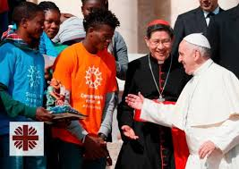
HOW CAN YOU SHOW COMPASSION?
What is your Lenten Resolution?
What are you going to do for others?
BDES

Slide 10
Looking Forward
~ “Looking forward to Easter” ~
Monday 22nd February 2021
Brentwood Diocese Education Service

