Slide 1
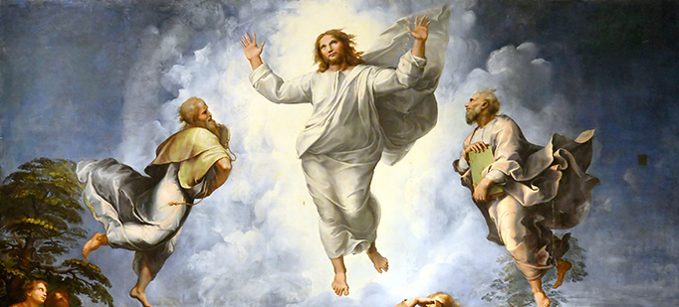
Looking Forward
~ Looking forward to Easter ~
Monday 1st March 2021
Brentwood Diocese Education Service

Slide 2
Looking Forward to Easter
~ In the Year of St Joseph ~
We are advised not to look forward without first looking back.
We are advised not to rush headlong into things.
We are advised to plan. We are advised to consider.
We are advised so often and so much and by so many.
And while we welcome advice as we make our plans,
there is one to whom we would do well
to pay the closest attention.
In looking forward, let us put our trust in Christ,
let us make time to be still and
Listen to Him
BDES

Slide 3
In context
LISTEN TO CHRIST
“And a cloud came, covering them in shadow; and there came a voice from the cloud, “This is my Son, the Beloved :
Listen to him.”
- Mark 9 : 7
BDES

Slide 4
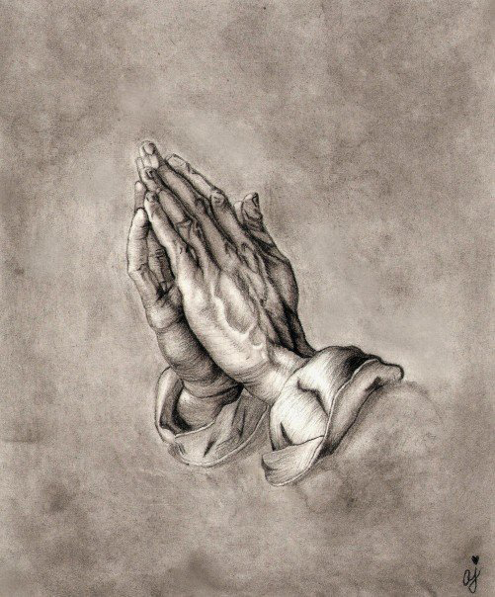
Reflection
“God speaks in the silence of the heart.
Listening is the beginning of prayer.”
- Saint Mother Teresa
BDES

Slide 5
Preparing for World Youth Day 2023
“Samuel was still a young boy, yet the Lord spoke to him. Thanks to the advice of an adult, he opened his heart to hear God’s call: ‘Speak, Lord, for your servant is listening.’”
- Pope Francis to the young people of the world
BDES

Slide 6
The Synoptic Problem
In Sunday’s Gospel Reading …
28th February 2021 :
2nd Sunday of Lent
It is God the Father Himself
who tells us in regard to His Son :
“Listen to Him!”
BDES

Slide 7
What is Jesus saying to you?…
‘Truly I tell you, whatever you did for one of the least of these brothers and sisters of mine, you did for me.’ - Matthew 25 : 40
In these days of pandemic,
what are you doing to ease the suffering of others?
Could you give
… your time?
… your patience?
… your attention?
… your help?
… your compassion?
“There was a time …when there was nothing. There wasn’t enough to buy food from the market. The only option was to take a loan and to survive by buying bread. We couldn’t afford wheat. We had to buy bread. And we made it last. It was very challenging.
“Another family we know, I gave some money to them. They didn’t have enough and they had big problems. I had to help them and they bought bread.” – Abba (Father) Tesfalem, a priest in northern Ethiopia
BDES

Slide 8
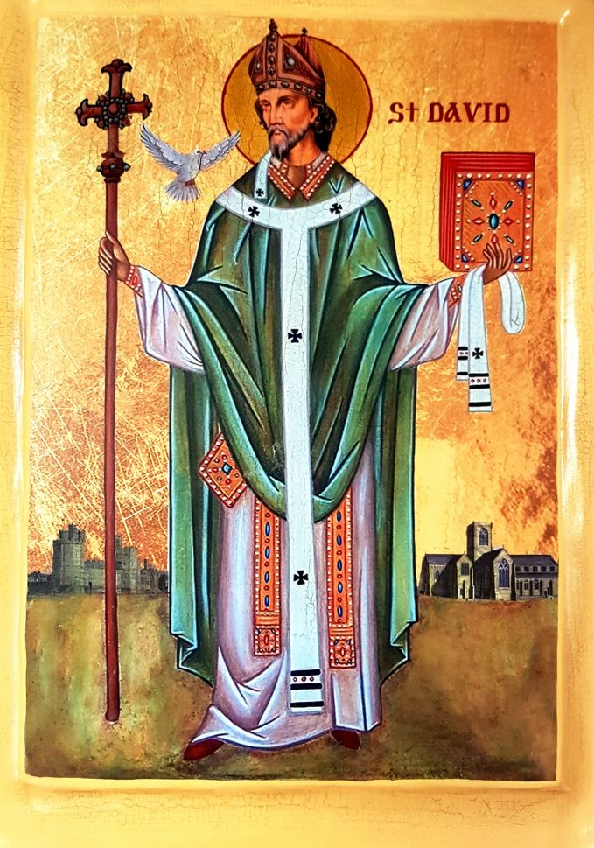
Saint
David
Feast day :
1st March
“Gwnewch y pethau bychain” - “Do the little things”.
These are supposed to have been St David’s final words of advice on his deathbed, advice to live your life by small acts of kindness which together would make a large difference.
He is the patron saint of Wales and was a bishop there in the 6th century. He was a teacher, a preacher, a founder of monasteries and churches, an inspirational man who lived a simple life, and a visionary.
BDES

Slide 9
Looking Forward
~ Looking forward to Easter ~
Monday 1st March 2021
Brentwood Diocese Education Service

