Slide 1
A morning of retreat and reflection
LENT 2021
~ with Bishop Alan Williams, SM ~
Thursday 11th March 2021
Brentwood Diocese Education Service

Slide 2
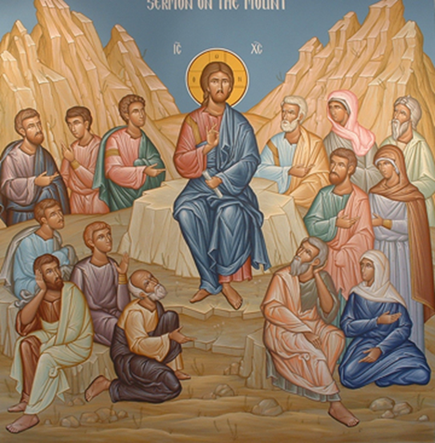
MORNING PRAYER
Antiphon
Today if you hear the voice of the Lord, harden not your hearts.
BDES

Slide 3
PSALM 95
Come, let us sing joyfully to the Lord; let us acclaim the rock of our salvation. Let us come into His presence with thanksgiving; let us joyfully sing psalms to Him.
Come, let us bow down in worship; let us kneel before the Lord who made us. For He is our God, and we are the people He shepherds, the flock He guides.
BDES

Slide 4
PSALM 95
Come, let us sing joyfully to the LORD; let us acclaim the Rock of our salvation. Let us come into His presence with thanksgiving; let us joyfully sing psalms to Him.
Come, let us bow down in worship; let us kneel before the Lord who made us. For He is our God, and we are the people He shepherds, the flock He guides.
BDES

Slide 5
Glory be to the Father, And to the Son, And to the Holy Spirit. As it was in the beginning, is now and ever shall be, world without end Amen
Antiphon
Today if you hear the voice of the Lord, harden not your hearts.
BDES

Slide 6
Reading
Make my joy complete: be of the same mind, having the same love, being in full accord and of one mind. Do nothing from selfish ambition or conceit, but in humility regard others as better than yourselves. Let each of you look not to your own interests, but to the interests of others.
Do all things without murmuring and arguing, so that you may be blameless and innocent, children of God without blemish in the midst of a crooked and perverse generation, in which you shine like stars in the world. It is by your holding fast to the word of life that I can boast on the day of Christ that I did not run in vain or labour in vain.
(Philippians, 2:2 – 4: 14 – 16)
BDES

Slide 7
Intercessions
Bless all the children; let their school years be fruitful ones for them;
R./ inspire our teachers with ways to draw out the best in all.
You left your mother to follow the call of the Spirit;
R./ help us to follow that same call and walk in your footsteps.
In God we live and move and serve with our whole being. Immersed in the mystery of this presence we humbly pray:
Jesus, you taught your followers the deepest lessons of life;
R./ show us how to teach our children your ways of forgiveness, reverence for one another and mutual support.
Jesus, our desires are boundless, but we are limited on every side;
R./ let the discipline of reality be a spur to our creativity.
BDES

Slide 8
Intercessions
Bless all the children; let their school years be fruitful ones for them;
R./ inspire our teachers with ways to draw out the best in all.
You left your mother to follow the call of the Spirit;
R./ help us to follow that same call and walk in your footsteps.
In God we live and move and serve with our whole being. Immersed in the mystery of this presence we humbly pray:
Jesus, you taught your followers the deepest lessons of life;
R./ show us how to teach our children your ways of forgiveness, reverence for one another and mutual support.
Jesus, our desires are boundless, but we are limited on every side;
R./ let the discipline of reality be a spur to our creativity.
BDES

Slide 9
Pause for reflection
BDES

Slide 10
Further reflection
But it was for this very reason that I came to this hour. (John 12:27)
We may often wonder why life proves difficult or why we face trials and pain.
Jesus wondered the same in days in the desert when he was tempted to run away, or hours in the garden when he felt severe loneliness.
Somewhere he found glimpses of meaning, and he knew that in going through his suffering, he would prove his love to the end, and in this love God would be glorified.
Suffering of itself does not glorify or please God, and sometimes we feel we’re like a river trying to get back up a waterfall.
It is not God’s will that we suffer, through violence or neglect of others, or through their greed and injustice.
The reason why Jesus came to his hour was love to God and to love us, to the edge of the cross and to the joy of resurrection.
God is glorified in our struggle over hurt and pain, and what is given in love to God and others is the reason for coming to any hour of our lives. And as for Jesus it can be the hour of our freedom.
- Donal Neary SJ
BDES

Slide 11
The Lord’s Prayer
BDES

Slide 12
The Lord’s Prayer
When you say to God “Our Father,” He has His ear right next to your lips.
- St André Bessette
BDES

Slide 13
Prayer
You are a God of Wonder and Mercy, as you call us into being and set us free in your loving plan.
Help us to grow in understanding the meaning of our freedom, so that we may discern wisely and respect the gift of freedom in all our sisters and brothers.
Grant this through the intercession of all who have died that others may be free.
Amen.
BDES

Slide 14
A morning of retreat and reflection
LENT 2021
~ with Bishop Alan Williams, SM ~
Thursday 11th March 2021
Brentwood Diocese Education Service

Slide 15
Closing Prayer
Lord, Father of our human family, you created all human beings equal in dignity: pour forth into our hearts a fraternal spirit and inspire in us a dream of renewed encounter, dialogue, justice and peace. Move us to create healthier societies and a more dignified world, a world without hunger, poverty, violence and war.
May our hearts be open to all the peoples and nations of the earth. May we recognize the goodness and beauty that you have sown in each of us, and thus forge bonds of unity, common projects, and shared dreams. Amen.
A prayer to the Creator
- Pope Francis - Fratelli Tutti 287 3rd October 2020
BDES

Slide 16
Blessing
May you take time to celebrate the quiet miracles that seek no attention.
May you experience each day as a sacred gift woven around the heart of wonder.
May you know that you are ever embraced in the kind circle of God.
- John O’Donohue
BDES

Slide 17
A morning of retreat and reflection
LENT 2021
~ with Bishop Alan Williams, SM ~
Thursday 11th March 2021
Brentwood Diocese Education Service

