Slide 1
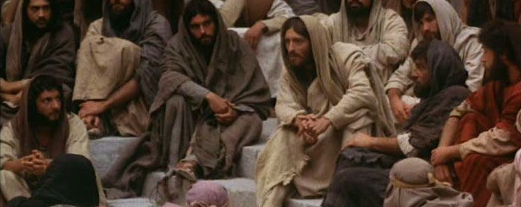
Looking Forward
~ “Looking forward to Easter” ~
Monday 8th March 2021
Brentwood Diocese Education Service

Slide 2
~ Looking forward to Easter ~
~ In the Year of St Joseph ~
Jesus Knows and Loves Us
Think about how much He loves you, and what He would want you to do in different situations.
Talk to Him every day through prayer.
Tell Him what is in your heart and how much you appreciate the good things He has given you.
The season of Lent is the time for prayer, fasting and almsgiving.
In this season of Lent, what are you doing to show your love for others?
BDES

Slide 3
Preparing for World Youth Day 2023
“Young hearts are naturally ready to change, to turn back, get up and learn from life.”
- Pope Francis to the young people of the world
BDES

Slide 4
The Synoptic Problem
Gospel Reading
7th March 2021 :
The Gospel of Mark tells us that:
“Jesus knew them all.”
BDES

Slide 5
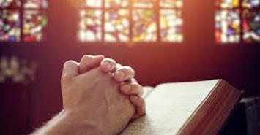
Reflect
Man has a noble task:
that of prayer and love.
To pray and love, that is the happiness of man on earth.
-St. Jean Marie Baptiste Vianney
BDES

Slide 6
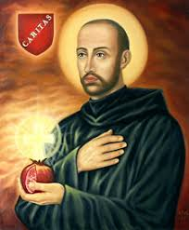
St John of God,
Feast day :
March 8th
John of God, was born on 8th March 1495 at Montemor-o-Novo in Portugal. Twice he enlisted in the Spanish army against the French and later the Turks.
After years of living a highly religious way of life in Spain resulting from a conversion experience, in 1535 he founded his first hospital at Granada, where he served the sick and afflicted. After ten years spent in the exercise of charity, he died on 8th March 1550, of pneumonia, after he had plunged into a river to save a young man from drowning. He was made a saint by Pope Alexander VIII in 1690 and was declared the patron saint of the dying and of all hospitals by Pope Leo XIII in 1898.
BDES

Slide 7
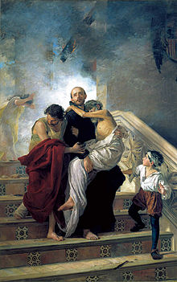
Brothers of St John of God
The Brothers Hospitaller of Saint John of God (officially the Hospitaller Order of the Brothers of Saint John of God; abbreviated as O.H.) were founded in 1572.
In Italian they are also known commonly as the Fatebenefratelli, meaning "Do-Good Brothers" and elsewhere as the Brothers of Mercy, the "Merciful Brothers" and the "John of God Brothers".
The Order carries out a wide range of health and social service activities in 389 centres and services in 46 countries across the world.
BDES

Slide 8
Prayer
O Lord, as You touched St. John of God, touch us too.
Transform our being and give us, like him, the capacity to choose You and to choose others, particularly those who suffer.
Make us sensitive to the needs of others, make us capable of being with each one of them, of being open and reaching out to those who need us.
May we like him, with his spirit, and with the aid of technology, choose to be hospitable to others, especially those who suffer.
Amen
BDES

Slide 9
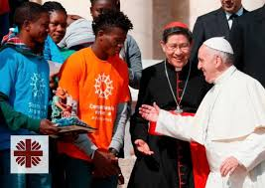
HOW CAN YOU SHOW LOVE?
What are you going to do to show your love for others during Lent?
BDES

Slide 10
Looking Forward
~ “Looking forward to Easter” ~
Monday 8th March 2021
Brentwood Diocese Education Service

