Slide 1
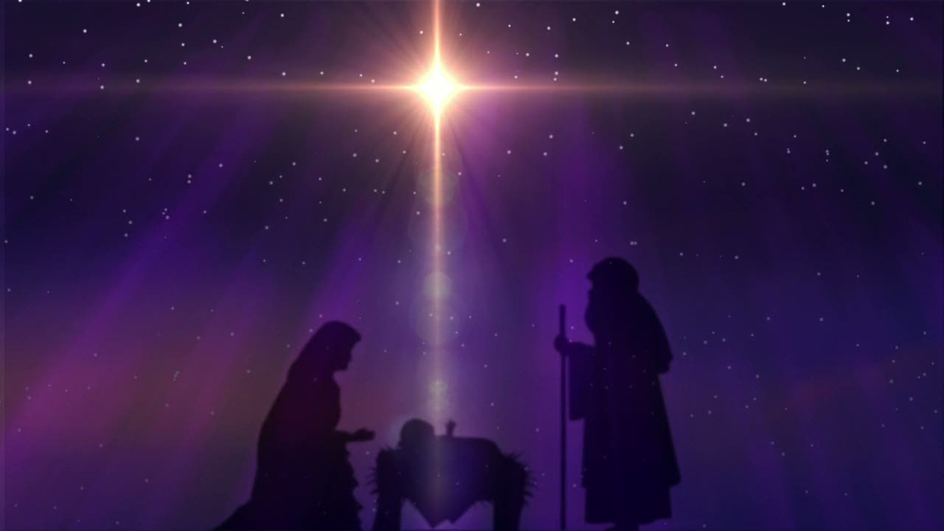
Looking Forward
~ Looking forward to Easter ~
Monday 15th March 2021
Brentwood Diocese Education Service

Slide 2
Looking Forward to Easter
~ In the Year of St Joseph ~
It seems such a short time ago that we were celebrating Christmas.
Celebrating, in the words of Cardinal Hume, that “the great and awesome God became man for me.”
In a short time we will be commemorating Jesus’ sacrificing His life for us.
Commemorating, in the words of Saint John’s Gospel, how “God so loved the world that He gave His only Son.”
In our reflections on the journey from the Crib to the Cross, let us remember :
God sent His Son into the world so that through Him the world might be saved.

Slide 3
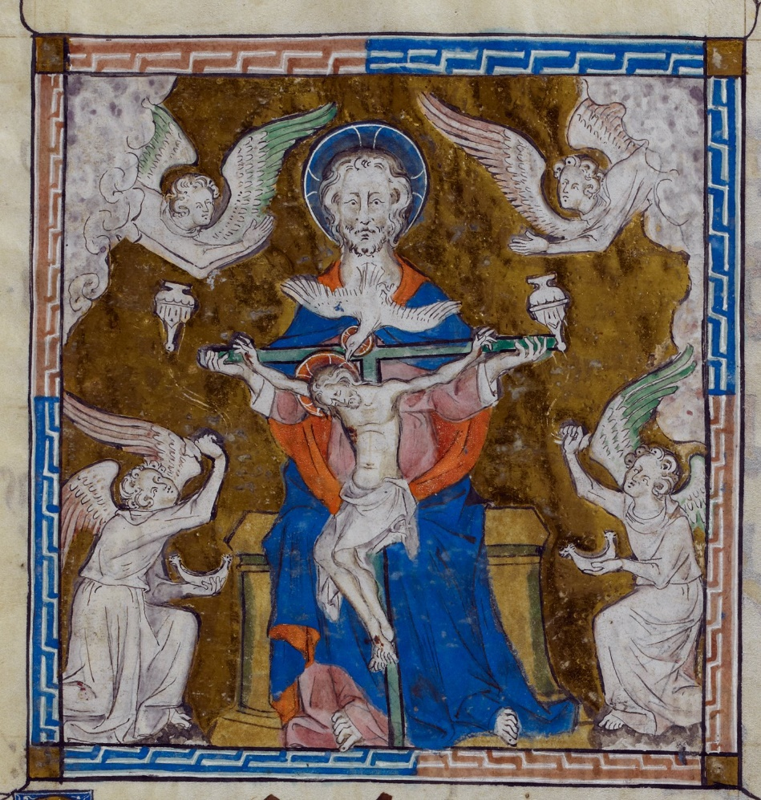
The Synoptic Problem
In Sunday’s Gospel Reading …
14th March 2021 :
4th Sunday of Lent
“God so loved the world that He gave His only Son.”
BDES

Slide 4
Reflection
God gave His only Son …
“This Lent, after so long in the desert, it’s time to look outwards : a Lent of giving, not giving up.”
- Father Dominic Howarth, homily for the 1st Sunday of Lent 2021
What can we give?
BDES

Slide 5
Preparing for World Youth Day 2023
“Jesus, himself eternally young, wants to give us hearts that are ever young.”
- Pope Francis to the young people of the world
BDES

Slide 6
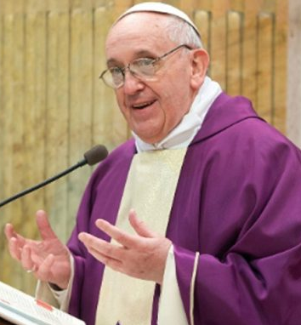
Still looking to give something up for Lent?
Do you still want to fast this Lent?
Fast from hurting words … and say kind words. Fast from sadness … and be filled with gratitude. Fast from anger … and be filled with patience. Fast from pessimism … and be filled with hope. Fast from worries … and trust in God. Fast from complaints … and contemplate simplicity. Fast from pressures … and be prayerful. Fast from bitterness … and fill your heart with joy. Fast from selfishness … and be compassionate to others. Fast from grudges … and be reconciled. Fast from words … and be silent so you can listen.
Pope Francis, Lent 2017
BDES

Slide 7
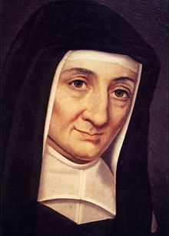
Saint Louise
de Marillac
Feast day :
15th March
Louise de Marillac (1591-1660) was a French aristocrat who received an education that prepared her for a life of comfort and security. She married in February 1613 but, sadly, her husband died in 1625. In that same year Louise met Vincent de Paul, whose collaborator she would be over the next 35 years until her death. Together, Louise and Vincent focused on those who were suffering: the sick, abandoned, illiterate, mentally ill or refugees – anyone who needed help.
She is the patron saint of social workers.
BDES

Slide 8
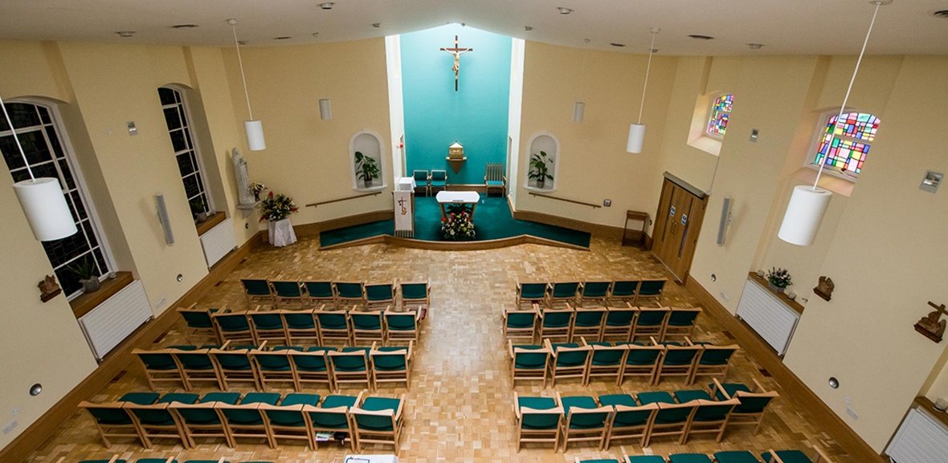
The Marillac , Brentwood :
Neurological Care Centre
Good works live on!
Marillac Neurological Care Centre has at its heart the vision to be a centre of excellence for health and healing for the care of people with neurological and physical disabilities.
Mission
At Marillac Neurological Care Centre we provide high quality care and specialist treatment for people who have neurological and physical disabilities. Through skilled and highly professional standards of nursing, caring and appropriate therapies, we respect their dignity and rights as individuals. Our holistic care, rooted in Christian values, enhances the quality of their lives providing people with optimum independence, freedom of choice and sense of fulfilment.
BDES

Slide 9
Looking Forward
~ Looking forward to Easter ~
Monday 15th March 2021
Brentwood Diocese Education Service

