Slide 1
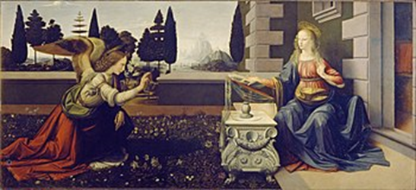
Looking Forward
~ “Looking forward to Easter” ~
Monday 22nd March 2021
Brentwood Diocese Education Service

Slide 2
~ Looking forward to Easter ~
~ In the Year of St Joseph ~
In June 2019 Pope Francis announced that the theme for the next World Youth Day, in Lisbon in 2022*, would be “Mary arose and went with haste” to tell news of her miraculous conception of the Son of God.
This week includes the feast of
the Annunciation
when Mary set aside her plans and opened herself to God’s will.
Mary opened herself to drastic change in her life.
How will you open your heart to do God’s will?
* Now in 2023 due to Covid
BDES

Slide 3
Preparing for World Youth Day 2023
“He is in you,
He is with you
and He never abandons you.”
- Pope Francis to the young people of the world
BDES

Slide 4
The Synoptic Problem
Gospel Reading
21st March 2021 :
The Gospel of John
tells us that some people said:
“We would like to see Jesus.”
BDES

Slide 5
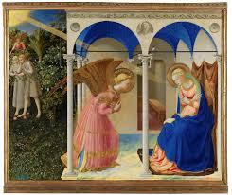
T
The Annunciation: March 25th
On the Feast of the Annunciation, we celebrate the day that the Angel Gabriel visited the Virgin Mary announcing that she was going to be the mother of Jesus. Even though Mary did not understand completely, she trusted God’s plan for her life, and she said yes to becoming the mother of God.
This event is celebrated through the three important liturgical texts, the Ave Maria, the Angelus, and the Magnificat.
The angel's greeting to Mary, which is traditionally translated as "Hail Mary, full of grace, the Lord is with thee," is the opening of the Ave Maria, and a part of the Rosary prayers.
The Angelus consists of three Ave Marias, together with some additional material. It is said three times a day in the Roman Catholic Church.
The Magnificat (Luke 1:46-55) is the poem with which Mary responds to the Annunciation and celebrates the power of God.
BDES

Slide 6
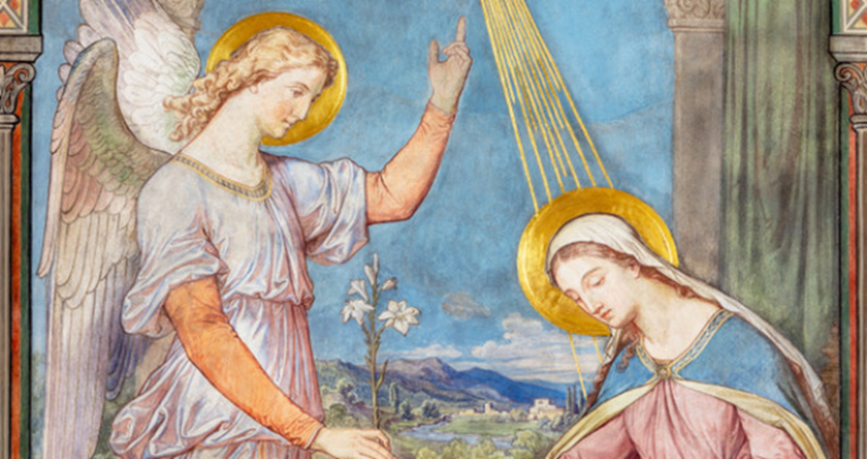
The Magnificat
My soul magnifies the Lord And my spirit rejoices in God my Saviour; Because He has regarded the lowliness of His handmaid; For behold, henceforth all generations shall call me blessed; Because He who is mighty has done great things for me, and holy is His name; And His mercy is from generation to generation on those who fear Him. He has shown might with His arm, He has scattered the proud in the conceit of their heart. He has put down the mighty from their thrones, and has exalted the lowly. He has filled the hungry with good things, and the rich He has sent away empty. He has given help to Israel, his servant, mindful of His mercy Even as he spoke to our fathers, to Abraham and to his posterity forever
BDES

Slide 7
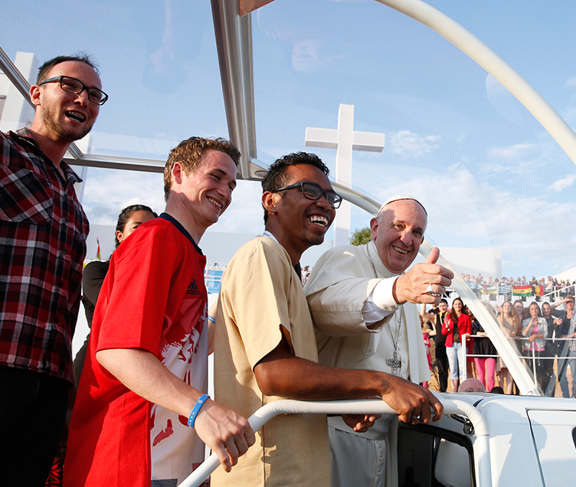
Pray and Reflect
Our Lady of the Visitation, you who left in haste towards the mountain to meet Elizabeth, lead us also to meet all those who await us to deliver them the living Gospel: Jesus Christ, your Son and our Lord! We will go in a hurry, with no distraction or delay, but with readiness and joy. We will go peacefully, because those who take Christ take peace, and welldoing is the best wellbeing.
BDES

Slide 8
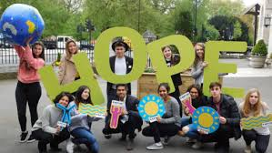
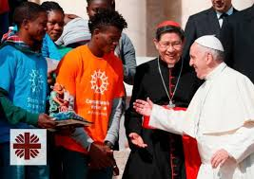
HOW CAN YOU SHOW LOVE?
How are you going to open your hearts to God and help others?
BDES

Slide 9
Looking Forward
~ “Looking forward to Easter” ~
Monday 22nd March 2021
Brentwood Diocese Education Service

