Slide 1
Looking Forward
~ “Mary arose and went with haste” ~
Monday 30th November 2020
Brentwood Diocese Education Service

Slide 2
“Mary arose and went with haste”
(Luke 1 : 39)
In June 2019 Pope Francis announced that the theme for the next World Youth Day, in Lisbon in 2022*, would be “Mary arose and went with haste”. Mary was a young Jewish girl who had had the deepest experience : the Angel appeared to her and announced that she would bear the Son of God. The angel left her (Luke 1 : 38 and the very next thing that she did (Luke 1 : 39) was to :
XXXXXXXXX GET UP AND GO X
to tell the news to her cousin Elizabeth in a faraway town in Judah, some three days’ journey away. She didn’t hesitate, she got up and went straight away to begin sharing her own personal good news which would be turn out to be Good News for everyone …
BDES
* now moved to 2023 due to Covid 19

Slide 3
Preparing for World Youth Day 2023
“Cultivate and bear witness to the hope, generosity, and solidarity that we all need in this difficult time.”
- Pope Francis to the young people of the world
BDES

Slide 4
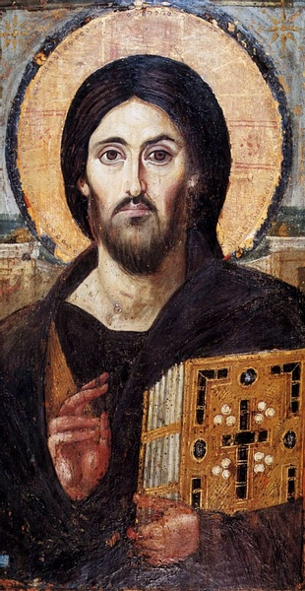
The Synoptic Problem
In Sunday’s Gospel Reading …
29th November 2020 : the First Sunday of Advent, the beginning of the Church’s New Year. In the Gospel Jesus tells his friends :
“Be on your guard, stay awake!”
BDES

Slide 5
Reflect
ARE YOU ON YOUR GUARD?
ARE YOU AWAKE?
ARE YOU READY TO GET UP AND GO?
Stay alert, the government says. Be on your guard. Save lives. Important messages, but it seems strange to encourage people to “Get up and go” when Lockdown tells us to stay at home whenever possible.
But “Get up and go” is an attitude. It’s being willing to DO something, to share something, to have a positive effect on other people.
BDES

Slide 6
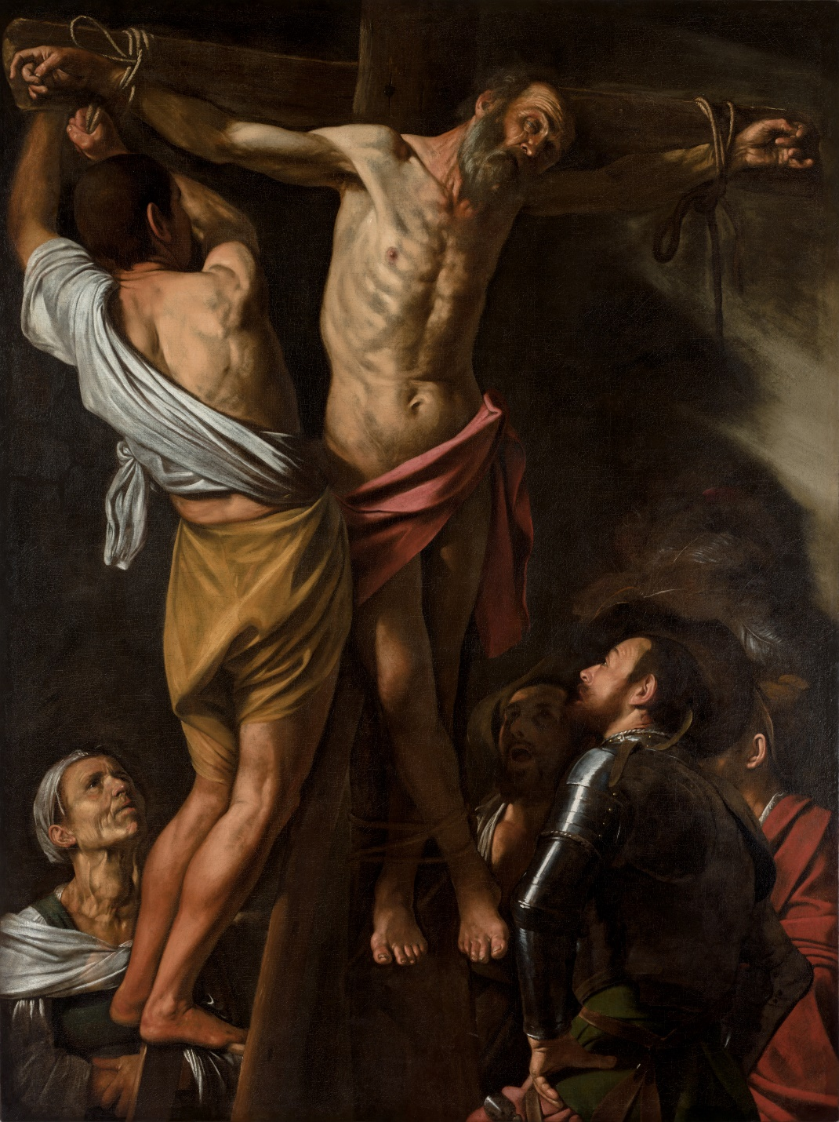
St Andrew’s Day, 30th November
A saint who had that “Get up and go” attitude. An ordinary fisherman, yet he was drawn to become a disciple of John the Baptist and then of Jesus. The Greek Church calls him Protokletos, the “First-Called”. Andrew became an apostle, a missionary and a martyr. He is the patron saint of Scotland and the instrument of his martyrdom, an X-shaped cross, is remembered in the Scottish saltire which is part of the Union Flag.
BDES
Detail of “The Crucifixion of St Andrew” by Caravaggio

Slide 7
WHAT CHARITY INITIATIVES ARE YOU SUPPORTING DURING ADVENT? HOW ARE YOU PREPARING TO CELEBRATE AND TO SHARE?
BDES

Slide 8
Get Up And Go!
~ “Mary arose and went with haste” ~
Monday 30th November 2020
Brentwood Diocese Education Service

