Slide 1
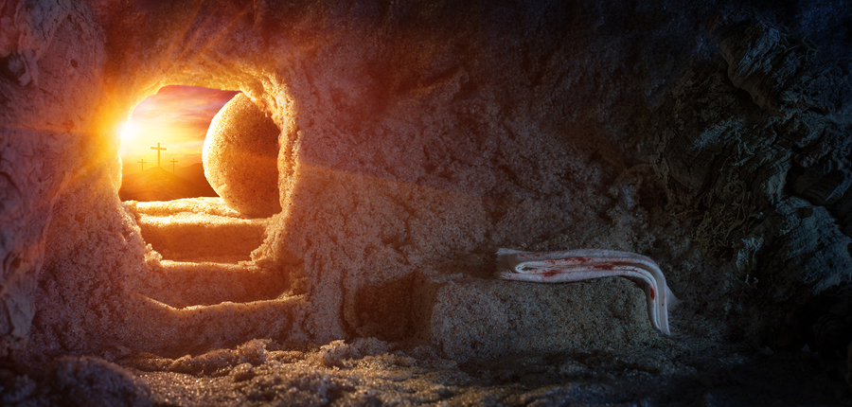
Looking Forward
~ We are an Easter People ~
Monday 12th April 2021
Brentwood Diocese Education Service

Slide 2
We are an Easter People
~ In the Year of St Joseph ~ In the Year of the Family ~
On 8th December Pope Francis declared a Year of St Joseph, to mark the 150th anniversary of the declaration of St Joseph as Patron of the Universal Church. We look forward to this year.
Last month Pope Francis declared a Year of the Family, to mark the 5th anniversary of the publication of his book Amoris Laetitia on the joy of family love. We look forward to this year too.
On 23rd March we remembered the first anniversary of the first lockdown, and remembered those who have died in the pandemic. We look forward to an end to the emergency.
~ Anniversaries help us to remember; anniversaries remind us to look forward. ~
The memory of the Resurrection reminds us to look forward. We are an Easter people.

Slide 3
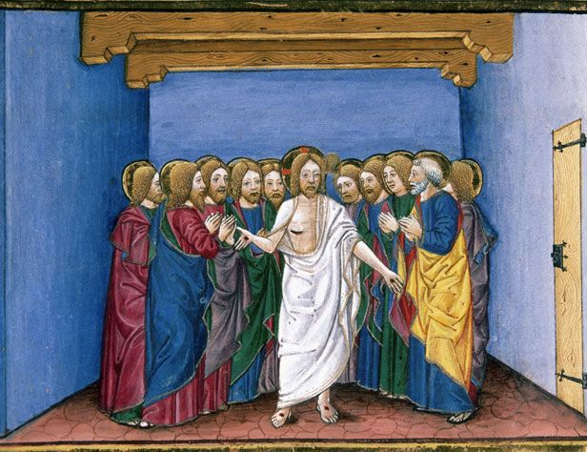
The Synoptic Problem
In Sunday’s Gospel Reading …
11th April 2021 :
2nd Sunday of Easter
“Receive the Holy Spirit.”
BDES

Slide 4
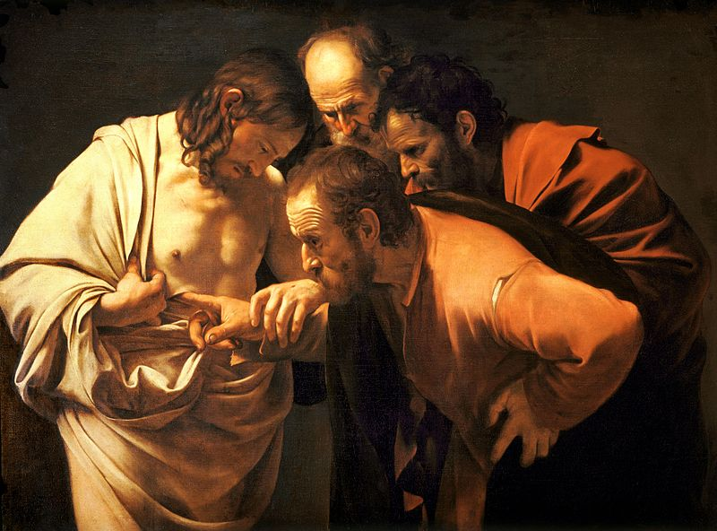
Reflection : Do we need proof in order to hope?
BDES

Slide 5
IS HOPE ALONE ENOUGH?
HOPE WITHOUT PROOF IS FAITH
ALL WE TRULY NEED IS CHRIST
TO HOPE IN CHRIST IS TO HAVE FAITH IN CHRIST
BDES

Slide 6
Preparing with our families for World Youth Day 2023
“Let us make this journey as families, let us keep walking together.
What we have been promised is greater than we can imagine.”
- Pope Francis on the Year of the Family
BDES

Slide 7
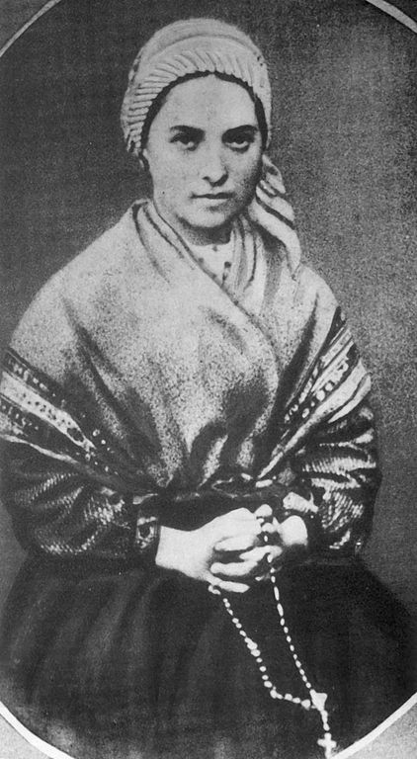
Saint Bernadette
Feast day :
16th April
Bernadette Soubirous was only 14 years old when she experienced the famous apparitions of Our Lady, the Immaculate Conception, at the grotto of Massabielle outside her home town of Lourdes between February and June of 1858. Her visions were declared as authentic by the Church in 1862 and Bernadette was canonised a saint in 1933. Lourdes has a population of only 15,000 but in years where travel is not affected by pandemic, 5 million pilgrims visit annually.
BDES

Slide 8
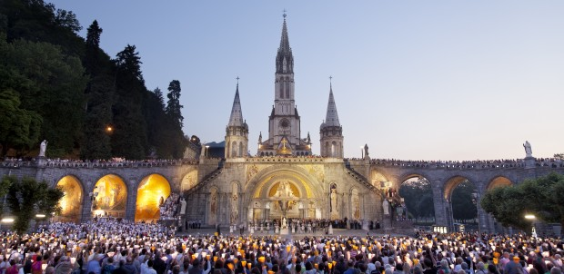
Looking forward to Lourdes again
Every year at Easter, except in 2020 and 2021 due to the pandemic, the HCPT Pilgrimage Trust goes on pilgrimage with 1,000 disabled and disadvantaged pilgrims and their volunteer helpers from all over the UK and beyond. Would you like to be a helper?
www.hcpt.org.uk
Every year in July, except in 2020 and 2021 due to the pandemic, the Diocese of Brentwood annual pilgrimage to Lourdes includes the Brentwood Catholic Youth Service Pilgrimage of some 200 young people. Would you like to be involved? The next pilgrimage will be in Summer 2022.
bcys.net
BDES

Slide 9
Looking Forward
~ We are an Easter People ~
Monday 12th April 2021
Brentwood Diocese Education Service

