Slide 1
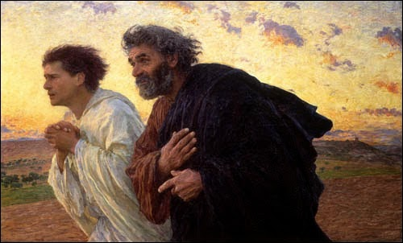
Looking Forward
~ “We are an Easter people ” ~
Monday 19th April 2021
Brentwood Diocese Education Service

Slide 2
~ Looking forward ~
~ In the Year of St Joseph ~
In June 2019 Pope Francis announced that the theme for the next World Youth Day, in Lisbon in 2022*, would be “Mary arose and went with haste”
This is the Year of St Joseph and the Year of the Family
Let us think about how we can support each other in our own families,
in the school family and in the families of Catholic schools
across the diocese, the country and the world.
* Now in 2023 due to Covid
BDES

Slide 3
Preparing for World Youth Day 2023
Jesus, Mary and Joseph, in you we contemplate the splendour of true love; to you we turn with trust.
– Pope Francis,
Prayer to the Holy Family
(from Amoris Laetitia)
BDES

Slide 4
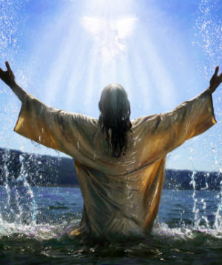
The Synoptic Problem
Gospel Reading
18th April 2021 :
3rd Sunday of Easter
In the Gospel of Luke
Jesus says to His friends :
“Peace be with you.”
BDES

Slide 5
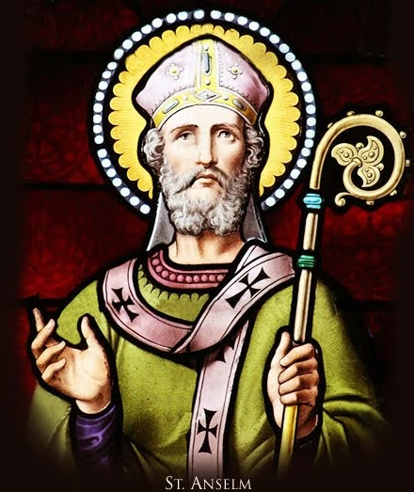
St Anselm of Canterbury Feast Day : 21st April
Anselm was an Italian monk who became abbot of Bec in Normandy and then Archbishop of Canterbury. He was also an important philosopher and widely respected theologian, who wrote many influential books, including two meditations on the nature of God, as well as a dialogue about sin and the importance of atonement for Christianity. He developed the idea of the nature of being and the ontological argument for the existence of God. He was one of the foremost thinkers of the Middle Ages and the founder of scholasticism. As Archbishop he had a number of conflicts with King William II and King Henry I, concerning the authority of the Pope over the Crown in England.
BDES

Slide 6
Reflection : Live life in love
Almighty God, who raised up your servant Anselm to teach the Church of his day to understand its faith in your eternal Being, perfect justice, and saving mercy: Provide your Church in every age with devout and learned scholars and teachers, that we may be able to give a reason for the hope that is in us; through Jesus Christ our Lord, who lives and reigns with you and the Holy Spirit, one God, for ever and ever.
BDES

Slide 7
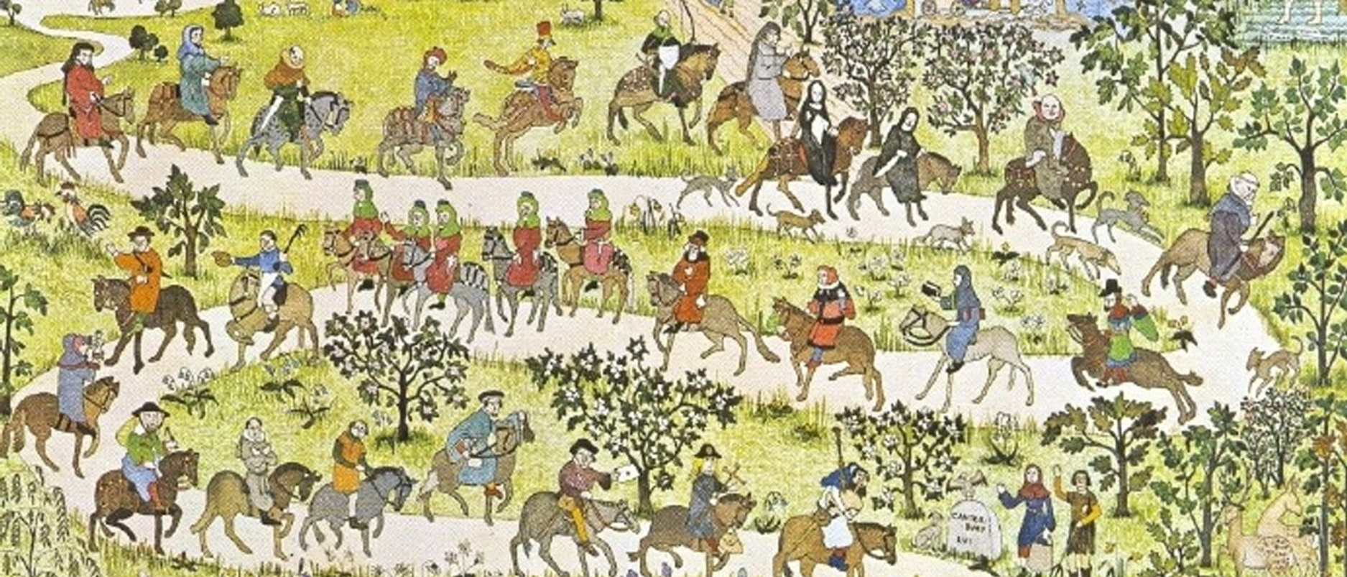
Canterbury
Pilgrimage has always been an important part of Christian faith. Most pilgrim routes are ancient, taking people to places made holy by events that have happened there, in the footsteps of those who have gone before them or the presence of shrines or relics of holy people.
The desire of Christians to grow in their relationship with God is often described as a journey, Going on pilgrimage is seen as a way of letting the outward journey demonstrate the inner spiritual journey.
Pilgrimage to Canterbury is especially famous since the publication of Chaucer’s Canterbury Tales in the 14th century.
Canterbury became a special place of pilgrimage in the 12th century when the Archbishop of Canterbury, St Thomas Becket, was murdered there by four knights of King Henry II.
BDES

Slide 8
Servant Song
Will you let me be your servant, Let me be as Christ to you; Pray that I may have the grace to Let you be my servant, too. We are pilgrims on a journey, We are trav'lers on the road; We are here to help each other Walk the mile and bear the load. I will hold the Christ-light for you In the night-time of your fear; I will hold my hand out to you, Speak the peace you long to hear.
I will weep when you are weeping; When you laugh I'll laugh with you. I will share your joy and sorrow 'Til we've seen this journey through. When we sing to God in heaven We shall find such harmony, Born of all we've known together Of Christ's love and agony. Richard Gillard
https://www.youtube.com/watch?v=MYpH3y4608E
BDES

Slide 9
How can you live life in love?
Let us live with integrity in a way that comes from
a single and central commitment of loving faith.
John’s Gospel shows us that living life to the full is living the life of Jesus;
and living the life of Jesus is living in perfect communion –
in the unity between the Father and the Son and the Spirit,
into which the community of Jesus’ friends is invited.
We were made to be able to receive from God the richness of intimacy, liberty, and love, and to be free to give this love back to God.
We are bound up with the lives of others at home and across the world.
Living life in love is to live simply and sustainably in a complex world full of difference.
BDES

Slide 10
Looking Forward
~ “We are an Easter people ” ~
Monday 19th April 2021
Brentwood Diocese Education Service

