Slide 1
Looking Forward
~ “Mary arose and went with haste” ~
Monday 14th December 2020
Brentwood Diocese Education Service

Slide 2
“Mary arose and went with haste”
(Luke 1 : 39)
In June 2019 Pope Francis announced that the theme for the next World Youth Day, in Lisbon in 2022*, would be “Mary arose and went with haste”. She went straight away to her cousin Elizabeth, already pregnant with John the Baptist. XXXXXXXXXX X John had the same attitude as Mary : X XXXXXXXXXXX X GET UP AND GO X John grew up in this spirit and lived a life of witness. He prepared the way for Jesus. He preached the coming of Jesus. He baptised people to make them ready and receptive to the Good News of Jesus. He told people how to behave kindly and to live in harmony with others. He criticised wrongdoing without fear and became a martyr – martyrion in Greek, a witness - for the Light.
BDES
* now moved to 2023 due to Covid 19

Slide 3
Preparing for World Youth Day 2023
“Dream big and don’t be scared to live in hope, for you are the “now” of Christ.”
- Pope Francis to the young people of the world
BDES

Slide 4
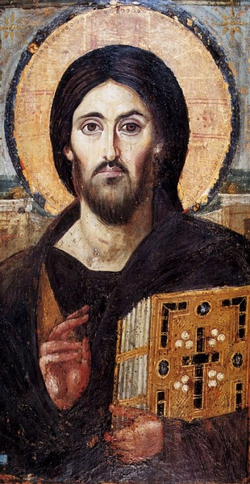
The Synoptic Problem
In Sunday’s Gospel Reading …
13th December 2020 : the Third Sunday of Advent, the beginning of the Church’s New Year. In the Gospel John the Baptist is identified as :
“A witness for the light.”
BDES

Slide 5
Reflect
HOW HAVE YOU BEEN A WITNESS FOR THE LIGHT? LET’S PRAY FOR A BETTER WORLD.
Being a witness needs a lot of courage. Speaking out for what is right and what is fair; speaking out against injustice; and doing actually doing something to write wrongs … that takes strength.
In your Christmas charity work, you’ve already been that witness. But you can’t do everything for everyone. You’re only human. That’s why we have prayer.
BDES

Slide 6
St John of the Cross,
Feast day :
14th December
You might well have seen a print of the popular painting of Christ of St John of the Cross by Salvador Dalí, and wondered at the unusual perspective. St John (1542-1591) sketched a vision he received of Christ on the Cross as though from above, from a heavenly perspective.
BDES
Detail of “Christ of St John of the Cross” by Salvador Dalí

Slide 7
WHAT SUCCESSES HAVE YOU ENJOYED WITH ADVENT CHARITY INITIATIVES?
HAVE YOU SEEN THINGS FROM A HEAVENLY PERSPECTIVE?
BDES

Slide 8
Get Up And Go!
~ “Mary arose and went with haste” ~
Monday 14th December 2020
Brentwood Diocese Education Service

