Slide 1
Looking Forward
~ “New Year, Good News” ~
Monday 4th January 2021
Brentwood Diocese Education Service

Slide 2
A New Year of Good News
~ The Year of St Joseph ~
In June 2019 Pope Francis announced that the theme for the next World Youth Day, in Lisbon in 2022*, would be “Mary arose and went with haste” to tell news of her miraculous conception of the Son of God. The Christmas story told us of how Joseph came to share in her joy and the joy of all humankind.
In this new year of 2021, let’s think how we can
Be Joyful!
The wise men came to visit the child and when they left him they returned to their own countries, and in doing so represent everyone who searches for Jesus. Their story is of people sharing the joy of having found the Messiah.
BDES
* now moved to 2023 due to Covid 19

Slide 3
Preparing for World Youth Day 2023
“Christ is alive! He is our hope, and in a wonderful way he brings youth to our world. The very first words, then, that I would like to say to every young Christian are these: Christ is alive and he wants you to be alive!”
- Pope Francis to the young people of the world
BDES

Slide 4
The Synoptic Problem
Gospel Reading of the Epiphany
6th January 2021 : The Feast of the Epiphany,
The Gospel of Matthew tells us that:
“The sight of the star filled them with delight.”
BDES

Slide 5
Prayer
BE JOYFUL! BE FILLED WITH DELIGHT!
God of Advent, Christmas and Epiphany, you have given us many signs and prophecies about your Son Jesus Christ’s birth, and they have been fulfilled. Help us to see from the past to the present, the present into the future, that your loving hand guides all things. May your glory remain forever within our reach. Amen.
BDES

Slide 6
Reflect
BE JOYFUL AND BRING JOY TO OTHERS
The New Year is usually a time of making resolutions which quite often do not last very long.
This year why not think of making a different kind of resolution :
to you can spread the Joy of the Gospel by doing something practical for others.
We can all do the small acts of kindness which fill other peoples’ lives with joy.
We can all work together on something bigger such as a charity event.
We can all be creative.
Could you design something which everyone can enJOY?
Something that spreads the True Joy
which is the GOOD NEWS?.
BDES

Slide 7
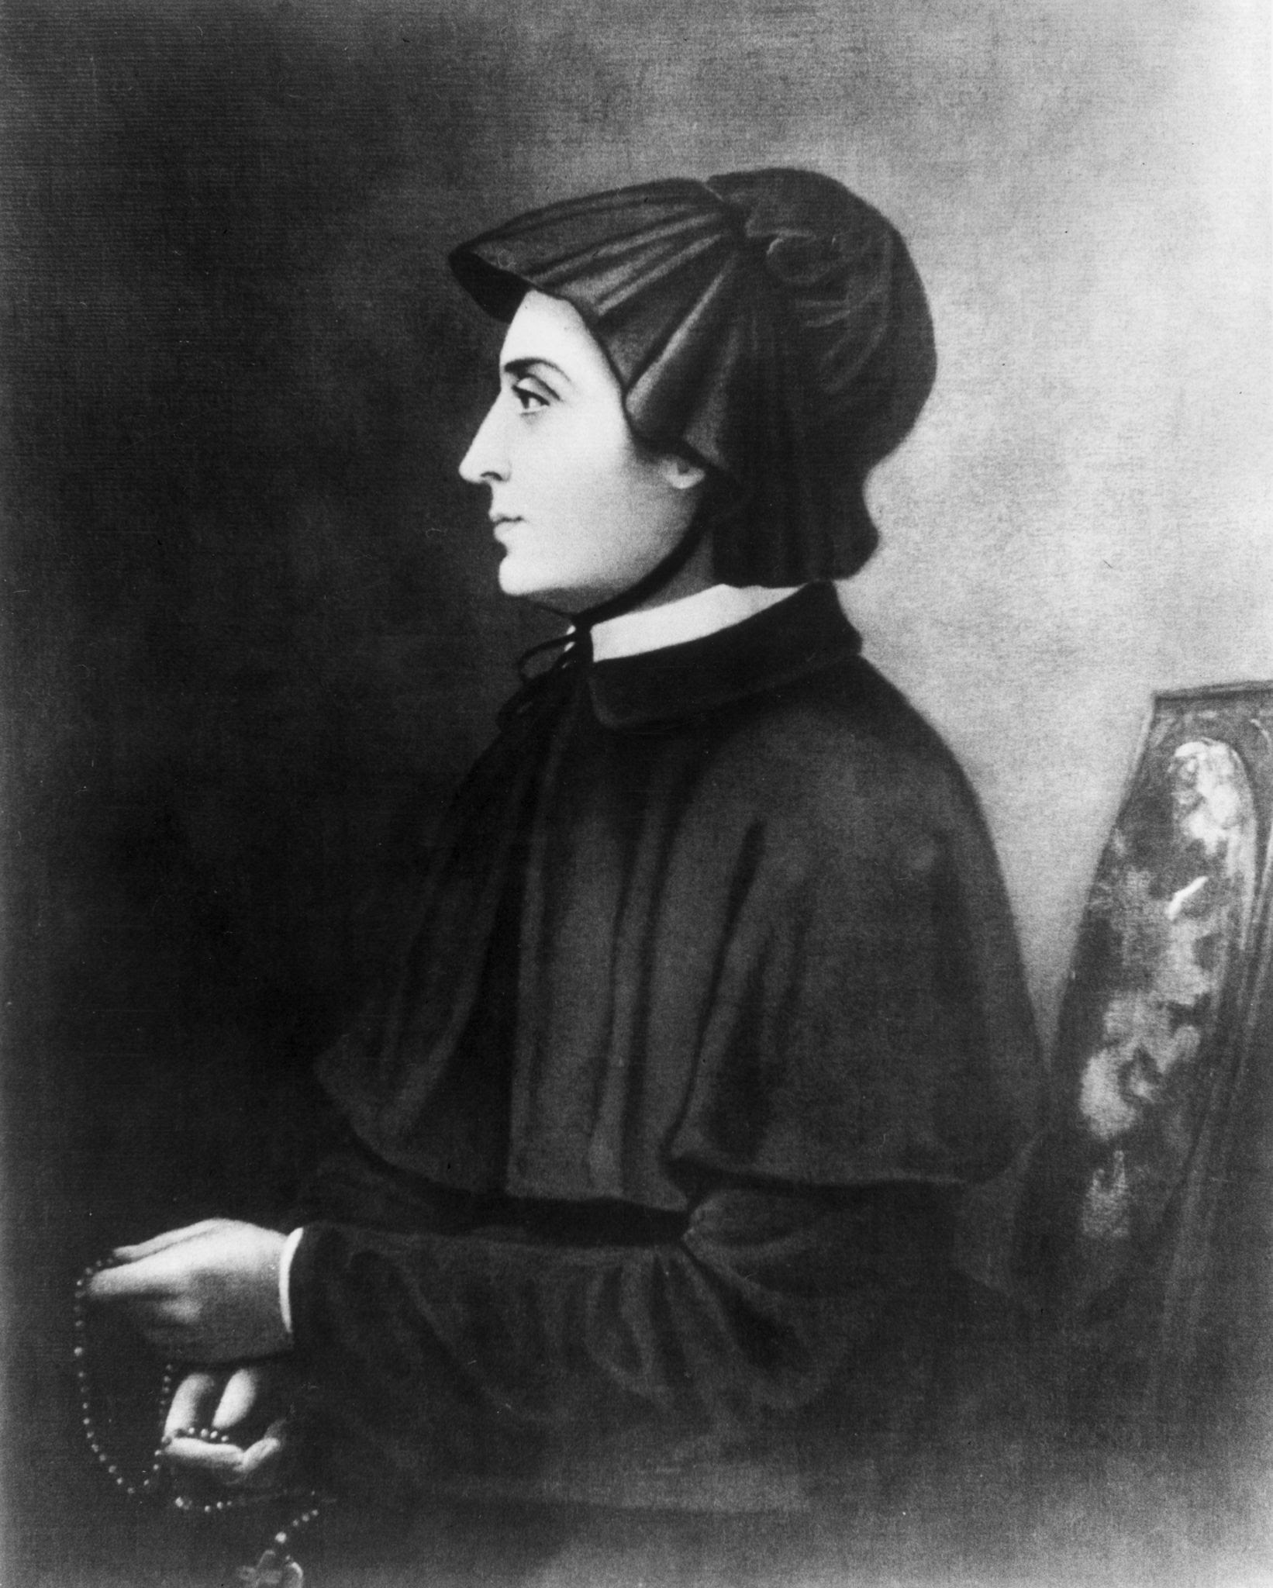
St Elizabeth Ann Seton,
Feast day :
4th January
She was the first person born in the Americas to be made a saint.
She wasn’t born a Catholic but, following her conversion to Catholicism on a trip to Rome, she founded a religious congregation which followed the rules of the Sisters of Charity. Following the death of her husband this became her new life’s new work.
She passed on the joy of her new work : the congregation specialised in running schools for the education of young girls. One of her own XXXXXX daughters was inspired to become a nun.
BDES

Slide 8
HOW CAN YOU ‘BE JOYFUL’
- AND SHARE THAT JOY?
What is your New Year Resolution?
How are you going to share the joy of the Gospel?
What are you going to do for others?
Remember : “it is in giving that we receive.”
BDES

Slide 9
Looking Forward
~ “New Year Good News” ~
Monday 4th January 2021
Brentwood Diocese Education Service

