Slide 1
Looking Forward
~ “New Year, Good News” ~
Monday 11th January 2021
Brentwood Diocese Education Service

Slide 2
A New Year of Good News
~ The Year of St Joseph ~
A New Year is a time for LOOKING FORWARD. We look forward to the Year of St Joseph unfolding; we look forward to the opportunities it will bring us. We look forward to the next World Youth Day, in Lisbon in 2023.
In this new year of 2021, let’s think how we can
Be filled with the Spirit!
When Jesus was baptised in the River Jordan, the Spirit came down upon him.
His Baptism marked a new beginning, the beginning of His mission.
Let us begin 2021 with a new sense of mission.
Let us be open to the Spirit of God.
BDES

Slide 3
Preparing for World Youth Day 2023
“The very first truth I would tell each of you is this: “God loves you”. It makes no difference whether you have already heard it or not. I want to remind you of it. God loves you. Never doubt this, whatever may happen to you in life. At every moment, you are infinitely loved.”
- Pope Francis to the young people of the world
BDES

Slide 4
The Synoptic Problem
In Sunday’s Gospel Reading …
10th January 2021 : The Baptism of the Lord.
John the Baptist tells the crowds about Jesus:
“He will baptise you with the Holy Spirit.”
BDES

Slide 5
Reflect
BE FILLED WITH THE SPIRIT!
Holy Spirit of God,
flame everlasting, so bright and clear,
spark this day in our hearts.
Lighten our darkness and purge us of fear,
Holy Spirit of God.
BDES

Slide 6
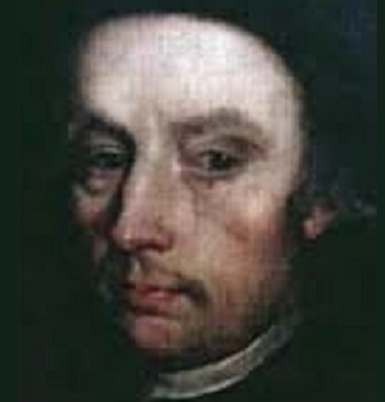
Blessed
William Carter,
Feast day :
11th January
William was a printer and bookseller who was arrested several times during the reign of Queen Elizabeth I for printing Catholic pamphlets and failing to attend Anglican services. On the final occasion, in 1581, he was accused of treason because of a publication.
During his 18 months imprisoned in the Tower of London, his wife died. He was tortured on the rack in an attempt to gain the names of further Catholic sympathisers. At his trial, while the jurors deliberated for only 15 minutes, he made his final confession to the priest who was on trial with him. William was hanged, drawn and quartered on 11th January 1584.
BDES

Slide 7
HOW CAN YOU BE ‘SPIRIT-FILLED’
AMIDST THE CHALLENGES OF 2021?
“Do not forget that your life is the greatest enterprise in the world …. Many appreciate you, admire you and love you. Remember that to be happy is not to have a sky without a storm, a road without accidents, work without fatigue, and relationships without disappointments. To be happy is to find strength in forgiveness, hope in battles, security in the stage of fear, love in discord. It is not only to enjoy the smile, but also to reflect on the sadness … It is to thank God for every morning, for the miracle of life.” - Fernando Passoa, Stages of Life
BDES

Slide 8
Looking Forward
~ “New Year, Good News” ~
Monday 11th January 2021
Brentwood Diocese Education Service

