Slide 1
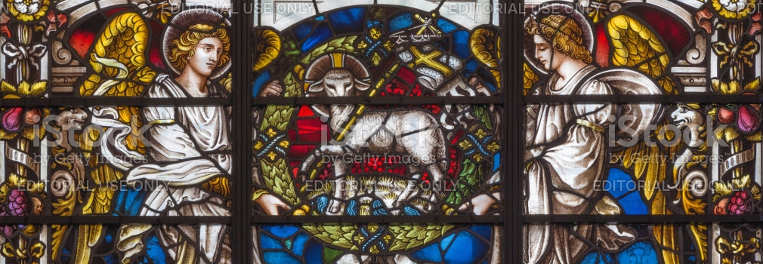
Looking Forward
~ “New Year Good News” ~
Monday 18th January 2021
Brentwood Diocese Education Service

Slide 2
A Year of Good News
~ The Year of St Joseph ~
This is a time for LOOKING FORWARD. We look forward to the Year of St Joseph unfolding; we look forward to the opportunities it will bring us. We look forward to the next World Youth Day, in Lisbon in 2023.
In this year of Our Lord 2021, will you
Come and See?
When something out of the ordinary grabs our attention, we have to know, don’t we? If we see a crowd of people gathering around something,
we want to know what’s going on.
What is our motive for following Jesus?
BDES

Slide 3
Preparing for World Youth Day 2023
“We are asked to open our eyes and take a moment to experience fully and with gratitude every one of life’s little gifts.”
- Pope Francis to the young people of the world
BDES

Slide 4
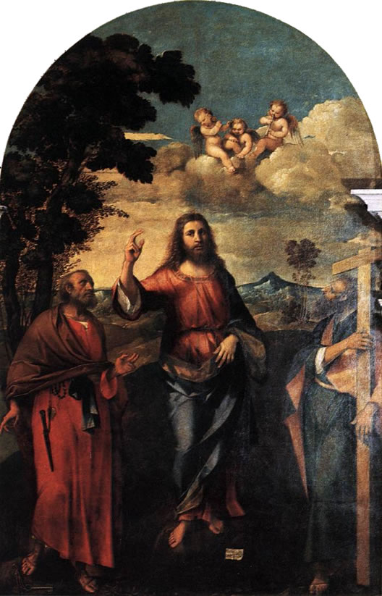
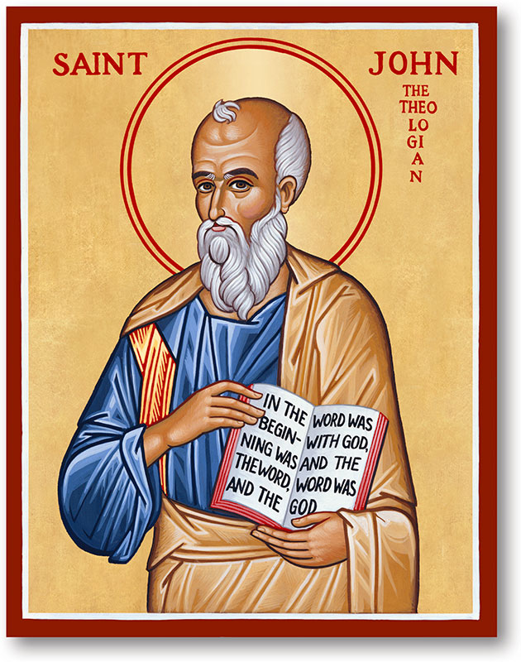
The Synoptic Problem
In Sunday’s Gospel Reading …
17th January 2021 : The 2nd Sunday of the Year:
Andrew said to Peter
“We have found the Messiah.”
BDES

Slide 5
Reflect
Come and See.
We need to find God, and he cannot be found in noise and restlessness. God is the friend of silence. See how nature – trees, flowers, grass – grows in silence; see the stars, the moon and the sun, how they move in silence… We need silence to be able to touch souls.
- Mother Teresa
BDES

Slide 6
Reflect
Come and See
BDES

Slide 7
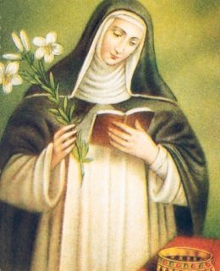
St Margaret of Hungary
Feast day :
18th January
From a young age, St. Margaret was called by God to serve in the religious life. Though she was born a princess, she refused to marry; as a pretty child who grew into a beautiful woman, she sought to counter the temptation to vanity by neglecting her appearance and concentrating on the poor.
She was born noble but she took on the most lowly tasks in the convent. She was considered a Saint even while she lived, and after her death at the young age of twenty-eight, many miracles were attributed to her intercession.
BDES

Slide 8
Will you ‘Come and See’?
The start of John’s gospel gives us a glimpse of the enormous depths of silence that lies behind all that Jesus does. Even his silence speaks powerfully of a life centred in God.
The crucial issue in discipleship is whether we desire to come and see, and then live in the presence of God, the only source of eternal life and growth in grace and truth.
How will you find opportunities during 2021 to be silent, to listen to God’s plan for you in a world that is very busy and very noisy?
BDES

Slide 9
Looking Forward
~ “New Year Good News” ~
Monday 18th January 2021
Brentwood Diocese Education Service

