Slide 1
Looking Forward
~ “New Year, Good News” ~
Monday 25th January 2021
Brentwood Diocese Education Service

Slide 2
A New Year of Good News
~ The Year of St Joseph ~
A New Year : a way forward. 2021, the Year of St Joseph. A new opportunity to look for and appreciate Good News. Maybe make plans to travel, to meet people again – maybe to the next World Youth Day, in Lisbon in 2023?
In a year where we feel we need good news, we have it already, so :
Believe in the Good News!
Jesus began his mission coming straight out of the desert with a new message : “Repent and believe in the Good News!”
Turn away from things which hold you back and hurt and harm :
Believe in the Gospel! Live the Gospel! Tell others about the Gospel!
The Gospel is the Good News!
BDES

Slide 3
Seriously ..
THE GOSPEL IS THE GOOD NEWS!
The English word
“Gospel”
is actually an Old English word :
goðspel.
It means : “good news”.
Gospel, Good News : same thing!
BDES

Slide 4
Preparing for World Youth Day 2023
“Give yourselves over to the best of life! Open the door of the cage, go out and fly!”
- Pope Francis to the young people of the world
BDES

Slide 5
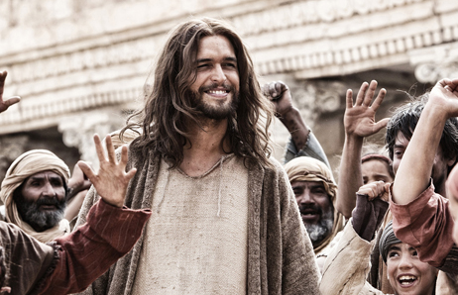
The Synoptic Problem
In Sunday’s Gospel Reading …
24th January 2021 : 3rd Sunday in Ordinary Time
Jesus comes out of the desert with the message :
“Repent and believe in the Good News!”
BDES

Slide 6
Prayer
Living the Good News …
Lord make Me an instrument of Your peace Where there is hatred let me sow love. Where there is injury, pardon. Where there is doubt, faith. Where there is despair, hope. Where there is darkness, light. Where there is sadness joy.
BDES

Slide 7
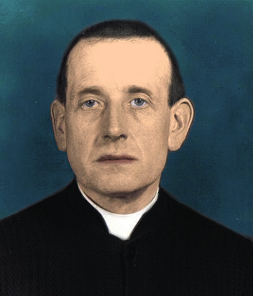
Blessed
Michal Kozal
Feast day :
26th January
Michal was born in a Polish part of Germany which gained its independence in the new Republic of Poland after the First World War. He was ordained a priest in 1918 and was made bishop of Wloclawek in 1939, less than three weeks before World War II began.
Poland was the first country to be attacked and occupied by the Nazis and Michal refused to cooperate with the authorities, who insisted on censoring his homilies. He was imprisoned by the Gestapo and tortured on multiple occasions before being sent to the infamous concentration camp at Dachau, where he ministered to fellow prisoners until he was murdered by the SS. He was beatified by Pope John Paul II in 1987.
BDES

Slide 8
Living the Gospel. Living the Good News.
Living for others.
“Lord Jesus, give us the grace to hear your voice,
And the strength to continue working for your kingdom in this time of pandemic.
Do not allow us to be indifferent to those who today suffer the loss of a loved one, or who suffer from the absence of work.
But give us the courage to accompany and side with those who suffer violence or injustice. Amen.”
- Javier Eduardo Martinez Rueda from Colombia.
Javier works for a CAFOD partner organisation
BDES

Slide 9
Looking Forward
~ “New Year, Good News” ~
Monday 25th January 2021
Brentwood Diocese Education Service

