Slide 1
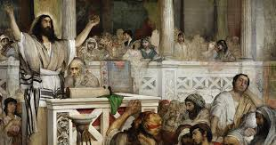
Looking Forward
~ “New Year, Good News” ~
Monday 1st February 2021
Brentwood Diocese Education Service

Slide 2
A New Year of Good News
~ The Year of St Joseph ~
2021, the Year of St Joseph. A way forward.
An opportunity to look for and appreciate the Good News.
In this year 2021 what are you going to do in order to
Listen to the teaching of Christ?
Jesus went to the village of Capernaum, a small village on the Sea of Galilee. Jesus taught in the synagogue on the Sabbath.
The people responded to Jesus’ teaching with astonishment,
noting Jesus’ authority and contrasting it with the scribes’.
BDES

Slide 3
Preparing for World Youth Day 2023
“Our best dreams are only attained through hope, patience and commitment …”
- Pope Francis to the young people of the world
BDES

Slide 4
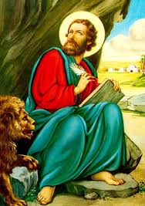
The Synoptic Problem
In Sunday’s Gospel Reading …
1st February 2021 :
The 4th Sunday of the Year:
The people said
“Here is a teaching that is new and with authority behind it.”
BDES

Slide 5
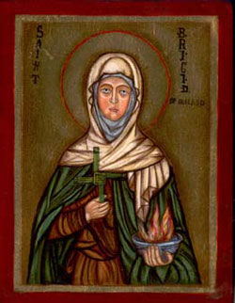
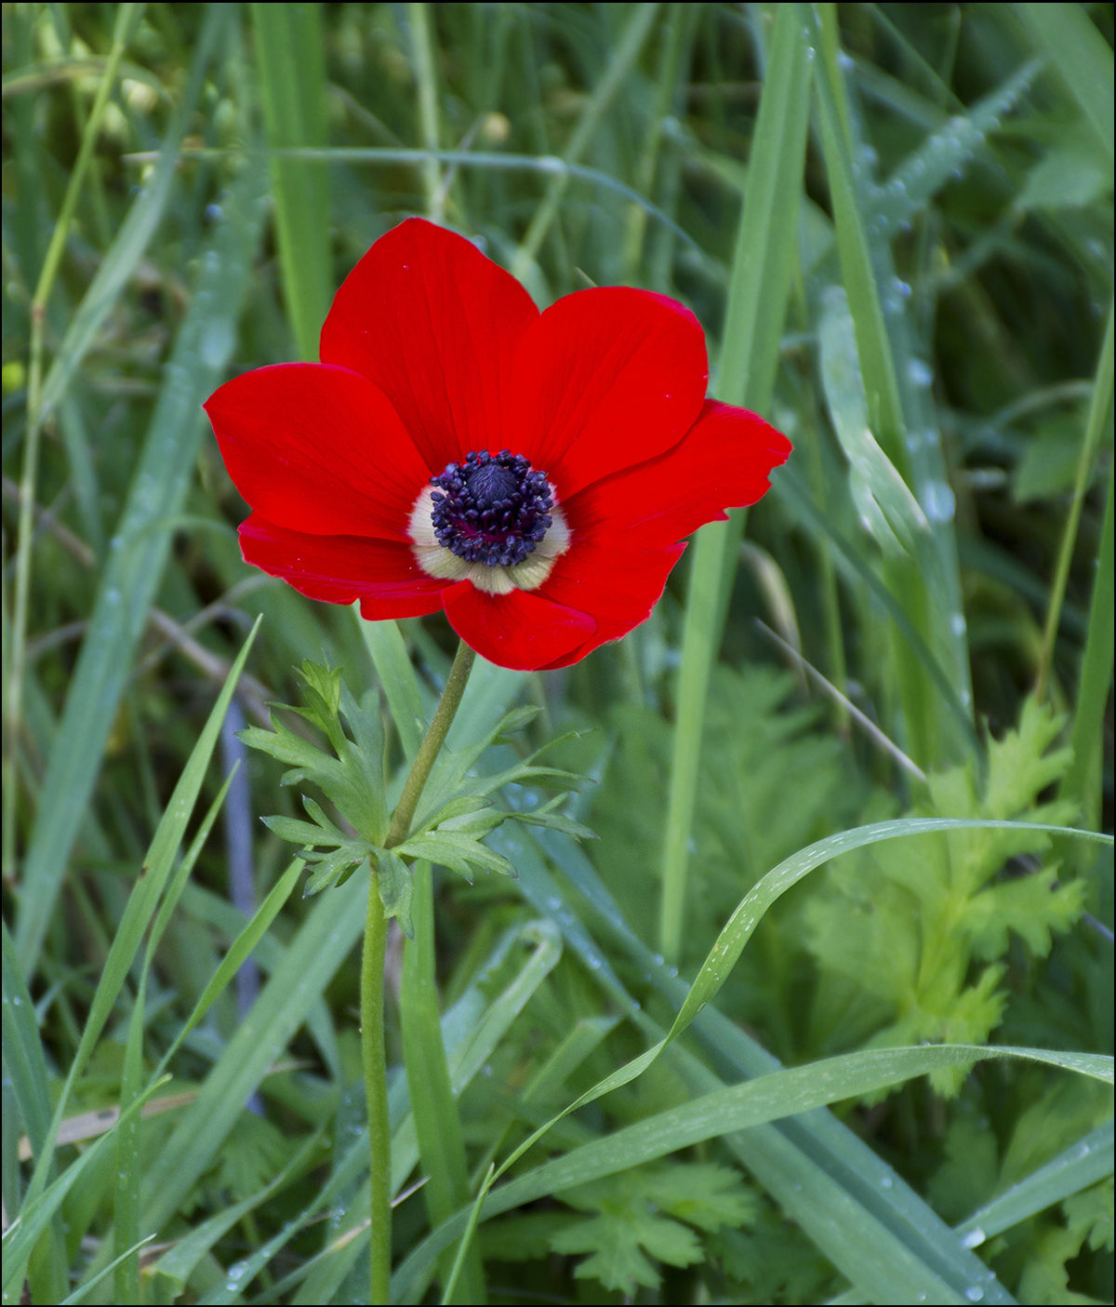
St Bridget of Ireland,
Feast day :1st February
Brigid of Ireland, or of Kildare, has been venerated since the early Middle Ages, along with Patrick and Columba, as one of the three national patron saints of Ireland.
By the end of the seventh century, at least two Latin biographies had been written describing her as a nobleman's daughter who chose to consecrate herself to God who took the veil as a Christian nun, and became the leader of a community of religious women—or perhaps of both women and men. Certainly by the 7th century there was an important double monastery at Kildare that regarded her as its founder.
There were many miracles associated with her.
BDES

Slide 6
Prayer
Brigid you were a woman of peace.
You brought harmony where there was conflict.
You brought light to the darkness.
You brought hope to the downcast.
May the mantle of your peace cover those who are troubled and anxious, and may peace be firmly rooted in our hearts and in our world.
Inspire us to act justly and to reverence all God has made.
Brigid you were a voice for the wounded and the weary.
Strengthen what is weak within us. Calm us into a quietness that heals and listens.
May we grow each day into greater wholeness in mind, body and spirit.
Amen.
BDES

Slide 7
Christ’s Teaching
Jesus impresses the crowds through his words, which are manifested by the power of his deeds.
What are you going to do that will show the power of your words and deeds?
How do you demonstrate the idea of acting with justice towards others, demonstrating the authority and power
of what we believe about God?
A new teaching, a new commandment
BDES

Slide 8
Looking Forward
~ “New Year, Good News” ~
Monday 1st February 2021
Brentwood Diocese Education Service

