Slide 1
Looking Forward
~ “New Year, Good News” ~
Monday 8th February 2021
Brentwood Diocese Education Service

Slide 2
A New Year of Good News
~ The Year of St Joseph ~
A New Year : one half-term completed.
An opportunity to reflect on what we have achieved so far.
Which resolutions have we kept? Which resolutions have we broken?
What further resolutions do we need to make in this year of challenge?
To help us in our resolve, let us remember to look for Christ in our lives,
and in the persons of the people we meet –
for they too are looking for Christ, they too have their successes and setbacks,
they too need help and strength to rededicate their efforts.
Our Gospel reading this Sunday reminds us that we are not alone, that :
Everybody is looking for Christ
BDES

Slide 3
In context
EVERYBODY IS LOOKING FOR CHRIST
“In the morning, long before dawn, he got up and left the house, and went off to a lonely place and prayed there. Simon and his companions set out in search of him, and when they found him they said :
“Everybody is looking for you.”
- Mark 1 : 35-37
BDES

Slide 4
Preparing for World Youth Day 2023
“Everyone is born as an original, but many people end up dying as photocopies.
Don’t let that happen to you!
Our best dreams are only attained through hope, patience and commitment …”
- Pope Francis to the young people of the world
BDES

Slide 5
The Synoptic Problem
In Sunday’s Gospel Reading …
7th February 2021 : 5th Sunday in Ordinary Time
Simon Peter says to Jesus :
“Everybody
is looking for you!”
BDES

Slide 6
Finding Jesus …
Pope Francis prayed on Sunday 24th January for a homeless man who died near St. Peter’s Square amid freezing temperatures.
Speaking after the Angelus, the pope led prayers for the 46-year-old Nigerian man who was reportedly found dead by volunteers from the Community of Sant’Egidio on Wednesday.
“A few days ago, a few metres from St. Peter’s Square, a 46-year-old Nigerian homeless man named Edwin was found dead because of the cold,” the pope said.
“His story was added to that of many other homeless people who recently died in Rome in the same dramatic circumstances. Let us pray for Edwin.”
He continued: “May we be reminded of the words of St. Gregory the Great, who, when faced with the death of a beggar from cold, said that Masses would not be celebrated that day because it was like Good Friday.”
“Let us think about Edwin. Let us think of what this man, 46 years old, felt in the cold, ignored by all, abandoned, even by us. Let us pray for him.”
BDES

Slide 7
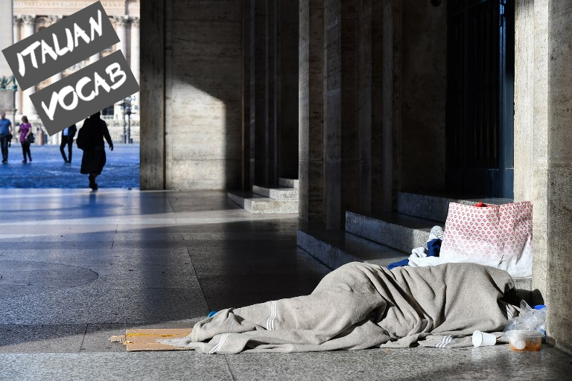
Finding Jesus … is easy
According to the news website RomaToday, Edwin was the fourth homeless person to die this year in Rome, where there are an estimated 8,000 homeless people. Many sleep along the edge of Bernini’s colonnade, the semi-circular columns enclosing St. Peter’s Square.
On the same day that Edwin’s body was discovered, the Vatican began vaccinating homeless people in its care against COVID-19. An initial group of around 25 homeless people received the first dose of the vaccine on Jan. 20 in the atrium of the Paul VI Audience Hall at the Vatican. Those receiving the vaccine are permanently housed in the care and residence facilities of the Office of Papal Charities, the Vatican department offering charitable assistance to the poor on behalf of the pope.
BDES

Slide 8
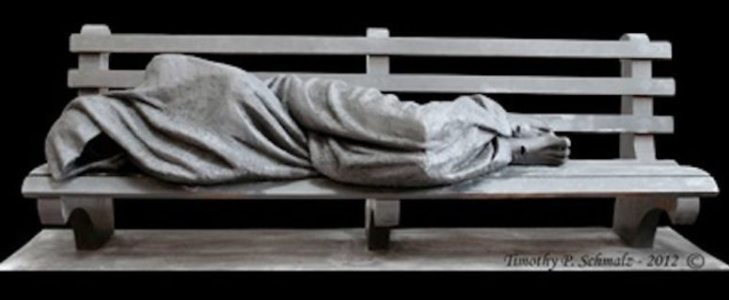
Find Jesus … in others
The statue Homeless Jesus was created by the Canadian sculptor Timothy Schmaltz. There are versions of the statue in many places across the world. The statue’s face cannot be made out. On closer inspection, wounds in the bare feet of the figure are apparent ...
There is space on the sculpted bench for someone to sit, to reach out and touch the figure,
to engage with the plight of the poor brother or sister in Christ which it represents.
BDES

Slide 9
Whatever you did …
I was hungry and you gave me something to eat, I was thirsty and you gave me something to drink, I was a stranger and you invited me in, I needed clothes and you clothed me, I was sick and you looked after me, I was in prison and you came to visit me.’
… ‘Truly I tell you, whatever you did for one of the least of these brothers and sisters of mine, you did for me.’ - Matthew 25 : 35-36, 40
In these cold February days, have you decided what charity you might be supporting during Lent, which begins after the half-term holiday?
Whatever you do for others,
in doing it you have
FOUND JESUS
… you did for me
BDES

Slide 10
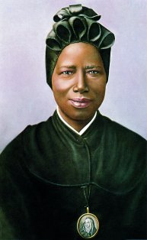
Saint
Josephine Bakhita
Feast day :
8th February
Saint Josephine (1869-1947) was born in Darfur in Sudan, captured by slave traders at the age of 7 and repeatedly sold and brutally treated. She was fortunate to be given into the care of the Canossian nuns in Venice where she encountered Christianity, converted and joined the community. Her personal holiness and her book “My Miraculous Story” were inspirational and continue to inspire today.
She was canonised in 2000 and is the patron saint of victims of human trafficking.
BDES

Slide 11
Looking Forward
~ “New Year, Good News” ~
Monday 8th February 2021
Brentwood Diocese Education Service

