Slide 1
Looking Forward
~ “Mary arose and went with haste” ~
Monday 7th December 2020
Brentwood Diocese Education Service

Slide 2
“Mary arose and went with haste”
(Luke 1 : 39)
In June 2019 Pope Francis announced that the theme for the next World Youth Day, in Lisbon in 2022*, would be “Mary arose and went with haste”. Mary didn’t hesitate, she got up and went straight away to begin sharing her own personal good news which would be turn out to be Good News for everyone. She had the right attitude : XXXXXXXXXXXXXXXXXX GET UP AND GO! XXXXXXXXX
One of the people who heard this Good News was her cousin Elizabeth. She was the mother of John the Baptist, another believer in the Good News who showed the same
XXXXXXXXXXXXXXX XX GET UP AND GO! XXXXXXXXX
In his preaching, John invites us, in the words of Isaiah, to look forward to the coming XXXXXXXXXXXXXXXXXof Christ, to prepare, to
XXXXXXXX GET UP AND GO!
BDES
* now moved to 2023 due to Covid 19

Slide 3
Preparing for World Youth Day 2023
“The Gospel is for everyone, not just for some. It is not only for those who seem closer to us, more receptive, more welcoming. It is for everyone.”
- Pope Francis to the young people of the world
BDES

Slide 4
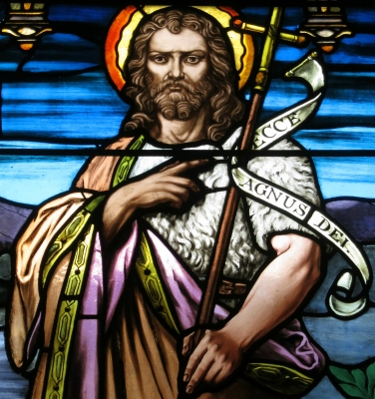
The Synoptic Problem
In Sunday’s Gospel Reading …
6th December 2020 : the Second Sunday of Advent, the beginning of the Church’s Year. In the Gospel John the Baptist says :
“Prepare a way for the Lord, make his paths straight.”
BDES

Slide 5
Reflect
HOW CAN YOU
PREPARE A WAY FOR THE LORD?
It’s easy in a consumer society to seek joy in owning things, but this doesn’t really bring us satisfaction.
What can you do? You can seek to be positive in how you deal with others, You can work with others to create peace rather than conflict. You can reach out to those in need.
Think practically: what is possible in the current circumstances? Maybe you could create a virtual message for someone who can’t get out or fundraise in a creative way.
BDES

Slide 6
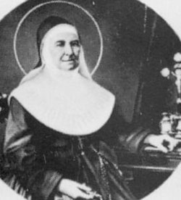
ST MARIA GUISEPPE ROSELLO
Feast Day :
7th December
She was a saint who believed in doing practical things to prepare a way for the Lord. At the age of 26 in 1837, she and three companions, founded a the Daughters of Our Lady of Mercy.
The congregation was devoted to charitable works, hospitals, and educating poor young women. In 1840, Maria Giuseppe, was made superior and put in charge. By the time she died on December 7, 1888, she had set up sixty-eight foundations. She was canonized in 1949.
BDES

Slide 7
HAVE YOU STARTED TO SUPPORT ANY CHARITY INITIATIVES DURING ADVENT?
HOW ARE YOU PREPARING TO CELEBRATE AND SHARE?
BDES

Slide 8
Get Up And Go!
~ “Mary arose and went with haste” ~
Monday 7th December 2020
Brentwood Diocese Education Service

