Slide 1
Looking Forward
~ “We are an Easter people ” ~
Tuesday 4th May 2021
Brentwood Diocese Education Service

Slide 2
~ Looking forward ~
~ In the Year of St Joseph ~
In June 2019 Pope Francis announced that the theme for the next World Youth Day, in Lisbon in 2022*, would be “Mary arose and went with haste.”
This is the Year of St Joseph and the Year of the Family
May 1st is the feast of St Joseph the Worker, described as the silent saint. He worked hard to support and look after the Holy Family.
How are you emulating this?
* Now in 2023 due to Covid
BDES

Slide 3
Preparing for World Youth Day 2023
Holy Family of Nazareth, grant that our families too may be places of communion and prayer, authentic schools of the Gospel and small domestic churches.
– Pope Francis,
Prayer to the Holy Family – Part 2
(from Amoris Laetitia)
BDES

Slide 4
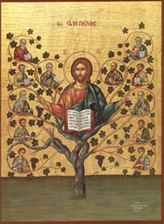
The Synoptic Problem
Gospel Reading
2nd May 2021 :
5th Sunday of Easter
In the Gospel of John
Jesus says :
“Make your home in me .”
BDES

Slide 5
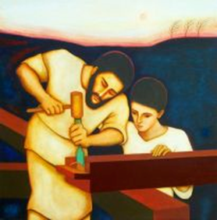
St Joseph the Worker Feast Day : 1st May
The feast of Saint Joseph the Worker was instituted by Pope Pius XII in 1955. This feast extends the long relationship between Joseph and the cause of workers in Catholic faith and devotion. The dignity of human work has long been celebrated as a participation in the creative work of God. Saint Joseph, the carpenter and foster father of Jesus, is one example of the holiness of human labour. Saint Joseph is held up as a model of such work.
This silent saint, who was given the task of caring and watching over the Virgin Mary and Jesus, now cares for and watches over the Church and models for all the dignity of human work.
Saint John Paul II stated: “the Church considers it her task always to call attention to the dignity and rights of those who work, to condemn situations in which that dignity and those rights are violated, and to help to guide [social] changes so as to ensure authentic progress by man and society.”
Laborem Exercens
BDES

Slide 6
Reflection:
Pope Francis’ Prayer for the Year of Saint Joseph
Hail, Guardian of the Redeemer, Spouse of the Blessed Virgin Mary. To you God entrusted his only Son; in you Mary placed her trust; with you Christ became a man. Blessed Joseph, to us too, show yourself a father and guide us in the path of life. Obtain for us grace, mercy and courage, and defend us from every evil. Amen.
BDES

Slide 7
How can you live life in Christ?
Saint John Henry Newman said: “God has created me to do Him some definite service. He has committed some work to me which He has not committed to another. I am a link in a chain, a bond of connection between persons. He has not created me for naught.
I shall do good, I shall do His work.”
How are you living life in Christ to make your place of work a holy place?
Don’t do things in isolation.
We won’t grow in holiness if Sunday Mass is separated from the realities of our daily life.
We are called to live an integrated life with our play and recreation part of our life of discipleship, which also includes our family and work, life linked to our prayer life.
BDES

Slide 8
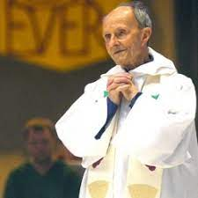
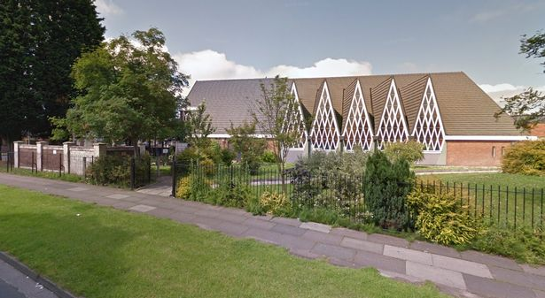
Living life in Christ:
Fr Jimmy Collins
Canon James Collins, or “Fr Jimmy” as he was affectionately known, was something of an icon in the North West of England. He came to real prominence when he arrived at St Joseph the Worker parish in Kirkby in the mid 60s. At the time, he had been to see the bishop because he wanted to work on the missions in South America. Instead the Bishop sent him to Kirkby. This was a new town which had been specially built to re-house the inhabitants of the inner city slums of Liverpool. The people had been promised jobs and a new life, but instead had been met with unfinished pavements, poor transport and shops and a lack of community resources. Fr Jimmy immediately set to work, visiting all the homes and finding out what was going on. The hardship, poverty and lack of hope he saw made him a firm supporter of the working man and his rights.
He became not only a local figure of importance but a national one, meeting both Harold Wilson the prime minister of the day and the Queen, and telling them about the situation of the people there.
A man of deep prayer, Fr Jimmy was also been a man of action too with a deep sense of justice. While at Kirkby he helped set up a credit union which was run from the presbytery. This enabled people to borrow money at very low rates of interest and effectively put the loan sharks in the area out of business.
He also set up an unemployment resource centre, to help people find jobs.
Truly living life in Christ!
BDES

Slide 9
Looking Forward
~ “We are an Easter people ” ~
Tuesday 4th May 2021
Brentwood Diocese Education Service

