Slide 1
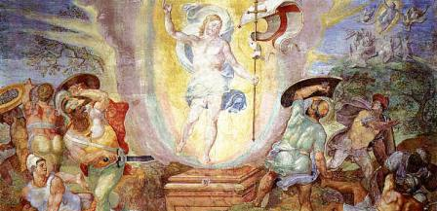
Looking Forward
~ We are an Easter People ~
Monday 10th May 2021
Brentwood Diocese Education Service

Slide 2
We are an Easter People
~ In the Year of St Joseph ~ In the Year of the Family ~
At the Last Supper, Jesus gave his friends a new commandment :
“Love one another as I have loved you.
By this everyone will know that you are my disciples,
If you love one another.”
To follow Jesus, to be his disciples,
We live in love with our fellow human beings.
We offer fellowship and friendship. We lift other people up.
We actively seek the good in others and the good of others.
We are an Easter people.
A people who look forward in love.

Slide 3
The Synoptic Problem
In Sunday’s Gospel Reading …
2nd May 2021 :
5th Sunday of Easter
“Love one another as I have loved you.”
BDES

Slide 4
The Synoptic Problem
Reflection : What is love?
Love is patient, love is kind. It does not envy, it does not boast, it is not proud. It does not dishonour others, it is not self-seeking, it is not easily angered, it keeps no record of wrongs. Love does not delight in evil but rejoices with the truth. It always protects, always trusts, always hopes, always perseveres.
(St Paul’s First letter to the Corinthians 13 : 4 - 7)
BDES

Slide 5
Preparing with our families for World Youth Day 2023
“There is no stereotype of the ideal family, but rather a challenging mosaic made up of many different realities, with all their joys, hopes and problems.”
- Pope Francis, Amoris Laetitia 57
BDES

Slide 6
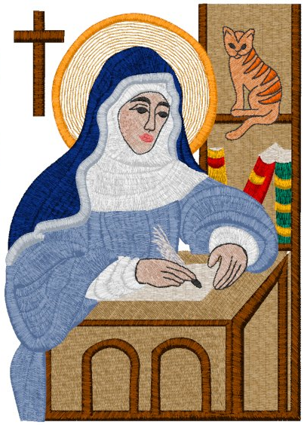
Saint Juliana of Norwich
Feast day : 13th May
Her real name is not certain, but she is known after the church of St Julian in Norwich where she lived - with her cat - as an anchoress in a small cell attached to the church. She wrote the first book in English written by a known female author, Revelations of Divine Love, in which she describes and reflects on her visions. A memorable and beautiful message of hope is often quoted : “All shall be well, and all shall be well, and all manner of thing shall be well.”
BDES

Slide 7
Looking forward : pilgrimage focus
• WALSINGHAM •
Pilgrims need not necessarily journey far abroad to find holy places. The Catholic National Shrine and Basilica of Our Lady of Walsingham is only a couple of hours away in Norfolk. For centuries it has been a place of pilgrimage, and Walsingham House, our diocesan retreat centre and xxxxxxxxx home of the Brentwood Catholic Youth Service, takes its name as inspiration.
BDES

Slide 8
Looking Forward
~ We are an Easter People ~
Monday 10th May 2021
Brentwood Diocese Education Service

