Slide 1
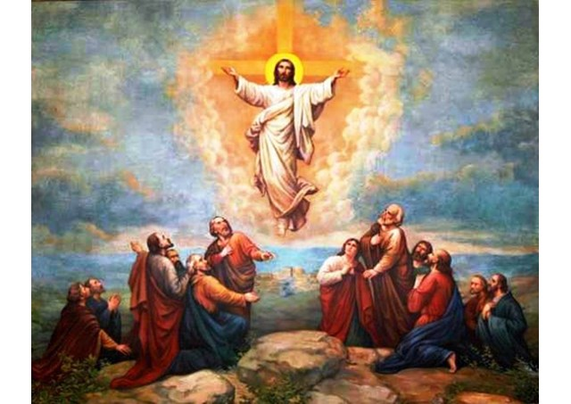
Looking Forward
~ “We are an Easter people ” ~
Monday 17th May 2021
Brentwood Diocese Education Service

Slide 2
~ Looking forward ~
~ In the Year of St Joseph ~
Many Catholics pray the Novena to the Holy Spirit in the days between Ascension Thursday and Pentecost.
Perhaps you could pray for the fruits of the Holy Spirit:
Charity, joy, peace, patience, kindness, goodness, gentleness, faith and self-control
to be evident in your life as they were in the life of
St Joseph
BDES

Slide 3
Preparing for World Youth Day 2023
Holy Family of Nazareth, make us once more mindful of the sacredness and inviolability of the family, and its beauty in God’s plan.
– Pope Francis,
Prayer to the Holy Family – Part 3
(from Amoris Laetitia)
BDES

Slide 4
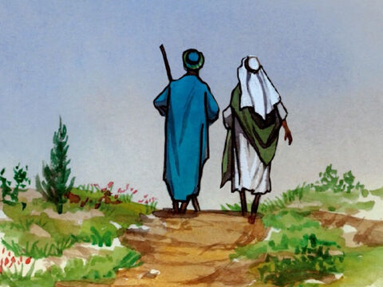
The Synoptic Problem
Gospel Reading
16th May 2021 :
In the Gospel of Mark
Jesus says :
“Go out and preach the Good News.”
BDES

Slide 5
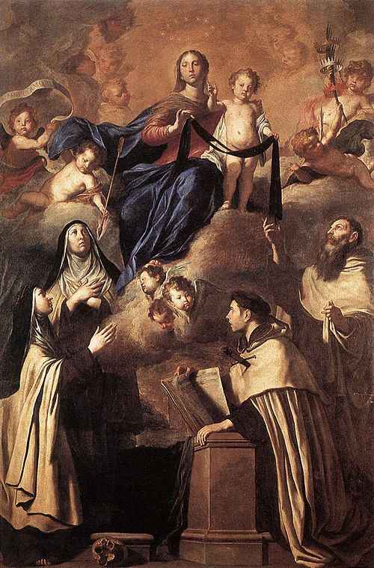
St Simon Stock Feast Day : 16th May
Saint Simon Stock was an Englishman who lived in the 13th century. He was an early Prior or leader of the Carmelite religious order. We do not have a lot of information about him but it is said that the Blessed Virgin Mary appeared to him and gave him the Carmelite habit. This is still worn and includes the Brown Scapular which is the piece of cloth that is worn over the habit.
Tradition states that “He was a man of great holiness and devotion, who always in his prayers asked the Virgin to favour his Order with some singular privilege. The Virgin appeared to him holding the Scapular in her hand saying, 'This is for you and yours a privilege; the one who dies in it will be saved.'“
Devotion to Simon Stock is usually associated with devotion to Our Lady of Mount Carmel.
BDES

Slide 6
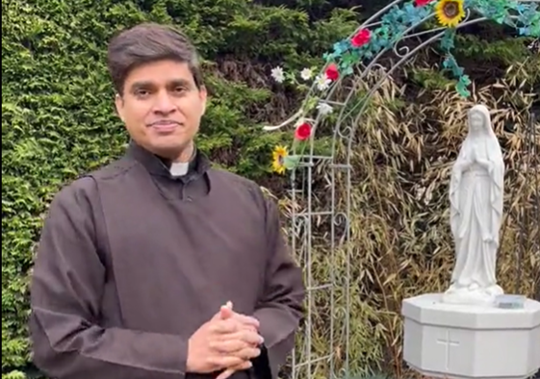
Pilgrimage: Carmelites at Aylesford
Pilgrimage: Carmelites in Ipswich
Close by the tree-lined River Medway near Aylesford is the principal house of the Carmelite religious order that came to Kent in 1242.
The area houses one of the finest intact medieval courtyards in England, 17th-century thatched barns and a hostelry for pilgrims dating to the late 1200s.
In its 750-year history, this has changed use many times.
When the Carmelite family returned in the 1949, they restored the tranquil gardens, built chapels and adorned them with distinguished ceramic artworks. Father Malachy Lynch who spearheaded the reconstruction, memorably described the Friars as a “prayer in stone”. it now serves as a centre of prayer for all Christians in Kent and a place of peace for those who search for meaning in their lives.
https://www.dioceseofbrentwood.net/departments/education/resources/religious-education-resources/looking-forward-series/
BDES

Slide 7
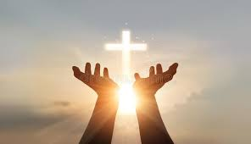
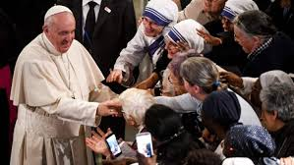
How can you be an Apostle?
The term means one who is sent out
How can you do to the work of Jesus using the fruits of the Spirit?
Think about how you can show
Faith,
Charity,
Joy,
Peace,
Patience,
Kindness,
Goodness,
Gentleness,
and Self-control
BDES

Slide 8
Looking Forward
~ “We are an Easter people ” ~
Monday 17th May 2021
Brentwood Diocese Education Service

