Slide 1
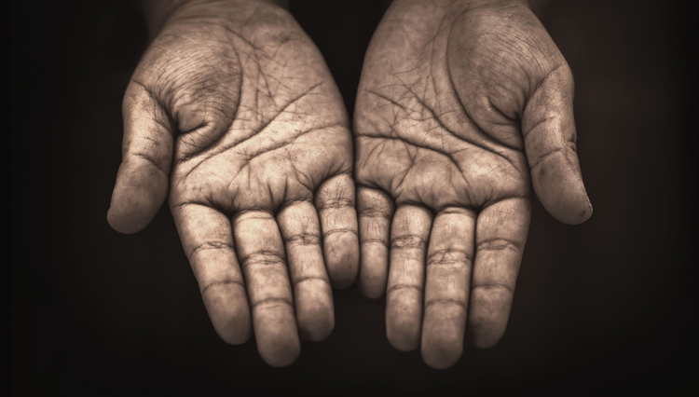
LECTIO DIVINA
Brentwood Diocese Education Service

Slide 2
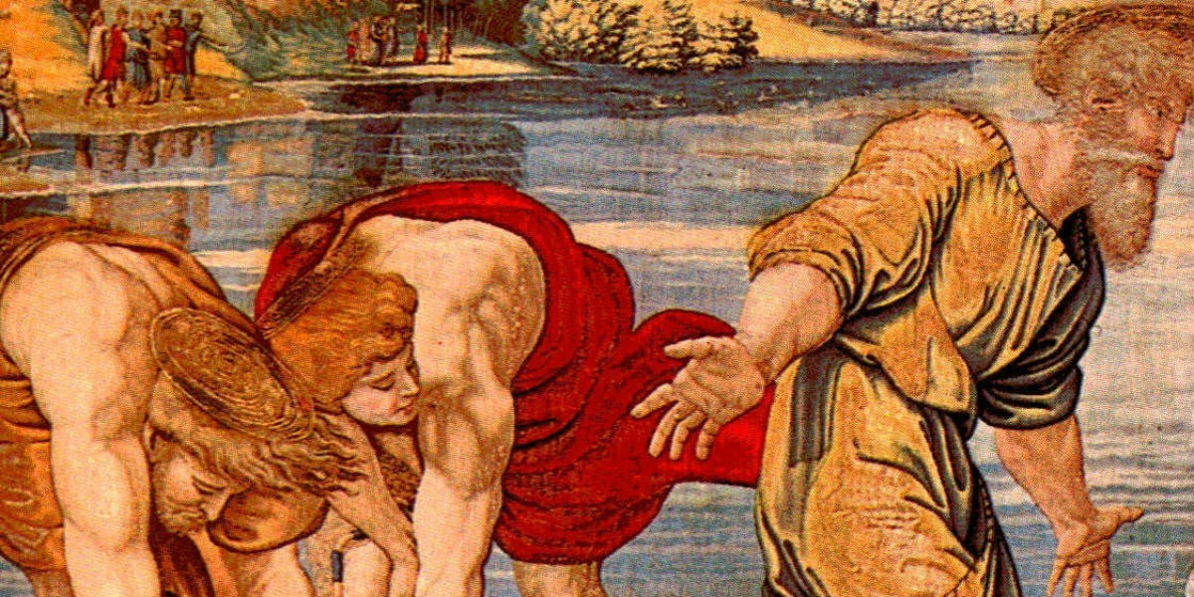
LECTIO DIVINA
Brentwood Diocese Education Service

Slide 3
The Sign of the Cross
BDES

Slide 4
Opening Prayer
Come, Holy Spirit, fill the hearts of your faithful. And kindle in them the fire of your love. Send forth your Spirit and they shall be created. And you will renew the face of the earth. Lord, by the light of the Holy Spirit you have taught the hearts of your faithful. In the same Spirit help us to relish what is right and always rejoice in your consolation. We ask this through Christ our Lord. Amen.
BDES

Slide 5
Silent Reflection
BDES

Slide 6
• LECTIO •
James and John, the sons of Zebedee, came to Jesus and said to him, “Teacher, we want you to do for us whatever we ask of you.”
He replied, “What do you wish me to do for you?”
They answered him, “Grant that in your glory we may sit one at your right and the other at your left.”
Jesus said to them, “You do not know what you are asking. Can you drink the cup that I drink or be baptized with the baptism with which I am baptised?”
They said to him, “We can.” Jesus said to them, “The cup that I drink, you will drink, and with the baptism with which I am baptised, you will be baptised; but to sit at my right or at my left is not mine to give but is for those for whom it has been prepared.”
BDES

Slide 7
• LECTIO •
When the ten heard this, they became indignant at James and John.
Jesus summoned them and said to them, “You know that those who are recognized as rulers over the Gentiles lord it over them, and their great ones make their authority over them felt.
But it shall not be so among you. Rather, whoever wishes to be great among you will be your servant;
whoever wishes to be first among you will be the slave of all.
For the Son of Man did not come to be served but to serve and to give his life as a ransom for many.”
BDES

Slide 8
• MEDITATIO •
REFLECTION
What God is saying to you?
Feel free to share ‘echoes’ of the text,
a phrase that strikes you.
If you wish, please say why.
BDES

Slide 9
• MEDITATIO •
James and John, the sons of Zebedee, came to Jesus and said to him, “Teacher, we want you to do for us whatever we ask of you.” He replied, “What do you wish me to do for you?” They answered him, “Grant that in your glory we may sit one at your right and the other at your left.” Jesus said to them, “You do not know what you are asking. Can you drink the cup that I drink or be baptized with the baptism with which I am baptized?”
They said to him, “We can.” Jesus said to them, “The cup that I drink, you will drink, and with the baptism with which I am baptized, you will be baptized; but to sit at my right or at my left is not mine to give but is for those for whom it has been prepared.” When the ten heard this, they became indignant at James and John. Jesus summoned them and said to them, “You know that those who are recognized as rulers over the Gentiles lord it over them, and their great ones make their authority over them felt. But it shall not be so among you. Rather, whoever wishes to be great among you will be your servant; whoever wishes to be first among you will be the slave of all. For the Son of Man did not come to be served but to serve and to give his life as a ransom for many.
BDES

Slide 10
• MEDITATIO •
BDES

Slide 11
• ORATIO •
PRAYER
What would you like to say to God?
……..
Lord in your mercy …
R / Hear our prayer
BDES

Slide 12
• ORATIO •
BDES

Slide 13
• CONTEMPLATIO •
LET US
REST IN GOD
IN SILENCE
May the Holy Spirit deepen our awareness of the Word
BDES

Slide 14
• CONTEMPLATIO •
BDES

Slide 15
The Lord’s Prayer
BDES

Slide 16
• ACTIO •
BDES

