Slide 1
How to use this Powerpoint
The Powerpoint can be used either in one session, or perhaps one slide daily during the 16 school days that comprise Black History Month of October 2021, i.e. Friday 1st October, Mon.-Fri. 4th - 8th October, Mon-Fri. 11th-15th October, and Mon.-Fri. 18th – 22nd October.
It is chronological by date of birth of the subjects and spans some 400 years, looking at the lives of those the Church regards as Saints, as Blessed, as Venerable, and as Servants of God.
It encompasses as wide a geographical spread as possible with people who lived their lives in Ghana, the Sudan, Madagascar, Uganda, the Congo, Nigeria, South Africa, Peru, Haiti, Cuba, the United States, Spain, Italy, and Papua New Guinea. We hope that it is informative and inspirational.
BDES

Slide 2
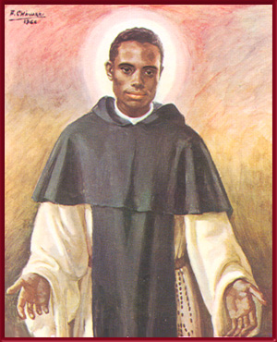
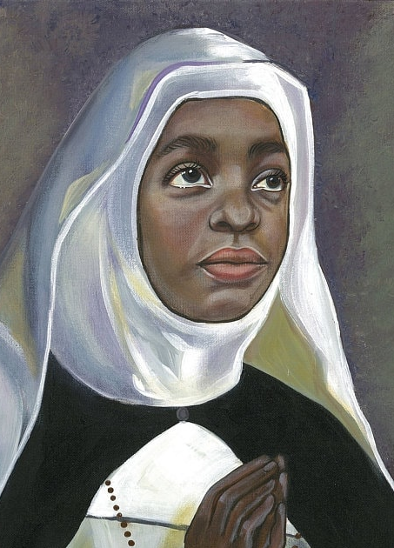
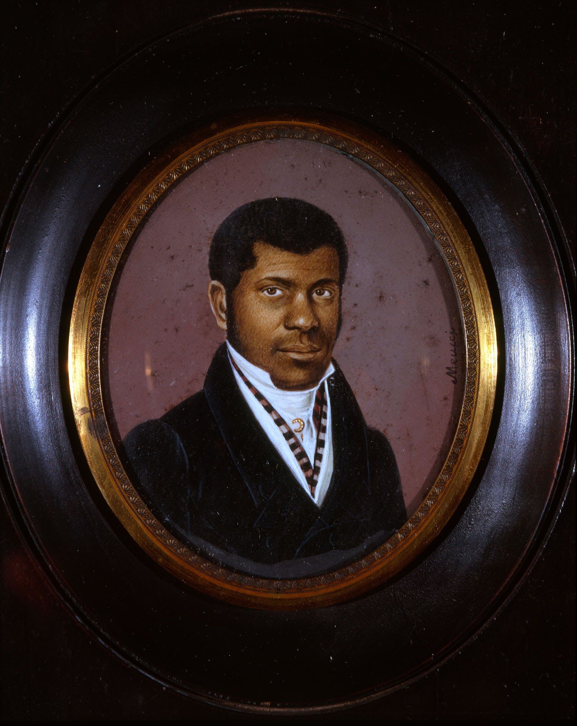
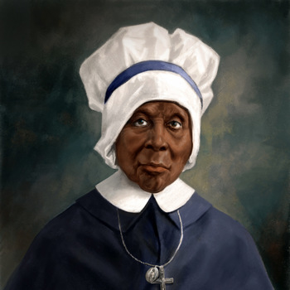
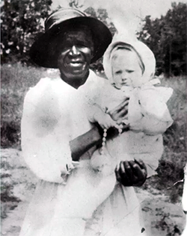
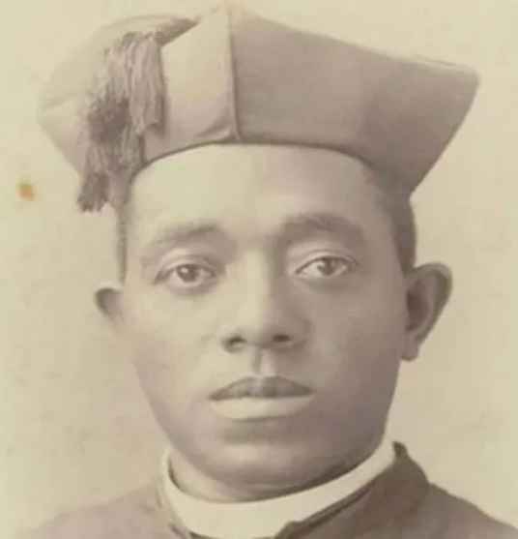
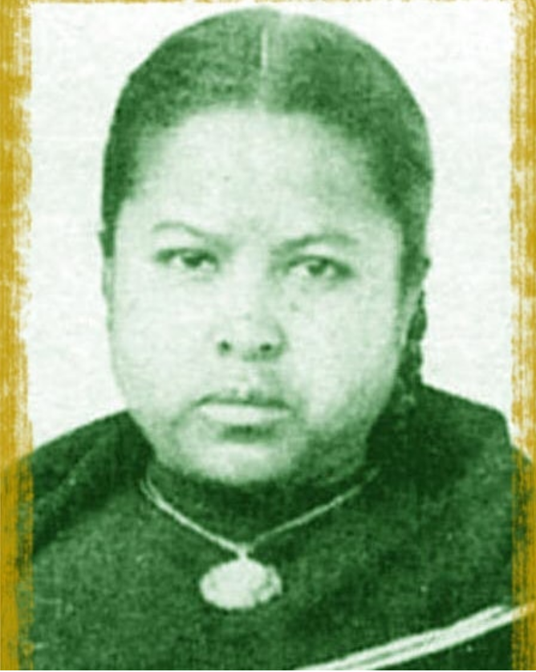
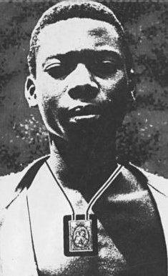
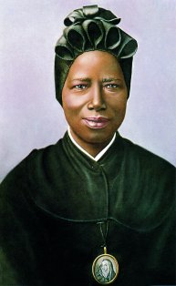
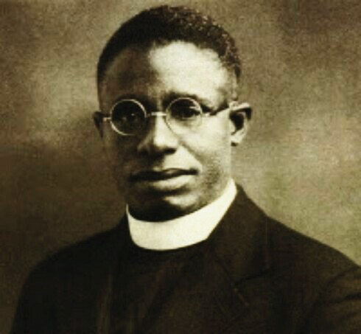
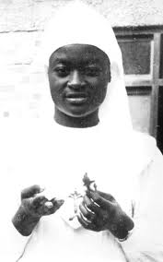
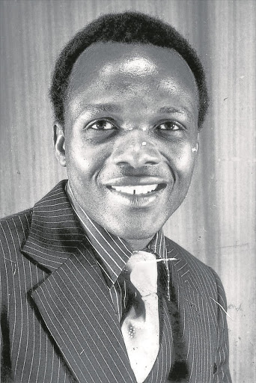
Inspirational and Holy Men and Women
October 2021
Black History Month
BDES

Slide 3
Saint
Martin de Porres
1579 - 1639
Martín de Porres Velázquez was a born in Peru and became a lay brother of the Dominican order. He worked with the poor, establishing an orphanage and a children’s hospital. He experienced racial discrimination but remained patient and compassionate, on one occasion putting an old beggar covered in ulcers in his own bed. When a bother complained, Martin simply said : “Compassion, my dear brother, is preferable to cleanliness. He was beatified in 1837 and canonized xxx in 1962 by Pope Saint John XXIII.
BDES

Slide 4
Venerable
Teresa Chikaba
1676 - 1748
Teresa Chikaba was a Ghanaian princess, kidnapped and sold into slavery. She was baptised and given the name Teresa, and purchased by a Spanish nobleman. She was kindly treated by the household and developed her spiritual life. When she was freed by the family, she entered a Dominican convent in Salamanca. She gained a reputation as a healer and a mystic and was especially known for her love for the sick and the poor, and her kindness and help for the down-hearted.
BDES

Slide 5
Venerable Pierre Toussaint
1766 - 1853
Pierre Toussaint was a Haitian hairdresser, philanthropist, and former slave brought to New York by his owners in 1787 and freed in 1807. He and his wife opened an orphanage, an employment office and a travellers’ hostel, and he contributed to and helped raise money for the building of St Patrick’s Cathedral, where he was the first layperson to be buried in the crypt below the main altar (usually reserved only for bishops). He was declared “Venerable” by Pope Saint John Paul II in 1996.
BDES

Slide 6
Mother Mary Elizabeth Lange (1789 – 1882)
Mother Mary Elizabeth founded the first ever African-American religious order, the Oblate Sisters of Providence, and became the first ever African-American mother superior. She is honoured as a Servant of God, a title used by the Church for someone being considered for sainthood. She was born in San Domingo and her family had to flee to Cuba, from where she emigrated to the United States.
The primary purpose of her order was Catholic education for girls, but the sisters went on to provide evening classes for women, vocational and career training, and establish homes for widows and orphans. The sisters also risked and gave their lives working with plague victims.
The congregation’s first school, the St Francis xxxxx Academy in Baltimore, exists to this day.
BDES

Slide 7
Servant of God Julia Greeley
1833 - 1918
Julia was born into slavery in Missouri in the United States, and was freed under the Emancipation Proclamation of 1865, moving to Colorado. She was baptised into the Catholic Church in 1880 and became a tireless evangelist in Denver, distributing literature of the Sacred Heart League. For her charitable work, pulling a wagon to deliver food, coal and clothing to needy families, she was known as “the Angel of Denver”. In 1901 she joined the Secular Franciscans, of whom she remained an active xxxxx member until her death at the age of 85.
BDES

Slide 8
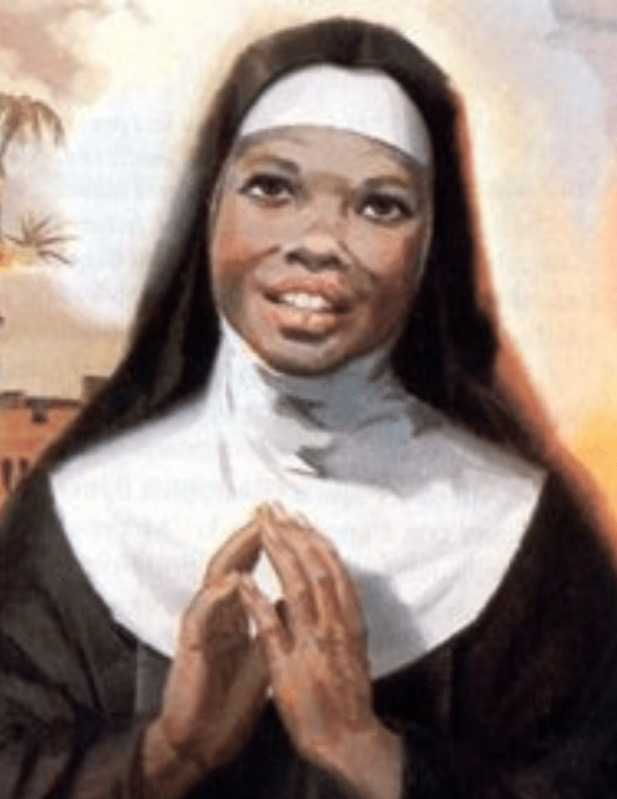
Venerable
Zeinab Alif
1845 - 1925
Born in the Sudan, Zeinab was kidnapped by slave traders and sold. She suffered as a slave until she was rescued by an Italian priest and left in the care of the Poor Clares of Belvedere Ostrense. She was baptised and joined the order as Sister Maria Giuseppina Benvenuti. She moved to the community of Serra de’Conti, where she ultimately became their abbess. Sister Maria had a gift for music and became an excellent organist, but is remembered for her humility, her joy and her life of devotion and prayer.
BDES

Slide 9
Blessed Victoire Rasoamanarivo (1846 – 1894)
Victoire was born into a rich family in Antanarivo in Madagascar, and against the will of her parents was baptised after enrolling in the French Jesuit mission school.
In 1883 the Catholic missionaries were expelled from Madagascar and Catholics like Victoire were considered to be traitors. However, she continued to profess her faith and led the Union Catholique during the years of persecution. The missionaries returned in 1886, from which time Victoire dedicated herself to charitable works among the poor and the lepers.
She suffered patiently an abusive marriage but prayed for her husband who finally begged her forgiveness and was himself baptised on account of her example of faith.
BDES

Slide 10
Father Augustus Tolton (1854 – 1897)
Father Augustus was the first black Catholic priest in the United States. He was born into slavery in Missouri but his family managed to escape by crossing the Mississippi into the free state of Illinois during the confusion of the Civil War. He was supported by his parish priest and was accepted for study in Rome, returning to America after his ordination to work in Chicago. “Good Father Gus” was known for his homilies, his beautiful singing and his abilities on the accordion. Sometimes he suffered discrimination, but reflected : “As I look back on my life, I realise that every time I thought I was being rejected from something good, I was actually being redirected to something better.” xxxxxxxxxxx He was declared “Venerable” by Pope Francis in 2019.
BDES

Slide 11
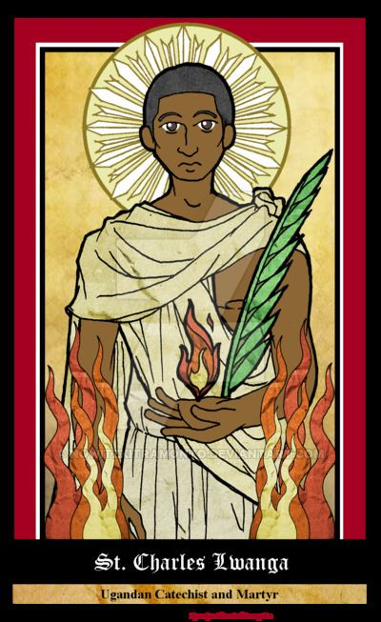
Saint Charles Lwanga
1860-1886
St Charles was born in the then Kingdom of Buganda, today part of modern Uganda. He was baptised by missionaries but had the misfortune to be senior page at the court of King Mwanga, a brutal ruler who purged Anglicans and Catholics by judicial murder when they refused to renounce Christianity. Charles was burned to death with 21 companions on 3rd June 1886. He was canonised in 1964, along with those who accompanied him as martyrs, by xx Pope Paul VI. In 1969, the pope made a pilgrimage to xxx the site of Charles’ martyrdom at Namugongo.
BDES

Slide 12
Saint
Josephine Bakhita
1869 - 1947
Saint Josephine was born in Darfur in Sudan, captured by slave traders at the age of 7 and repeatedly sold and brutally treated. She was fortunate to be given into the care of the Canossian nuns in Venice where she encountered Christianity, converted and joined the community. Her personal holiness and her book “My Miraculous Story” were inspirational and continue to inspire today.
She was canonised in 2000 and is the patron saint of victims of human trafficking.
BDES

Slide 13
Blessed Isidore Bakanja (1887 – 1909)
Isidore was born in 1887 at Bokandela in what was then the Congo Free State. He became a Christian at the age of 18 and wore the scapular of Our Lady of Mount Carmel as we can see in the picture. He was told to stop spreading the Gospel by his plantation supervisor and to stop wearing the scapular. When he refused, he was repeatedly beaten and chained. As he lay dying as a result of his ill treatment, he told the plantations inspector who had rescued him : “tell them that I am dying because I am a Christian.” Missionaries in the area visited Isidore and urged him to forgive the supervisor. He assured them that he already had, declaring “When I am in heaven, I shall pray for him very much.” He was beatified on 24th April 1994 by Pope John Paul II and his feast day is 15th August.
BDES

Slide 14
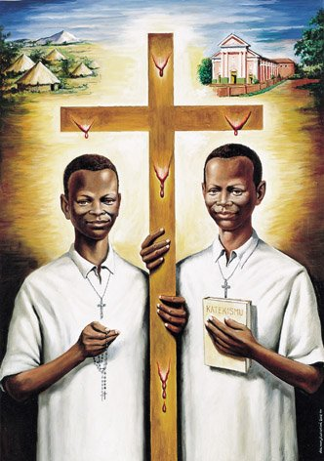
Blessed Daudi Okelo (1902 – 1918)
“These two courageous witnesses were no more than boys when, with simplicity and faith, they shed their blood for Christ and his Church. With youthful enthusiasm for their mission of teaching the faith to their fellow countrymen, they set out in 1918 for northern Uganda. It was there, as evangelization was just beginning in that region, that they chose to embrace death rather than abandon the area and forsake their duties as catechists. Truly, in their lives and witness we can see that they were “beloved by God and chosen by him.” xxxxxxxxxxxxx x– Pope St John Paul II on World Mission Sunday, 20th October 2002.
Daudi and Jildo were young Ugandan catechists who were murdered for their refusal to stop spreading the Gospel in the Paimol region.
Blessed Jildo Irwa (1906 – 1918)
BDES

Slide 15
Blessed Cyprian Michael Iwene Tansi
1903 – 1964
Father Cyprian was a priest of the Archdiocese of Onitsha in Nigeria. He later became a Trappist monk at the monastery of Mount St Bernard in England. In 1998 he was beatified by Pope St John Paul II, who said
of him : “Blessed Cyprian Michael Tansi is a prime example of the fruits of holiness which have grown and matured in the Church in Nigeria since the Gospel was first preached in this land. He xxxxxx received the gift of faith through the efforts of the missionaries, and, taking the xxxxxxxxxxxxx Christian way of life as his own, he made it truly African and Nigerian.”
BDES

Slide 16
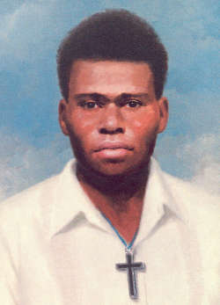
Blessed Peter to Rot
1912-1945
Peter was a Catholic from Papua New Guinea.
He served as a well respected and beloved catechist in his village and was asked to look after the local parish during World War II when the Japanese occupied the region.
He stood up for religious values in the face of Japanese oppression and continued to hold secret services when the Japanese restricted him from active pastoral service. He was sentenced to two months imprisonment in a concentration camp and was killed there in 1945 by being given poison and then suffocated. He had asked his wife to bring his good clothes so he could go to God dressed properly.
His beatification was celebrated in Papua New Guinea in 1995 by
Pope St John Paul II.
BDES

Slide 17
Blessed Marie-Clémentine Anuarite Nengapeta
1939 – 1964
Anuarite Nengapeta ran away from her family to join the Sisters of the Holy Family as Sister Marie-Clémentine, where she taught and served as cook and sacristan. Defending her sisters, she was killed during the civil war in the Democratic Republic of the Congo and on 15th August 1985, the Feast of the Assumption, became the first Bantu woman to be beatified.
BDES

Slide 18
Blessed
Benedict Daswa
1946 - 1990
Born as Tshimangadzo Samuel Daswa in South Africa, he was baptised into the Catholic faith in 1963 and chose the name Benedict, taking as his personal motto St Benedict’s rule of Ora et Labora, “Work and pray.” He became an active member of the Catholic Church as a teacher and catechist, and assisted poor families. He built a church, and established two football teams. When local elders demanded a tax to find a witch responsible for lightning storms, Benedict refused, arguing that they were natural phenomena. He was murdered by a mob and his last words xxxx were : “God, into Your hands receive my spirit!”
BDES

