Slide 1
How to use this Powerpoint
The Powerpoint can be used either in one session, or perhaps one slide daily during the 15 school days that begin on 4th October (the Feast of St Francis of Assisi and the date of the launch of the diocesan Laudato Si initiative).
The first slide is specifically for 4th October, the second explains the relationship between the Canticle of the Creatures, the third and fourth have quotations from Pope Francis. The following 11 slides are from the Canticle of Creatures itself and will take you up until the half-term holiday on 22nd October.
Cross-curricular links : the words on the slide are in English at the top and Italian at the bottom (links to Modern Foreign Languages). For Italian purists : the Italian is actually St Francis’ original in medieval Umbrian dialect, hence for example the odd appearance of the letter k (links to History).
BDES

Slide 2
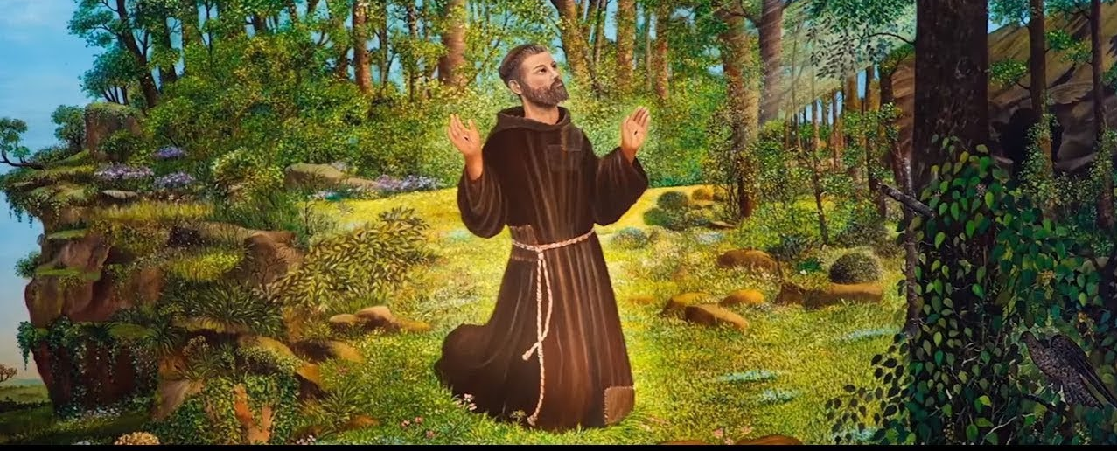
St Francis of Assisi
Feast Day : October 4th
Laudato Si
Invitations
Commitments
Actions
BDES

Slide 3
St Francis of Assisi wrote the Canticle of the Creatures in the early 13th century. It repeats the phrase :
Laudato si, mi Signore (Praised be You, my Lord).
____________________
In 2015 Pope Francis wrote to bishops and the faithful about the need to take care of Creation and our common home; he called this encyclical :
Laudato Si.
BDES

Slide 4
BDES

Slide 5
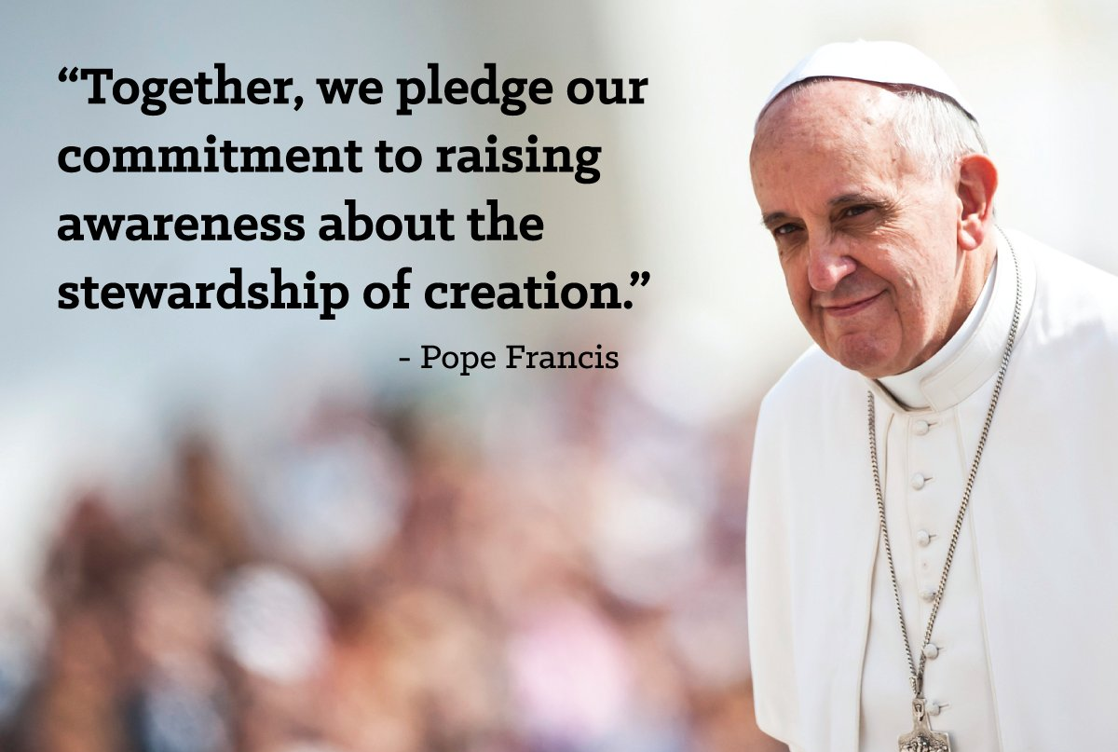
BDES

Slide 6
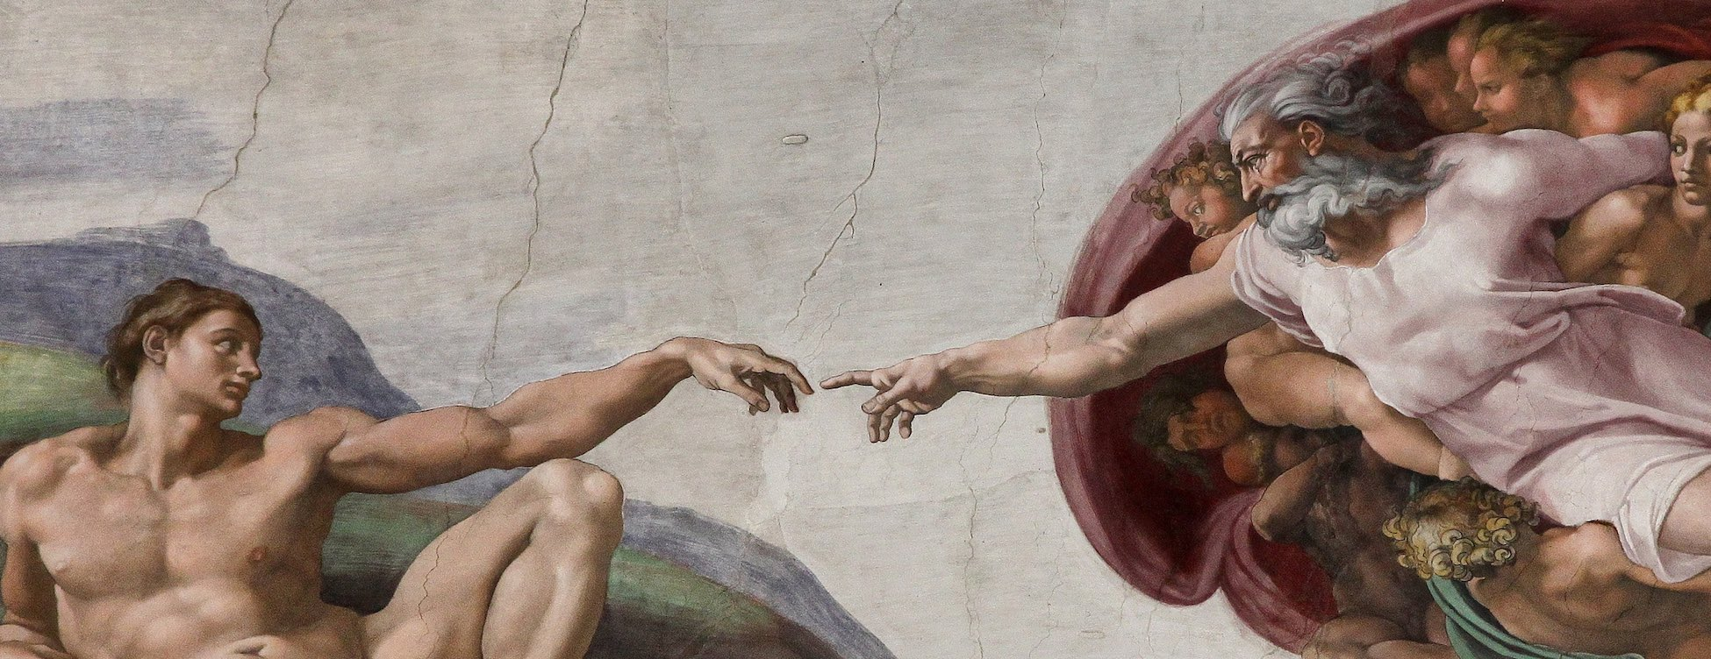
Most High, all powerful, good Lord, Yours are the praises, the glory, the honour, and all blessing.
To You alone, Most High, do they belong, and no man is worthy to mention Your name.
Altissimu, omnipotente bon Signore, Tue so le laude, la gloria e l'honore et onne benedictione. Ad Te solo, Altissimo, se konfano, et nullu homo ène dignu te mentouare.
BDES

Slide 7
Be praised, my Lord, through all your creatures, especially through my lord Brother Sun, who brings the day; and you give light through him. And he is beautiful and radiant in all his splendour! of you, Most High, he bears the likeness.
Laudato sie, mi Signore cum tucte le Tue creature, spetialmente messor lo frate Sole, lo qual è iorno, et allumini noi per lui. Et ellu è bellu e radiante cum grande splendore : de Te, Altissimo, porta significatione.
BDES

Slide 8
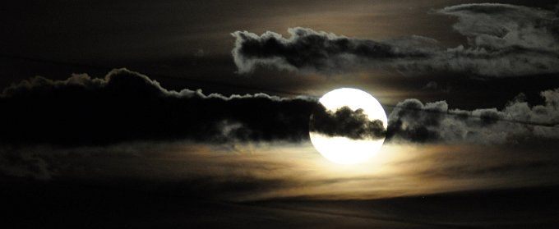
Praised be You, my Lord, through Sister Moon and the stars, in heaven you formed them clear and precious and beautiful.
Laudato si, mi Signore, per sora Luna e le stelle: in celu l'ài formate clarite et pretiose et belle.
BDES

Slide 9
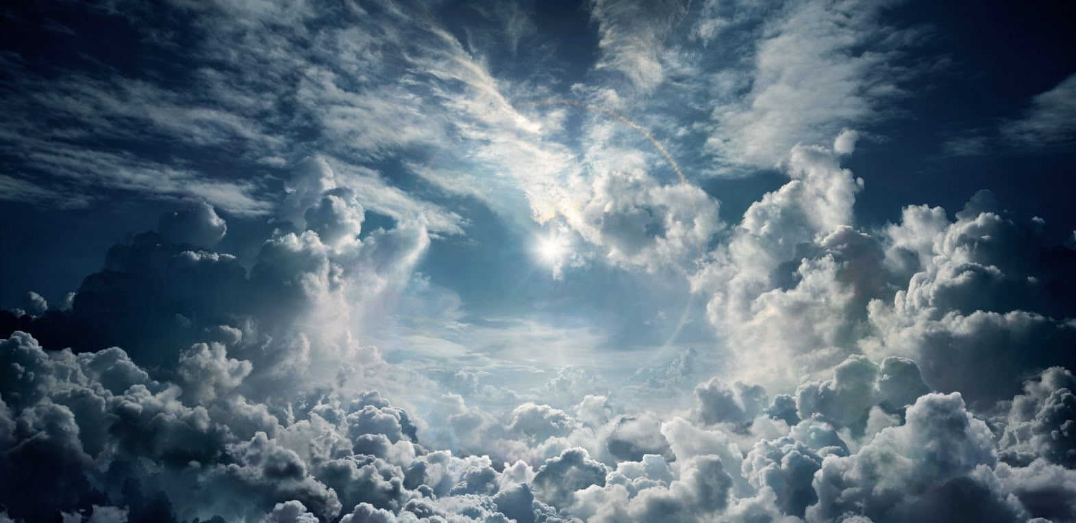
Praised be You, my Lord, through Brother Wind, and through the air, cloudy and serene, and every kind of weather through which You give sustenance to Your creatures.
Laudato si, mi Signore, per frate Uento et per aere et nubilo et sereno et onne tempo, per lo quale, a le Tue creature dài sustentamento.
BDES

Slide 10
Praised be You, my Lord, through Sister Water, which is very useful and humble and precious and chaste.
Laudato si, mi Signore, per sor'Acqua, la quale è multo utile et humile et pretiosa et casta.
BDES

Slide 11
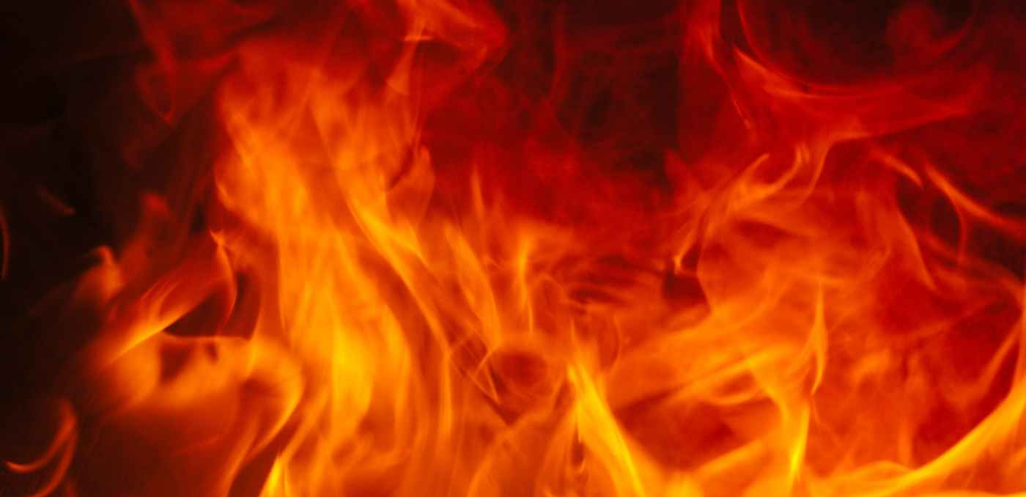
Praised be You, my Lord, through Brother Fire, through whom you light the night : and he is beautiful and playful and robust and strong.
Laudato si, mi Signore, per frate Focu, per lo quale ennallumini la nocte : ed ello è bello et iucundo et robustoso et forte.
BDES

Slide 12
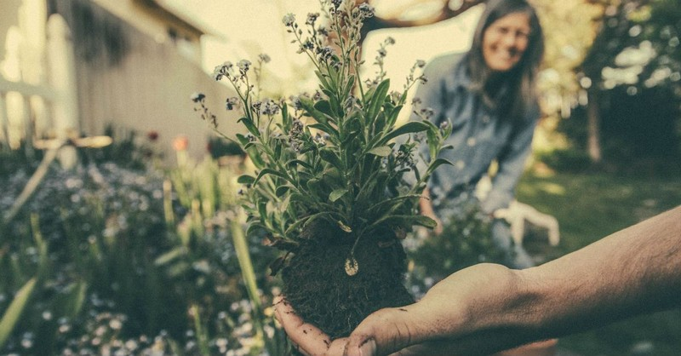
Praised be You, my Lord, through Sister Mother Earth, who sustains us and governs us and who produces varied fruits with coloured flowers and herbs.
Laudato si, mi Signore, per sora nostra matre Terra, la quale ne sustenta et gouerna, et produce diuersi fructi con coloriti fior et herba.
BDES

Slide 13
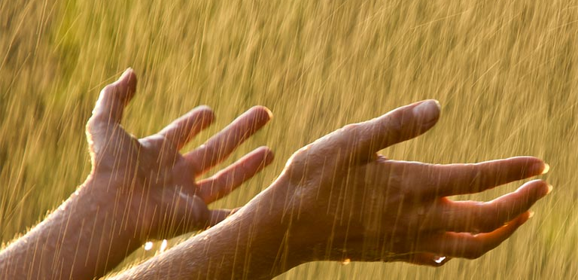
Praised be You, my Lord, through those who give pardon for Your love, and bear infirmity and tribulation.
Laudato si, mi Signore, per quelli ke perdonano per lo Tuo amore et sostengono infirmitate et tribulatione.
BDES

Slide 14
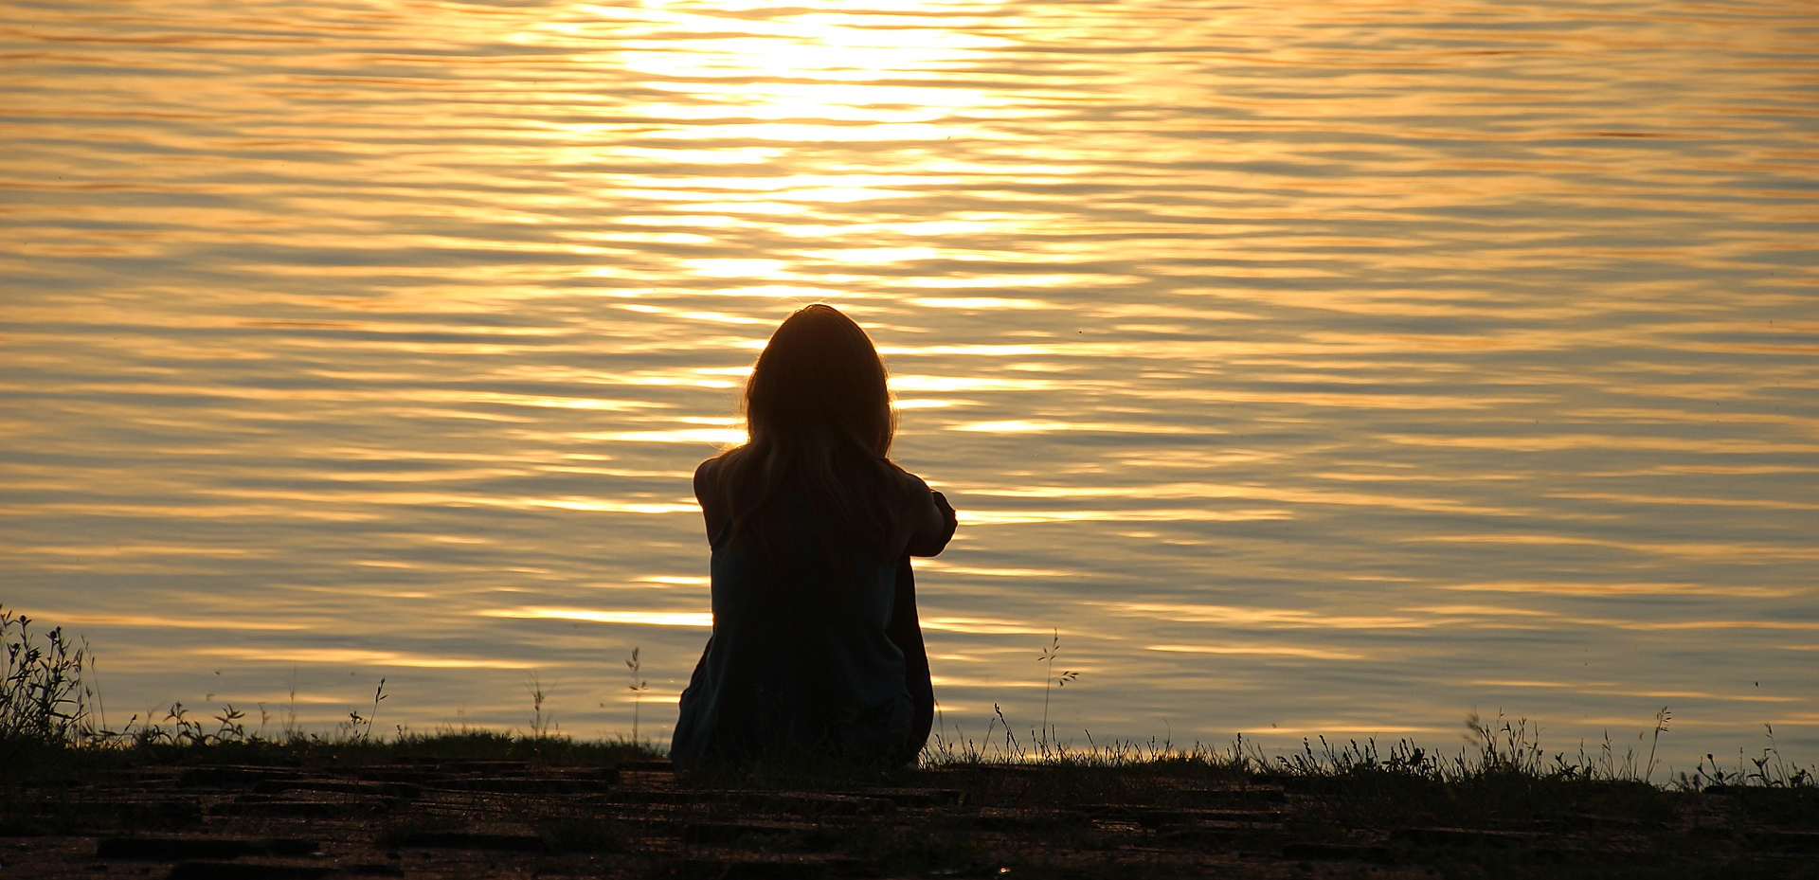
Blessed are those who endure in peace for by You, Most High, they shall be crowned.
Beati quelli ke 'l sosterranno in pace, ka da Te, Altissimo, sirano incoronati.
BDES

Slide 15
Praise and bless my Lord, and give Him thanks and serve Him with great humility.
Laudate et benedicete mi Signore et rengratiate e seruiteli cum grande humilitate.
BDES

