Slide 1
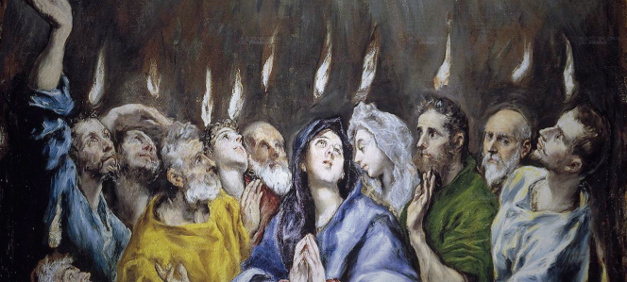
Looking Forward
~ We are His People ~
Monday 24th May 2021
Brentwood Diocese Education Service

Slide 2
We are His People
~ In the Year of St Joseph ~ In the Year of the Family ~
Holy Spirit, memory of God, revive in us the memory of the gift received.
Free us from the paralysis of selfishness and awaken in us the desire to serve, to do good. Even worse than this crisis is the tragedy of squandering it by closing in on ourselves. Come, Holy Spirit: you are harmony; make us builders of unity.
You always give yourself; grant us the courage
to go out of ourselves, to love and help each other,
in order to become one family.
xxxxxxxxxxxxxxxxxxxxxxxxxxxxxxxxx Amen. – Pope Francis, Pentecost Sunday 2020
_____________________________________________________________________________________________________________________________________________
Like the apostles at Pentecost,
let us look forward and outward without fear.

Slide 3
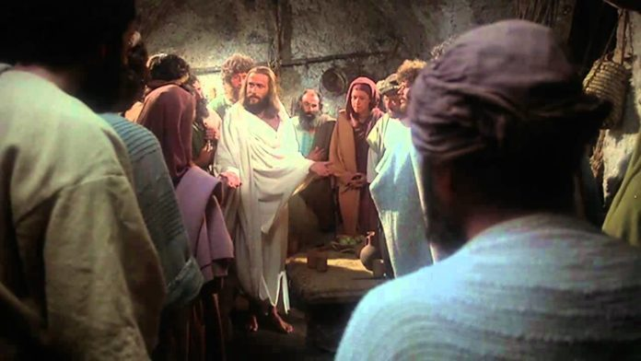
The Synoptic Problem
In Sunday’s Gospel Reading …
23rd May 2021 :
Pentecost Sunday
“Receive the Holy Spirit.”
BDES

Slide 4
PSALM 95
Come, let us sing joyfully to the Lord; let us acclaim the rock of our salvation. Let us come into His presence with thanksgiving; let us joyfully sing psalms to Him.
Come, let us bow down in worship; let us kneel before the Lord who made us. For He is our God, and we are the people He shepherds, the flock He guides.
BDES

Slide 5
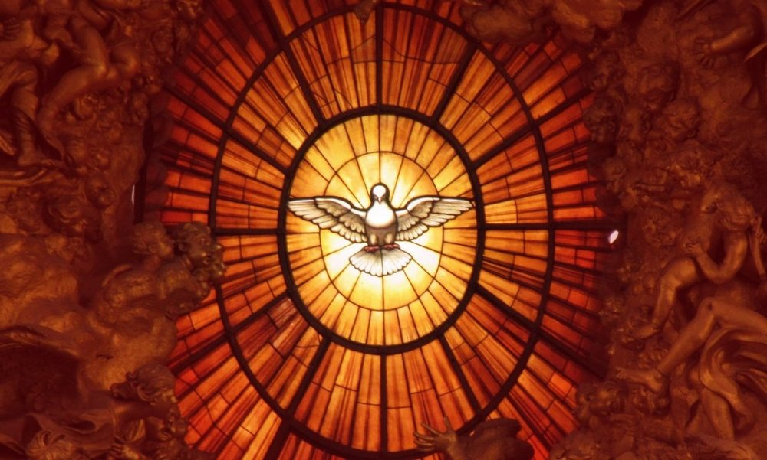
Pentecost
When the day of Pentecost came, they were all together in one place. Suddenly a sound like the blowing of a violent wind came from heaven and filled the whole house where they were sitting. They saw what seemed to be tongues of fire that separated and came to rest on each of them. All of them were filled with the Holy Spirit and began to speak in other tongues as the Spirit enabled them. em.
(Acts of the Apostles 2 : 1-4)
BDES

Slide 6
Reflection
Come, Holy Spirit, fill the hearts of your faithful and kindle in them the fire of your love.
BDES

Slide 7
Preparing with our families for World Youth Day 2023
“Love needs time and space; everything else is secondary.”
- Pope Francis, Amoris Laetitia 224
BDES

Slide 8
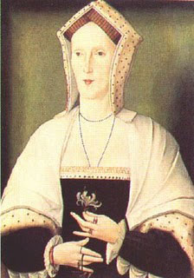
Blessed Margaret Pole
Feast day : 28th May
Margaret Plantagenet, Countess of Salisbury, was the niece of kings Edward IV and Rich­ard III. Widow of Sir Reginald Pole, she was appointed governess to Princess Mary, daughter of Henry VIII. When she opposed Henry's marriage to Anne Boleyn, the king exiled her from court, although he called her “the holiest woman in England.” When her son, Cardinal Pole, denied Henry's Act of Supremacy, the king imprisoned Margaret in the Tower of London for two years and then beheaded her on May 28^{thxxx} 1541 without a legal trial. She was seventy when she-was --- martyred.
BDES

Slide 9
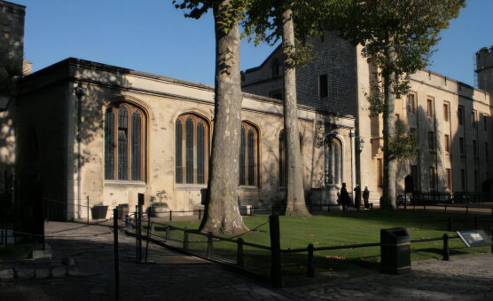
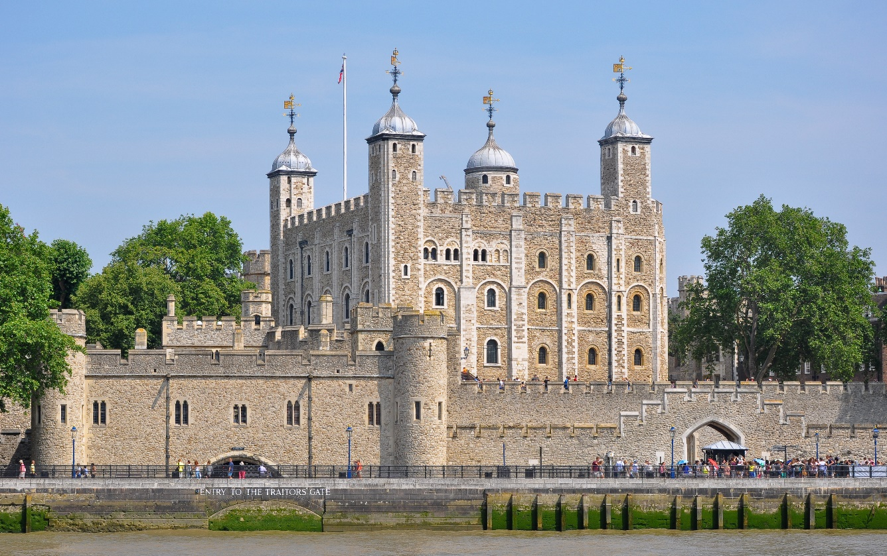
Looking forward : Catholic heritage
• TOWER OF LONDON •
One of the places we will be able to visit again soon is the Tower of London, steeped in history and heritage. But it has also been a place of suffering and persecution. In the chapel of St Peter ad Vincula (St Peter in Chains), there is a memorial to, among others, Catholic martyrs who suffered ----there ::St Thomas More, St John Fisher, St Philip Howard and Blessed Margaret Pole.
BDES

Slide 10
Looking Forward
~ We are His People ~
Monday 24th May 2021
Brentwood Diocese Education Service

