Slide 1
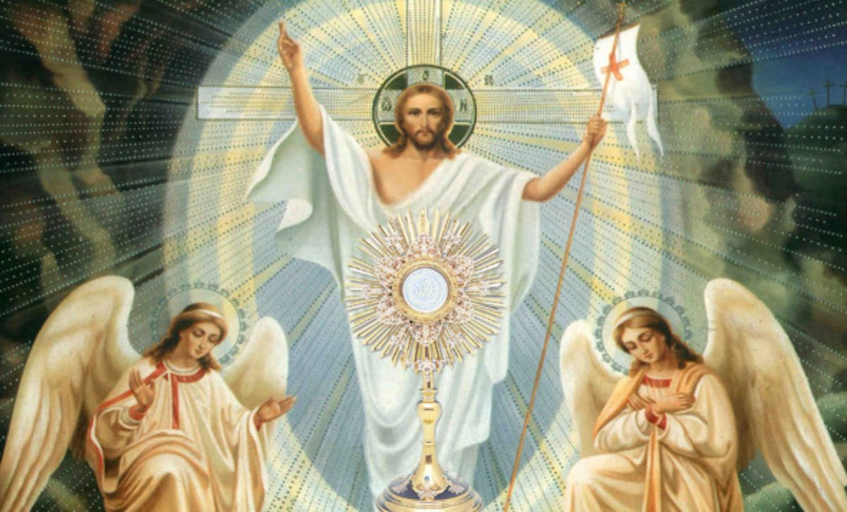


Looking Forward
~ “We are a Community Looking Forward ” ~
Monday 7th June 2021
Brentwood Diocese Education Service

Slide 2
~ Looking forward ~
~ In the Year of St Joseph ~
The Body of Christ
St Paul in his writings shows that the Church is the ‘Body of Christ’
We are all part of that one Body with Christ as the head and as such we all contribute to the work of the Church.
We should all be celebrated for our talents
and respected for what we have to offer.
“For as with the human body which is a unity although it has many parts -- all the parts of the body, though many, still making up one single body - so it is with Christ.” 1 Cor 12:12
BDES

Slide 3
Preparing for World Youth Day 2023
As a community, we have an obligation to ensure that every person lives with dignity.
- Pope Francis,
Fratelli Tutti, 118
BDES

Slide 4
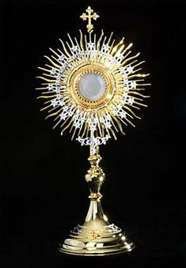
The Synoptic Problem
Gospel Reading
6th June 2021 :
In the Gospel of Mark,
Jesus says :
“This is My Body.”
BDES

Slide 5
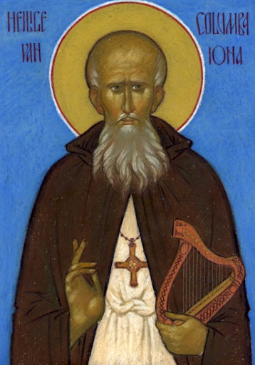

St Columba
Feast Day : 9th June
Saint Columba (known in Ireland as Colmcille) was an Irish missionary who died in 597 AD. He was the leader of a group of monks who founded an abbey on the island of Iona on the west of Scotland. This was a centre of learning and Columba is reputed to have written several hymns himself. He is also associated with the Books of Kells and Durrow, famous examples of medieval manuscripts. He is a patron saint of Ireland following St Patrick and St Brigid and was acknowledged as a saint not long after his death.
The Knights of St Columba are an Order of Catholic men bound together in Charity, Unity and Fraternity in order to enrich their own faith and spirituality and by their own words and actions to proclaim the spiritual, moral and social message of the Catholic Church. They were founded in 1919 and and and named after the saint.
BDES

Slide 6
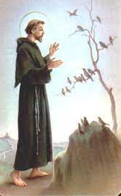
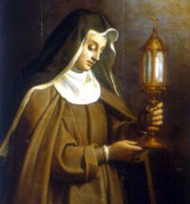
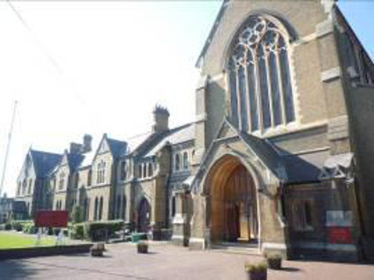
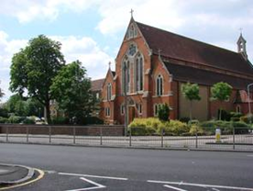
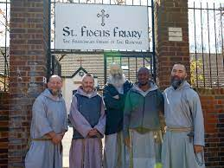
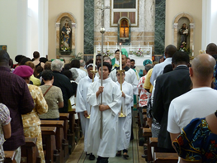
Communities: Franciscans
The Franciscans have a long tradition in England, going back to 1224 when the first friars landed near Dover and a friary was established in London.
With the growth of the Catholic Church following the Catholic Emancipation Act of 1829 the friars were established in Stratford in 1873 and Woodford in 1894. These areas still have a proud Franciscan tradition. The Diocese of Brentwood has strong Franciscan links with a number of communities active within it.
BDES

Slide 7
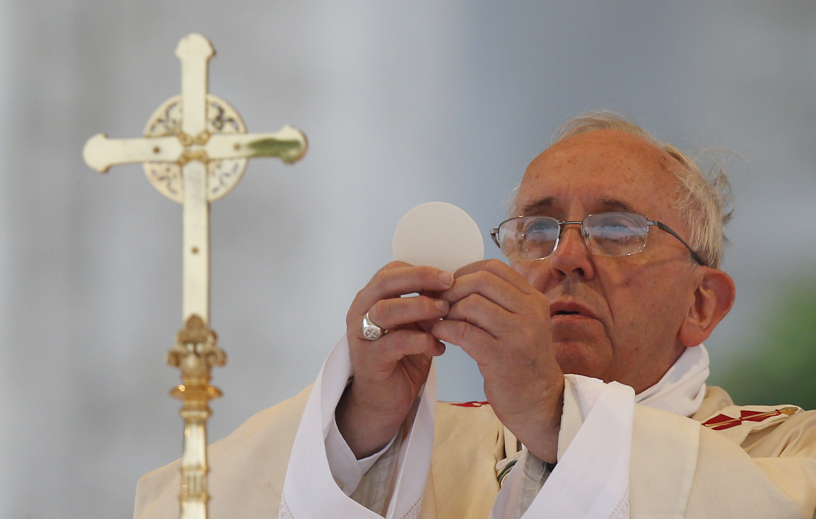
Reflection
Being in Communion. Being in Community.
Pope Francis said
“Whenever we pray, we find ourselves immersed in a great stream of past, present and future intercession for the needs of individuals and of the whole world …
We are joined in the communion of all those who have gone before and we should work to build peace, welcoming all and moving towards a fairer world.”
BDES

Slide 8
Looking Forward
~ “We are a Community Looking Forward ” ~
Monday 7th June 2021
Brentwood Diocese Education Service

