Slide 1
Looking Forward
~ We are a Community, Looking Forward~
Monday 14th June 2021
Brentwood Diocese Education Service

Slide 2
We are a Community, Looking Forward
~ In the Year of St Joseph ~ In the Year of the Family ~
Dear Jesus, we know you are present in the little things of life. We sense that the seeds of faith which you continue to plant within us
will grow, even without our awareness.
When we are discouraged, remind us again of the mustard seed, this image of growth.
Let us take the longer view, let us see the bigger picture, let us be strengthened by the good news.
Amen.
_____________________________________________________________________________________________________________________________________________
Let us look forward, let us grow.
Let our communities flourish.

Slide 3
The Synoptic Problem
In Sunday’s Gospel Reading …
13th June 2021 :
“To what shall we compare the Kingdom of God?”
BDES

Slide 4
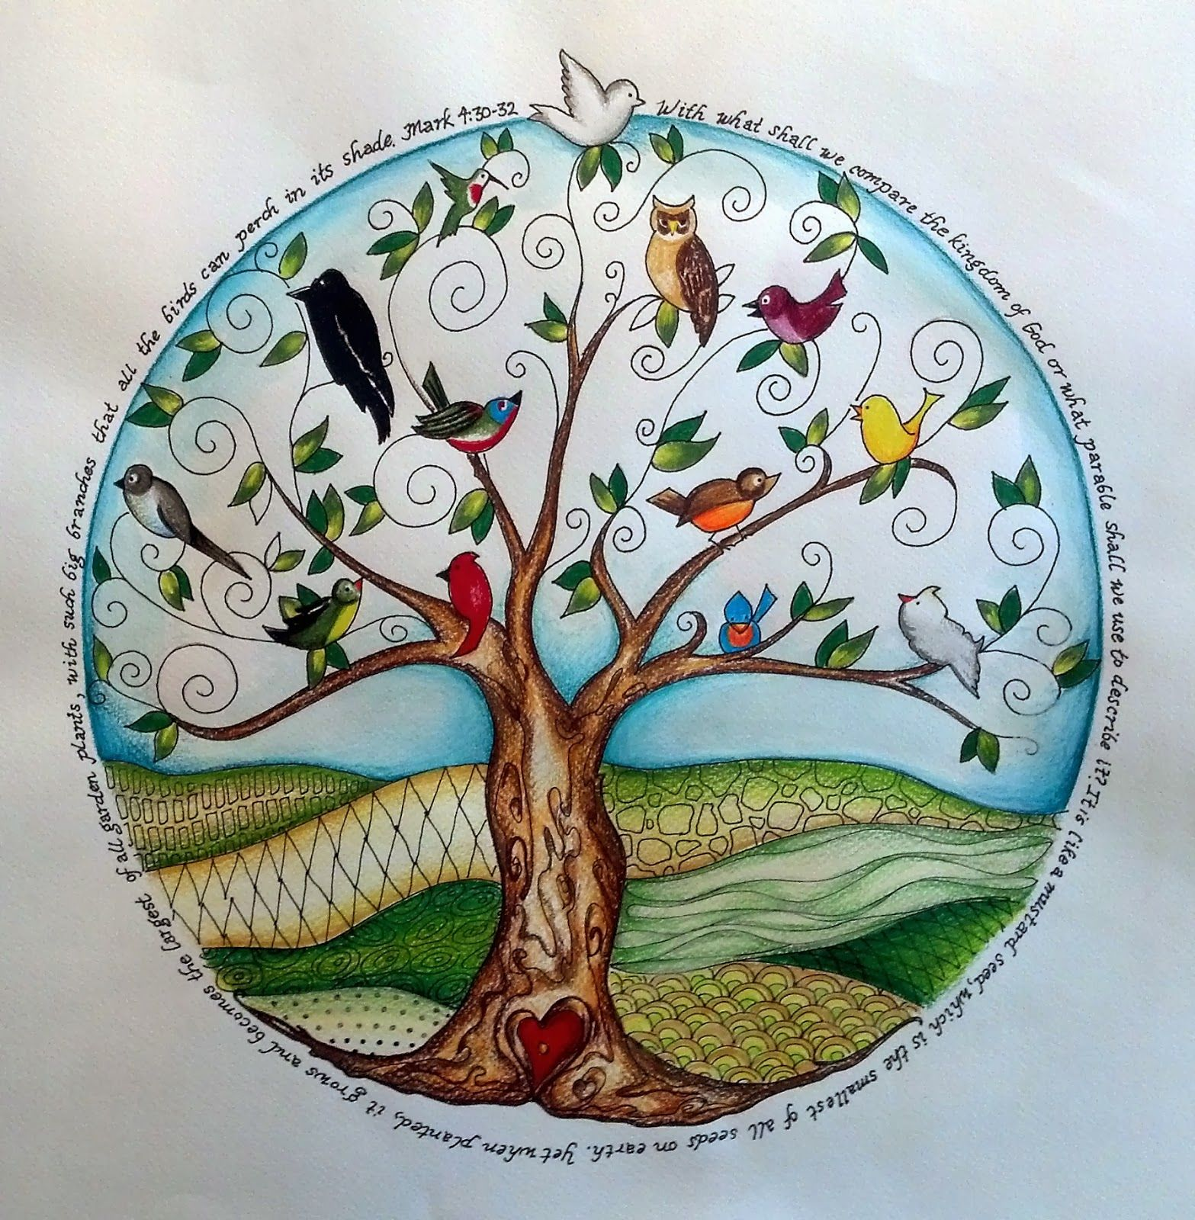
The Parable of the Mustard Seed
“To what shall we compare the kingdom of God, or what parable can we use for it?
It is like a mustard seed that, when it is sown in the ground, is the smallest of all the seeds on the earth.
But once it is sown, it springs up and becomes the largest of plants and puts forth large branches, so that the birds of the sky can dwell in its shade.”
em.
(Mark 4 : 30-32)
BDES

Slide 5
Reflection
Do not despise small beginnings, for the Lord rejoices to see the work begin.
xxxxxxxxxxxxxxxxxxxxxxxxxxxxxxxxxxxxxxxx- Zechariah, 4 : 10
BDES

Slide 6
Preparing as communities for World Youth Day 2023
“The world exists for everyone, because all of us were born with the same dignity.”
- Pope Francis, Fratelli Tutti 118
BDES

Slide 7
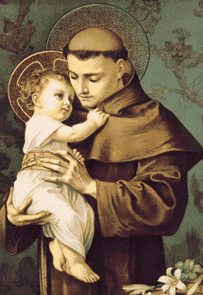
Saint Anthony of Padua
Feast day : 13th June
Saint Anthony was born into a wealthy family in Portugal but gave up worldly wealth to become a poor Franciscan. He preached in Morocco and his skill led St Francis, the founder of the Order, to entrust the friars’ studies to him. He taught at the universities of Montpellier and Toulouse and continued to preach with great success. He died at the age of only 35, and is depicted as holding the Christ Child, referencing a vision he once had. He is the patron of those who have lost things and numerous churches contain a box poor box for offerings from those grateful for his xxxxx intercession.
BDES

Slide 8
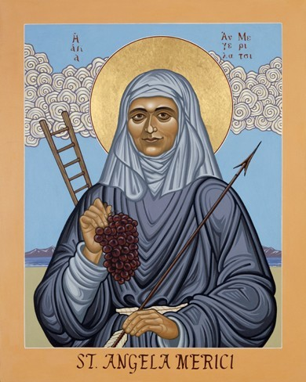
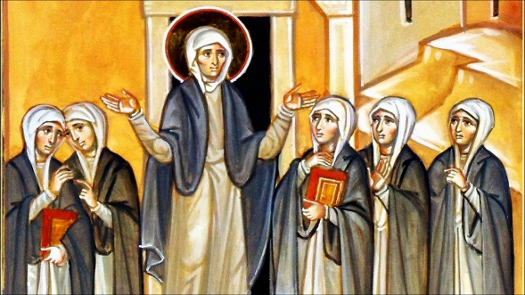
Communities : Ursulines
St Angela Merici founded the Company of St Ursula in 1535 in Brescia, in which women dedicated their lives to the service of the worldwide Church community through the education of girls. Her feast day is on the day of her death, 27th January, and is celebrated in schools of the Ursuline tradition in our diocese : Brentwood Ursuline Convent High School, St Angela’s in Forest Gate, the Ursuline Academy Ilford and the Ursuline Preparatory School in Warley.
The schools’ mottos are “Duty” and “Serviam” (“I will serve”).
BDES

Slide 9
Looking Forward
~ We are a Community, Looking Forward~
Monday 14th June 2021
Brentwood Diocese Education Service

