Slide 1
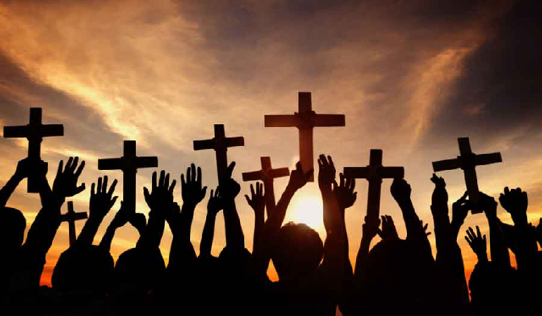
Looking Forward
~ We are a Community, Looking Forward~
Monday 21st June 2021
Brentwood Diocese Education Service

Slide 2
We are a Community, Looking Forward
~ In the Year of St Joseph ~ In the Year of the Family ~
Pope Francis said :
“Prayer and working in community is what keeps the world going.
It is a motor.”
Just as an engine provides power for a car so praying and working together gives us the power to move forward.
__________________________________________________________________________________________________________________________
Let us look forward, let us pray together .
Let our communities grow.

Slide 3
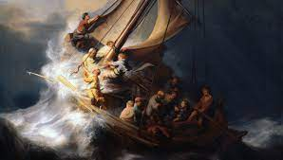
The Synoptic Problem
In Sunday’s Gospel Reading …
20th June 2021 :
“Do you not yet have faith?”
BDES

Slide 4
Be Trusting
O Christ Jesus, when all is darkness and we feel our weakness and helplessness, give us the sense of Your presence, Your love, and Your strength. Help us to have perfect trust in Your protecting love and strengthening power, so that nothing may frighten or worry us, for, living close to You, we shall see Your hand, Your purpose, Your will through all things. Amen
BDES

Slide 5
Reflection
When the disciples were on the Sea of Galilee with Jesus, they were afraid.
Jesus asked them to put their trust in him, and we should do the same.
Sometimes it is very difficult for us to do this; like the disciples, we don’t understand why things happen - but we should have faith.
BDES

Slide 6
Preparing as communities for World Youth Day 2023
“Each of us can learn something from others.”
- Pope Francis, Fratelli Tutti (215)
BDES

Slide 7
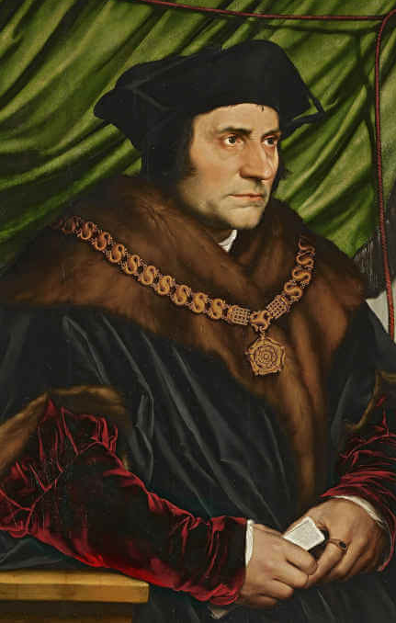
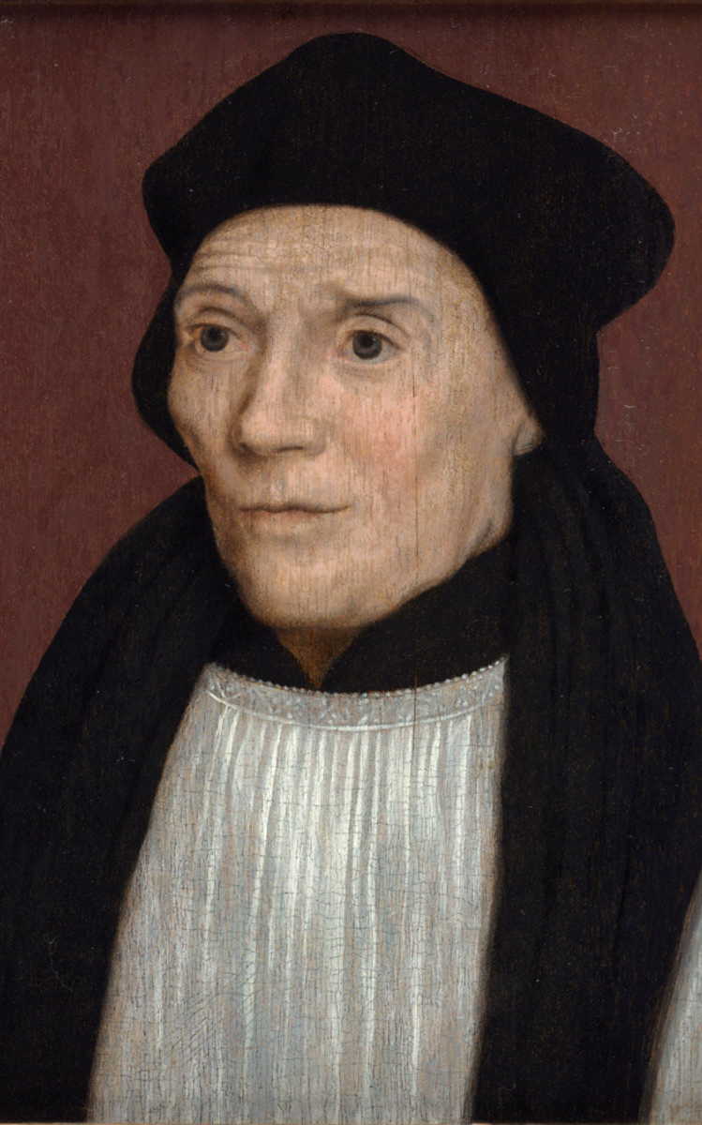
St John Fisher and St Thomas More
Feast day : 22nd June
St John Fisher and St Thomas More were executed on the orders of Henry VIII for refusing to accept Henry as Supreme Head of the Church in England.
They were both executed in the Tower of London and their headless corpses buried in the church of St Peter ad Vincula inside the walls of the Tower. Fisher’s head was displayed on London Bridge and then thrown into the Thames to be replaced by More’s head. This was later rescued by More’s daughter Margaret.
The two men were made saints in 1935 and their feast is 22nd June, the date of Fisher’s execution.
Before he was put to death, More is reported to have said “I die the King’s good servant, but God’s first”.
BDES

Slide 8
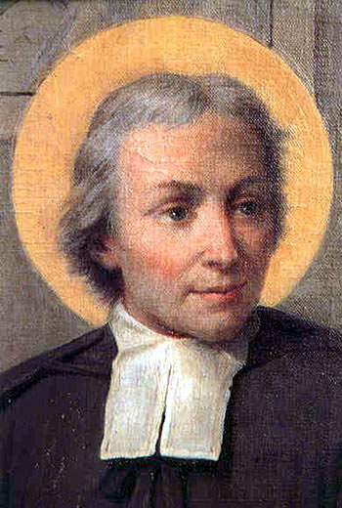
Communities : Lasallians
Jean Baptise De La Salle was a French priest who dedicated his life to education. He believed education gave hope and opportunity so founded the Brothers of the Christian Schools (known as the De La Salle Brothers) to teach poor students.
He was made a saint in 1900 and declared the Patron Saint of Teachers in 1950.
The De La Salle Brothers have a presence in 80 countries and provide education to one million students of all ages, at primary, secondary and university level.
Lasallian education enriches the whole person through teaching, technology and the development of the student’s cultural, intellectual, physical, social and spiritual well-being. It centres on Catholic values and personal relationships, emphasising academic excellence, faith formation, inclusion, respect for the individual, service and social justice.
BDES

Slide 9
Looking Forward
~ We are a Community, Looking Forward~
Monday 21st June 2021
Brentwood Diocese Education Service

