Slide 1
Looking Forward
~ We are a Community, Looking Forward~
Monday 28th June 2021
Brentwood Diocese Education Service

Slide 2
We are a Community, Looking Forward
~ In the Year of St Joseph ~ In the Year of the Family ~
OUR COMMUNITY PRAYS FOR THE GLOBAL COMMUNITY
Heavenly Father,
You hold the whole world deep in your heart,
sharing our pains and burdens,
delighting in our joys and successes.
We offer you our prayers – both spoken and unspoken –
and ask you to hear us as we pray for others around our world.
Amen.
_____________________________________________________________________________________________________________________________________________
Let us look forward, let us grow.
Let our communities flourish.
BDES

Slide 3
The Synoptic Problem
In Sunday’s Gospel Reading …
27th June 2021 :
“Your faith has saved you.”
BDES

Slide 4
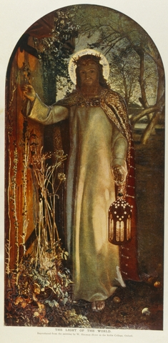
Reflection
“Behold, I stand at the door and knock. If anyone hears my voice and opens the door, I will come in to him and eat with him, and he with me.”
- Revelation 3 : 20
BDES

Slide 5
Preparing as communities for World Youth Day 2023
“No one is useless and no one is expendable.”
- Pope Francis, Fratelli Tutti 215
BDES

Slide 6
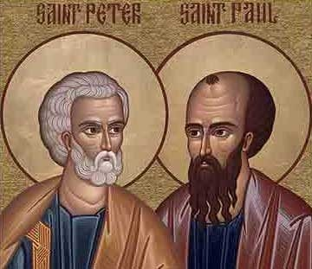
Saints Peter and Paul
Feast day : 29th June
 Tuesday 29th June is a Holy Day of Obligation 
St. Peter and Paul’s day is the feast day that honours the martyrdom of the two saints, sometime between AD 64 and 68. While the church recognizes that they may not have died on the same day, tradition says that this is the day that they were both martyred in Rome by Emperor Nero.
The day is a solemnity or a feast day of the highest rank. This honour is reserved for only the most important events, such as those in the lives of Jesus or Mary. Therefore this xxxx emphasizes just how important the two saints are to the Catholic faith.
BDES

Slide 7
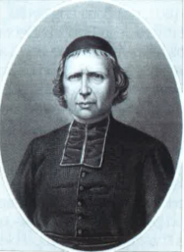
Communities : La Sainte Union
The Sisters of the Holy Union of the Sacred Hearts are a religious congregation founded at Douai, France, in 1828, by Father Jean Baptiste Debrabant (1801 – 1889, see right). The congregation was approved by the Holy See in 1877. Its rules are taken principally from those of the Order of the Visitation of Holy Mary, founded by Francis of Sales. The Holy Union Sisters devoted themselves to the education of young people, and we have in the Diocese two schools of La Sainte Union, Grays Convent High School and Holy Cross Primary School.
BDES

Slide 8
Looking Forward
~ We are a Community, Looking Forward~
Monday 28th June 2021
Brentwood Diocese Education Service

