Slide 1
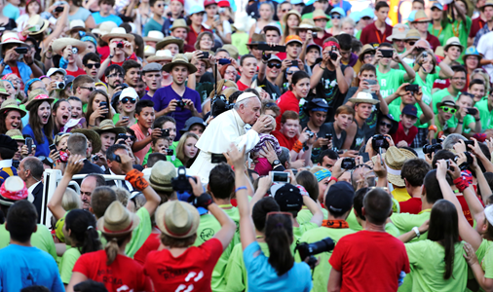
Looking Forward
~ We are a Community, Looking Forward~
Monday 5th July 2021
Brentwood Diocese Education Service

Slide 2
We are a Community, Looking Forward
~ In the Year of St Joseph ~ In the Year of the Family ~
Pope Francis said that:
Living in community also means standing together against injustice and spreading hope among those who suffer.
We need a certain “bravery to go out” and to encounter others.
We can follow the disciples’ example and go out into the world to live the Good News.
Let us look forward, let us grow.
Let our communities flourish.

Slide 3
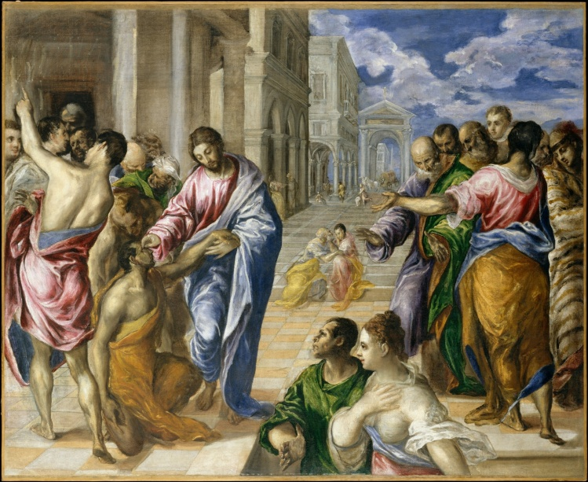
The Synoptic Problem
In Sunday’s Gospel Reading …
4th July 2021 :
The Gospel of Mark says
“What mighty deeds are worked by his hands”
BDES

Slide 4
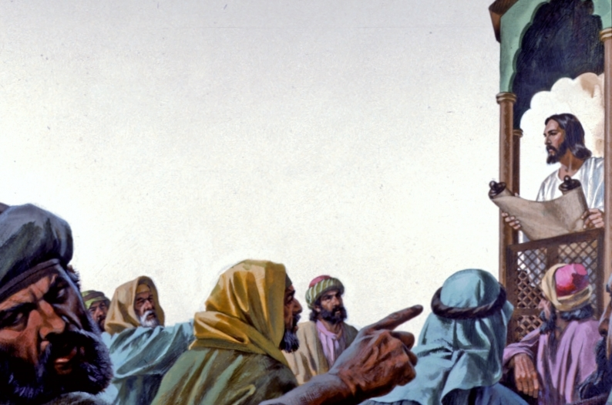
Reflection
By showing that Jesus himself was rejected, the Gospel of Mark is trying to reassure his first readers who were themselves suffering persecution. He also prepares us to accept rejection as a possible consequence of Christian discipleship, which we have to overcome.
BDES

Slide 5
Preparing as communities for World Youth Day 2023
“It is an act of charity to assist someone suffering, but it is also an act of charity … to work to change the social conditions that caused his or her suffering.”
- Pope Francis, Fratelli Tutti 186
BDES

Slide 6
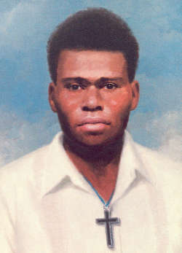
Blessed Peter to Rot
Feast day : 7th July
Peter was a Catholic from Papua New Guinea.
He served as a well respected and beloved catechist in his village and was asked to look after the local parish during World War II when the Japanese occupied the region.
He stood up for religious values in the face of Japanese oppression and continued to hold secret services when the Japanese restricted him from active pastoral service. He was sentenced to two months imprisonment in a concentration camp and was killed there in 1945 by being given poison and then suffocated. He had asked his wife to bring his good clothes so he could go to God dressed properly.
His beatification was celebrated in Papua New Guinea in 1995 by
Pope St John Paul II.
BDES

Slide 7
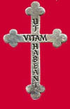
Our communities : R.S.H.M.
The Religious of the Sacred Heart of Mary
The RSHM symbol is the Cross worn by the sisters. The words on the cross, Ut Vitam Habeant mean: "That They May Have Life" (Jn. 10:10)
This is an international congregation of Catholic women religious who work to change the lives of others. Their motto, "ut vitam habeant" ("that they may have life"), is taken from the Gospel of John and explains their mission, “to know and love God, to make God known and loved, to proclaim that Jesus Christ has come in order that all may have life” (RSHM Constitutions #7).
The congregation was founded in 1849, and now serves in Africa, Europe, Asia, and North and South America in diverse ministries including in schools.
Their schools can be found in the USA, Mexico, Colombia, Brazil, Portugal, France, Italy and England and includes the Sacred Heart of Mary Girls School in Upminster.
BDES

Slide 8
Looking Forward
~ We are a Community, Looking Forward~
Monday 5th July 2021
Brentwood Diocese Education Service

