Slide 1
Looking Forward
~ We are a Community, Looking Forward~
Monday 12th July 2021
Brentwood Diocese Education Service

Slide 2
We are a Community, Looking Forward
~ In the Year of St Joseph ~ In the Year of the Family ~
A PRAYER OF THANKS FOR OUR COMMUNITIES
_____________________________________________________________________________________________________________________________________________
Let us look forward, let us grow.
Let our communities flourish.
We are, all of us, wonderfully made. young or old, weak or strong, we are able to both receive and give love, to be blessed and be a blessing, to be singers of the angels’ song and point to the one who gives us life. We are, all of us, wonderfully made. Thank you, Creator God, who loves each one.
BDES

Slide 3
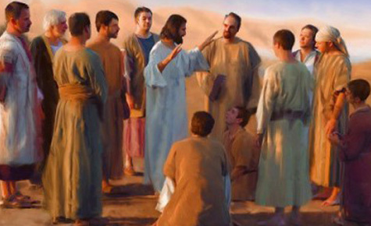
The Synoptic Problem
In Sunday’s Gospel Reading …
11th July 2021 :
“Jesus sent them out.”
BDES

Slide 4
Reflection
BDES

Slide 5
Preparing as communities for World Youth Day 2023
“I will give everyone the possibility of sharing this planet with me, despite all our differences.”
- Pope Francis, Fratelli Tutti 269
BDES

Slide 6
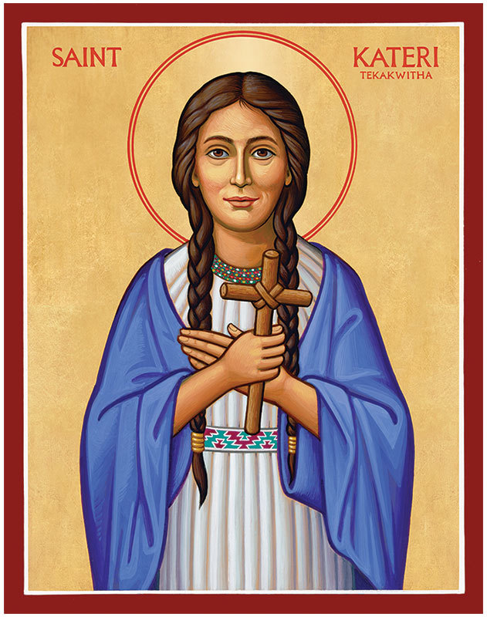
Saint Kateri Tekakwitha Feast day : 14th July
Canonised under Pope Benedict XVI in 2012, Saint Kateri Tekakwitha (1656-1680) was the first Native American woman to be recognised as a saint. She was an Algonquin-Mohawk laywoman who converted to Catholicism at the age of 19, and was shunned by some of her tribe for her conversion. She lived a life of prayer and was praised for her “charity, industry, purity and fortitude.”
BDES

Slide 7
Communities : Bernardines
The Bernardine Cistercians of Esquermes are a small branch of the Cistercian Order who follow the Rule of St Benedict. Even before they fled the French Revolution, which saw their abbeys suppressed, the order was dedicated to the education of young girls, a charism which continues to inform their work today.
In our diocese the Bernardines founded St Bernard’s school in Westcliff in 1910. The school’s houses are named after abbeys and monasteries connected with St Bernard of Clairvaux, and its motto is Dieu mon abri - “God is my shelter”.
BDES

Slide 8
Looking Forward
~ We are a Community, Looking Forward~
Monday 12th July 2021
Brentwood Diocese Education Service

