Slide 1
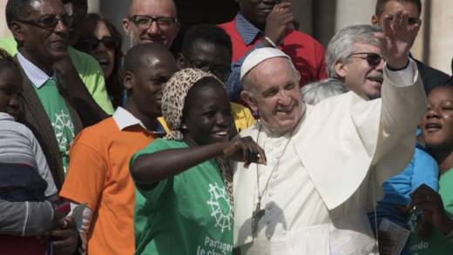
Looking Forward
~ We are a Community, Looking Forward~
Monday 19th July 2021
Brentwood Diocese Education Service

Slide 2
We are a Community, Looking Forward
~ In the Year of St Joseph ~ In the Year of the Family ~
As we come to the end of the academic year, what have you learned?
Don’t just think about academic subjects, but about living in the school community.
What are you going to do better next year?
Let us look forward, let us grow.
Let our communities flourish.

Slide 3
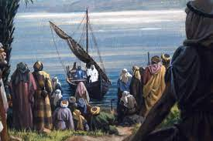
The Synoptic Problem
In Sunday’s Gospel Reading …
18th July 2021 :
The Gospel of Mark says
“He taught them many things”
BDES

Slide 4
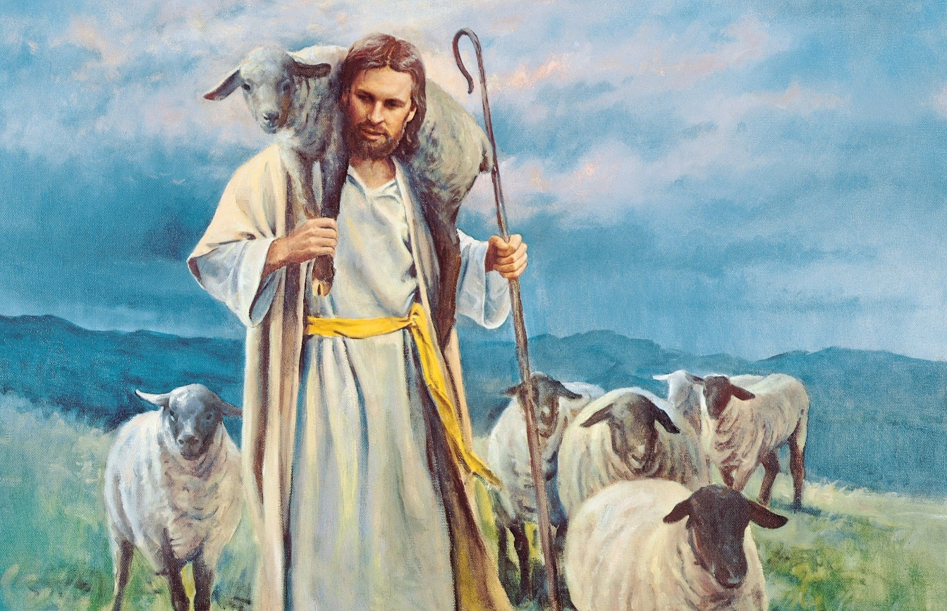
Reflection
Jesus said the people were like sheep without a shepherd, and he took pity on them.
How could you reflect this by looking after others this summer?
BDES

Slide 5
Preparing as communities for World Youth Day 2023
“We can choose to cultivate kindness.”
- Pope Francis, Fratelli Tutti 222
BDES

Slide 6
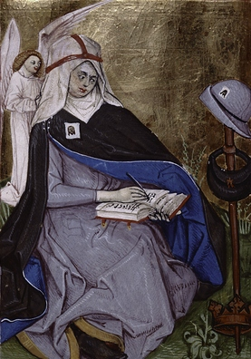
St Bridget of Sweden
Feast day : 23rd July
She lived in Sweden from 1303 to 1373 and founded an order of monks and nuns called the Bridgettines after the death of her husband. The order was expected to give away any surplus to the poor but they were allowed as many books as they wanted.
She made a pilgrimage to Rome in very difficult circumstances where she lived the rest of her life. She was much loved for her kindness and good works.
One of her daughters is also a saint.
BDES

Slide 7
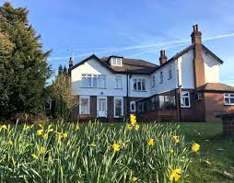
Our communities : B.C.Y.S
The Brentwood Catholic Youth Service
The Walsingham House Team have welcomed young people on retreat for more than thirty years, firstly at Chingford, then at Canvey Island, and now at Abbotswick.
They are a young adult team, usually aged 19-25, supported by staff members who have years of Youth Ministry experience, the Walsingham House Team live the model advocated by Pope St John Paul II, Pope Benedict and Pope Francis, who have each expressed the deep truth that “the best evangelisers of young people are other young people.”
They work in schools and have the facilities at Walsingham House to accommodate residential groups.
BDES

Slide 8
Looking Forward
~ We are a Community, Looking Forward~
Monday 19th July 2021
Brentwood Diocese Education Service

