Slide 1
Looking Forward
~ A Roadmap for Saints ~
Wednesday 1st September 2021
Brentwood Diocese Education Service

Slide 2
We are Looking Forward
~ In the Year of St Joseph ~ In the Year of the Family ~
What are you looking forward to at the start of the school year?
Seeing old friends? Making new friends?
New knowledge? New skills?
New challenges? New opportunities?
What roadmap will you be following this year?
A roadmap to being a better you?
Helping others to be better, brighter and happier too?
Sounds very much like a path to sainthood!

Slide 3
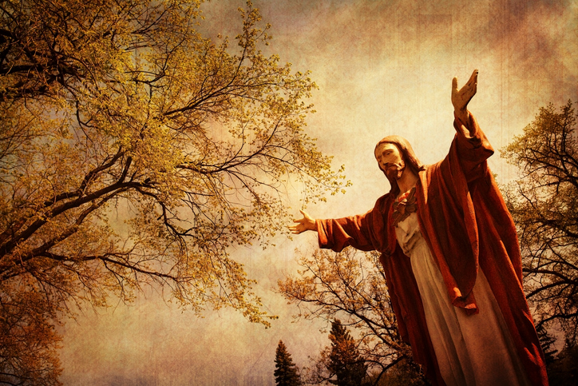
The Synoptic Problem
In Sunday’s Gospel Reading …
29th August 2021 :
In the Gospel of Mark, Jesus tells us :
“Hear me, all of you, and understand.”
BDES

Slide 4
Reflection
Jesus said
I AM
the
Way,
the Truth and the Life.
BDES

Slide 5
Reflection
How will you follow The Way?
BDES

Slide 6
Preparing as communities for World Youth Day 2023
“You are priceless.”
- Pope Francis, Christus Vivit
BDES

Slide 7
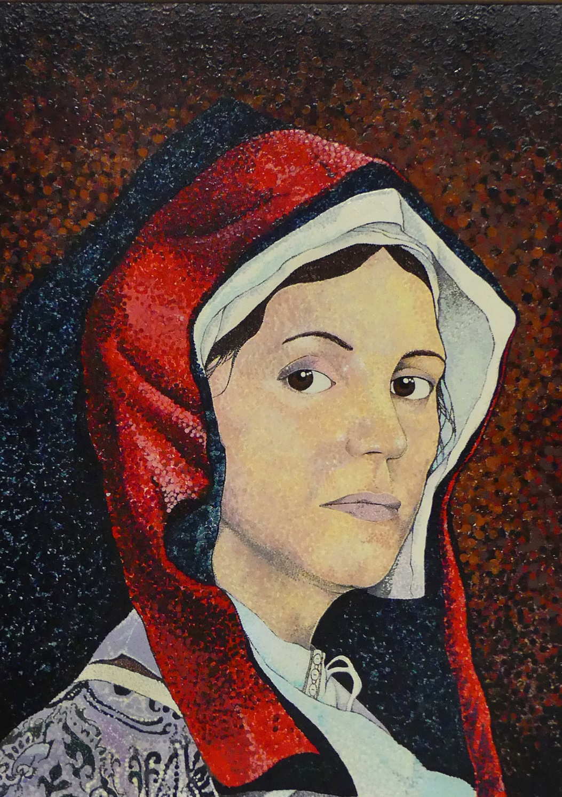
St. Margaret Ward
Feast day : 30th August
Margaret Ward lived in London in the service of a lady when she learned of the severe maltreatment of Father Richard Watson in the Bridewell Prison. She visited him and she managed to smuggle him a rope with which he escaped. She was a logical suspect and was arrested and tortured, but refused to disclose the priest's whereabouts. She was hanged at Tyburn on 30th August 1588, and declared one of the Forty Martyrs … of England and Wales by Pope Paul VI in 1970.
BDES

Slide 8
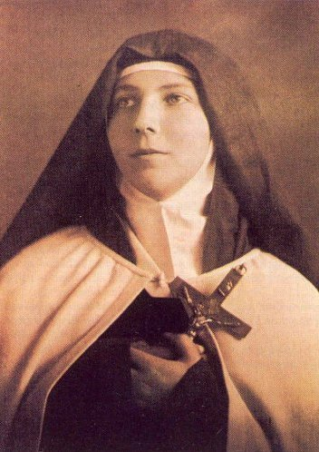
Young Saints # 1 : Saint Teresa of the Andes
St Teresa of the Andes died of leukaemia in 1920, aged only 19.
She was born in 1900 in Chile, as Juana Enriqueta Josephina de Los Sagrados Corazones Fernández Solar.
She was a spirited young person and often argued with her siblings. Once, when her sister Rebeca slapped her, Juana stopped herself from retaliating and kissed her on the cheek.
She was an enthusiastic swimmer and enjoyed playing the piano.
While still quite young, she read the autobiography of St Thérèse of Lisieux and was deeply affected by the example of the saint.
She became a novice of the Order of Discalced Carmelites at the age of 18. She spent time writing letters to others, encouraging them and sharing thoughts on her spiritual life.
Dying in the Spanish flu pandemic, she was allowed to take her final vows early.
BDES

Slide 9
Looking Forward
~ A Roadmap for Saints ~
Wednesday 1st September 2021
Brentwood Diocese Education Service

