Slide 1
Looking Forward
~ A Roadmap for Saints ~
Monday 6th September 2021
Brentwood Diocese Education Service

Slide 2
We are Looking Forward
~ In the Year of St Joseph ~ In the Year of the Family ~
At the start of the academic year,
what are you looking forward to?
Think about living in the school community.
How are you going to do follow the right road?
How are you going to help others along the way?

Slide 3
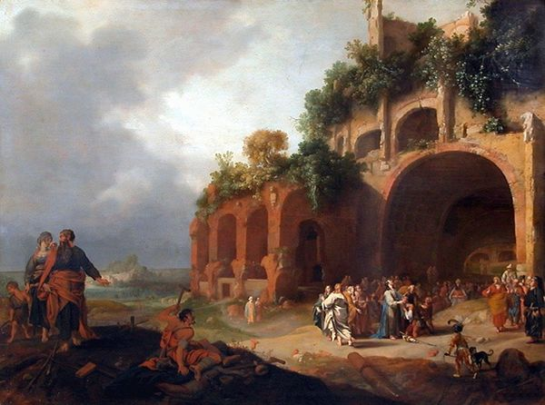
The Synoptic Problem
In Sunday’s Gospel Reading …
5th September 2021 :
In the Gospel of Mark, people say of Jesus :
“He has done all things well”
BDES

Slide 4
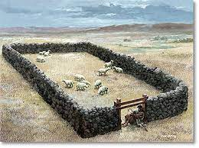
Reflection
Jesus said
I AM
the
Gate
….. whoever enters through me will be saved.
BDES

Slide 5
Reflection
How can I imitate Jesus’ openness to people of different races and cultures?
What is my attitude to people with disabilities?
- Fr Adrian Graffy
Let us pray that we may use all our senses in the service of the gospel.
BDES

Slide 6
Preparing as communities for World Youth Day 2023
“Imitating the Saints does not mean copying their lifestyle and their way of living holiness. You have to discover who you are and develop your own way of being holy, whatever others may say or think.”
- Pope Francis, Christus Vivit
BDES

Slide 7
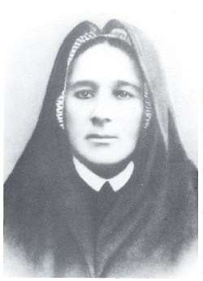
Blessed Eugenia Picco
Feast day : 7th September
She was born in the district of Milan called Crescenzaga in 1867. Her father was a famous musician and she was left with her grandparents while her parents were away, then her father disappeared and her home life was difficult. She ran away from home at the age of 20 and joined the Congregation of the Little Daughters of the Sacred Hearts of Jesus and Mary. She became their Superior General in 1911 and was a kind mother to all she met. She suffered ill health patiently, dying in 1921. Blessed Eugenia is is remembered as a model of virtue and a wise teacher.
BDES

Slide 8
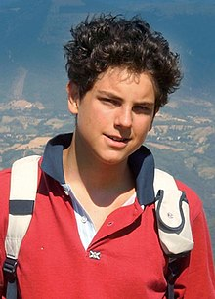
Young Saints # 2 : Blessed Carlo Acutis
Carlo Acutis died of leukaemia in 2006, aged only 15.
He was born in 1991 in England of Italian parents and moved to Italy when he was small.
At home he would spend time with friends whose parents were going through a divorce and in school he stood up for people who were being bullied. He volunteered to work with the homeless but was also an amateur computer programmer who enjoyed films and playing on his PlayStation.
He spent time documenting Eucharistic miracles from around the world on his website.
Following a miracle attributed to him he was beatified in 2020 by Pope Francis.
BDES

Slide 9
Looking Forward
~ A Roadmap for Saints~
Monday 6th September 2021
Brentwood Diocese Education Service

