Slide 1
Looking Forward
~ A Roadmap for Saints ~
Monday 13th September 2021
Brentwood Diocese Education Service

Slide 2
We are Looking Forward
~ In the Year of St Joseph ~ In the Year of the Family ~
Where are you now on your road to sainthood?
Do you recognise Jesus? Do you want to follow him?
Do you know that he will keep you and guide you on your way?
Are you living life to the full?
Are you doing your best with the gifts and talents you’ve been given?
Are you prepared to forgive others?
Are you looking forward?

Slide 3
The Synoptic Problem
In Sunday’s Gospel Reading …
12th September 2021 :
In the Gospel of Mark, Jesus asks :
“Who do you say I am?”
BDES

Slide 4
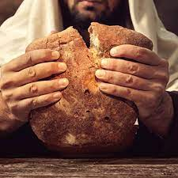
Reflection
Jesus said
I AM
the
Bread of Life
BDES

Slide 5
Reflection
How does Jesus sustain us on the journey?
BDES

Slide 6
Preparing as communities for World Youth Day 2023
“Make the most of these years of your youth. Don’t observe life from a balcony.”
- Pope Francis, Christus Vivit
BDES

Slide 7
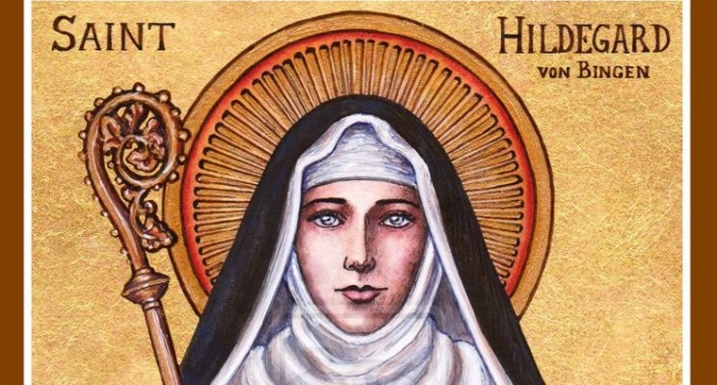
St. Hildegard of Bingen
Feast day :
17th September
Hildegard was born in 1098 and experienced visions from a young age. She joined a Benedictine convent, of which she became the abbess. She had extraordinary gifts and as well as being remembered as a visionary, she achieved fame as a scholar, a writer, a composer, a philosopher and a mystic. She wrote theological, botanical and medical texts as well as letters, hymns, antiphons, and poems. She is one of the few known composers of the Middle Ages to have written both the music and the words. She wrote the earliest surviving mystery play and invented a language; she is seen as the founder of scientific natural history in Germany. On 7th October 2012, Pope Benedict XVI named her a Doctor of the xxx Church, in recognition of “her holiness of life and the originality of her teaching.”
BDES

Slide 8
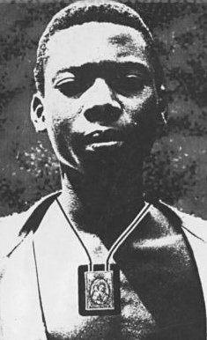
Young Saints # 3 : Blessed Isidore Bakanja
Isidore was born in 1887 at Bokandela in what was then the Congo Free State. He became a Christian at the age of 18 and wore the scapular of Our Lady of Mount Carmel as we can see in the picture. He was told to stop spreading the Gospel by his plantation supervisor and to stop wearing the scapular. When he refused, he was repeatedly beaten and chained. As he lay dying as a result of his ill treatment, he told the plantations inspector who had rescued him : “tell them that I am dying because I am a Christian.” Missionaries in the area visited Isidore and urged him to forgive the supervisor. He assured them that he already had, declaring “When I am in heaven, I shall pray for him very much.” He was beatified on 24th April 1994 by Pope John Paul II and his feast day is 15th August.
BDES

Slide 9
Looking Forward
~ A Roadmap for Saints ~
Monday 13th September 2021
Brentwood Diocese Education Service

