Slide 1
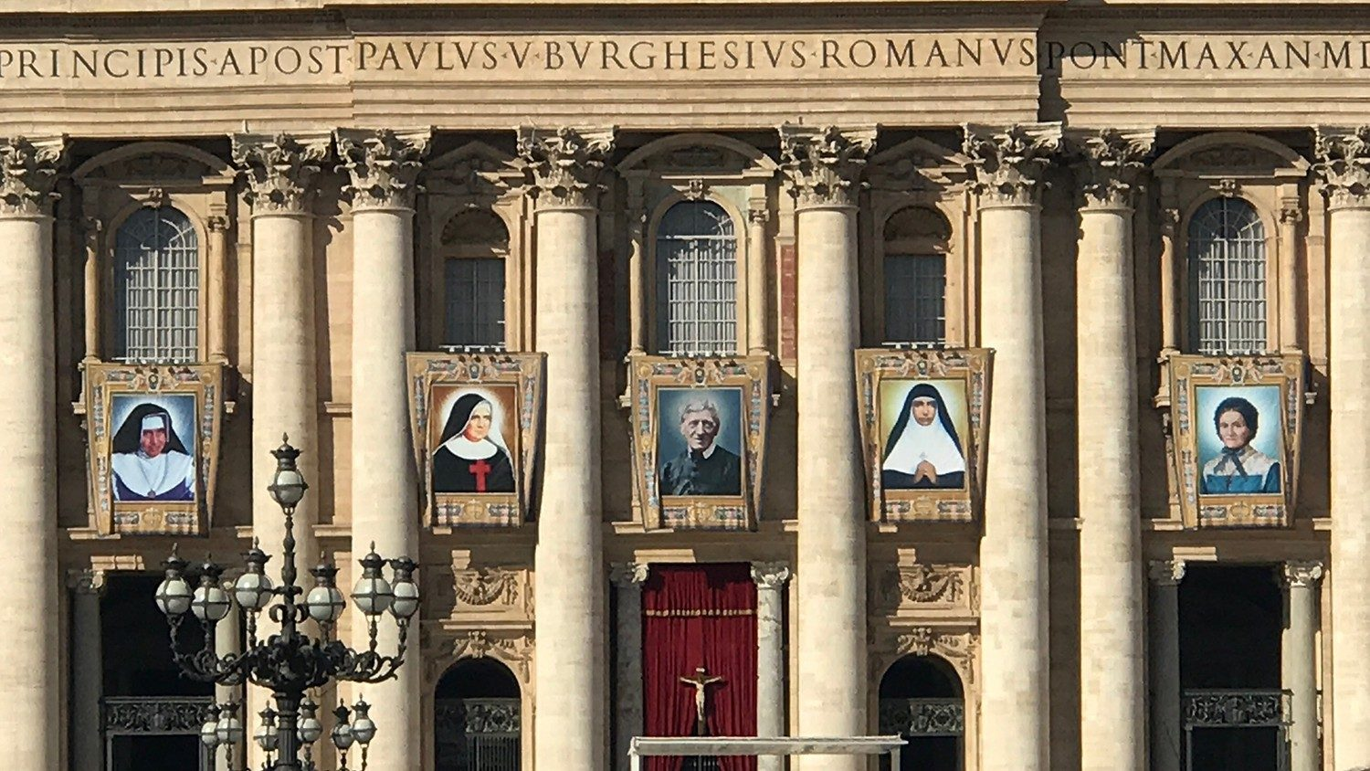
Looking Forward
~ A Roadmap for Saints ~
Monday 20th September 2021
Brentwood Diocese Education Service

Slide 2
We are Looking Forward
~ In the Year of St Joseph ~ In the Year of the Family ~
A Roadmap for Saints
Like any journey, in life, we need a plan and a roadmap.
Without these, we will not know where we are or where we are going.
What is your roadmap in life?
How are you following Jesus?

Slide 3
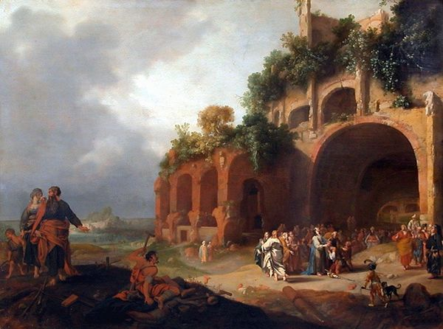
The Synoptic Problem
In Sunday’s Gospel Reading …
19th September 2021 :
In the Gospel of Mark, Jesus teaches us :
“If anyone wishes to be first, he shall be the servant of all.”
BDES

Slide 4
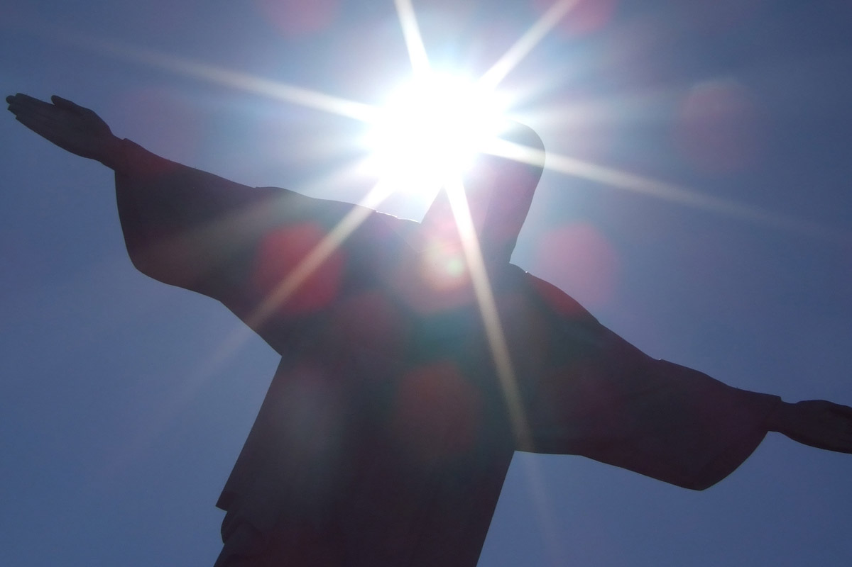
Reflection
Jesus said :
I AM
the
Light of the World
BDES

Slide 5
Preparing as communities for World Youth Day 2023
“Just as you try not to lose your connection to the internet, make sure that you stay connected with the Lord.”
- Pope Francis, Christus Vivit
BDES

Slide 6
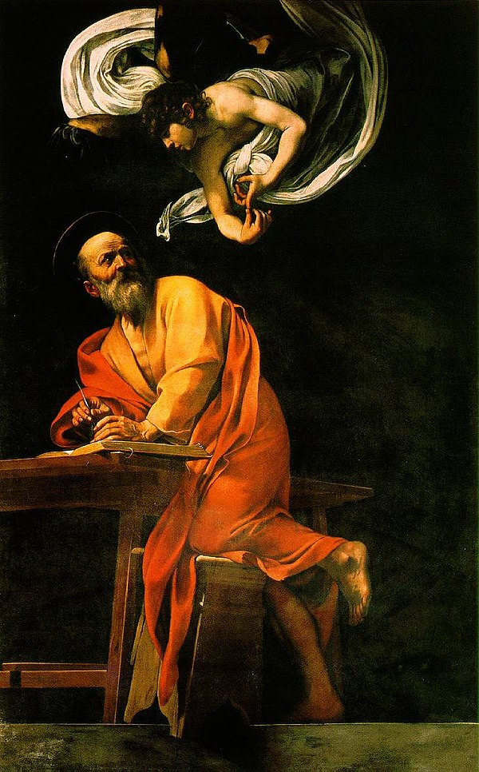
St Matthew
Feast day : 21st September
St Matthew was one of Jesus’ disciples who witnessed His Ascension into heaven.
Matthew was a tax collector, as such he would have been despised by his fellow Jews as he worked for the Romans. Matthew invited Jesus to dinner, causing the Pharisees and Scribes to criticise Jesus. Jesus’ response, recorded in the Gospel, was that He had not come to call the righteous but to call sinners to repent.
St Matthew is remembered as one of the Four Evangelists.
He died as a martyr and his feast is celebrated on 21st September.
BDES

Slide 7
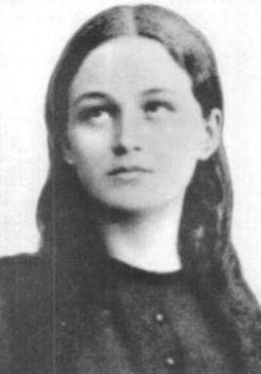
Young Saints # 4 : Saint Clelia Barbieri
Clelia Barbieri died at the age of 23 in 1870.
She is seen as the youngest founder of a religious order in the history of the Catholic Church.
She was born in poverty in Bologna in Italy, where she made her First Communion at the age of eleven.
When she was fourteen she became an assistant teacher and the parish priest entrusted her with the teaching and guidance of girls in doctrine.
She then founded the religious order of the Little Sisters of the Mother of Sorrows, who looked after the poor and sick.
She died of tuberculosis and after her death her voice continued to be heard.
She was made a Saint by Pope John Paul II in 1989 and the Sisters of her order continue to work in areas like Tanzania and India today.
BDES

Slide 8
Looking Forward
~ A Roadmap for Saints ~
Monday 20th September 2021
Brentwood Diocese Education Service

