Slide 1
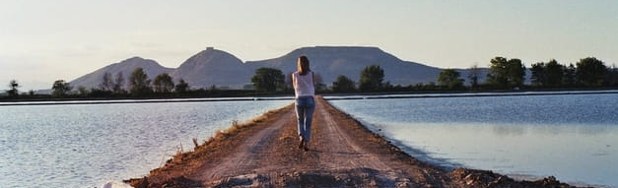
Looking Forward
~ A Roadmap for Saints ~
Monday 27th September 2021
Brentwood Diocese Education Service

Slide 2
We are Looking Forward
~ In the Year of St Joseph ~ In the Year of the Family ~
How to follow Jesus? How to do as Jesus asks?
Sometimes it in the big things, the challenges, the difficult things, the major decisions, the changing of one’s life and attitudes.
And sometimes … It’s in the little things.
We all belong to Christ.
The small acts of kindness, the smiles, the politeness, being understanding, giving the benefit of the doubt, the words of thanks and encouragement and apology.

Slide 3
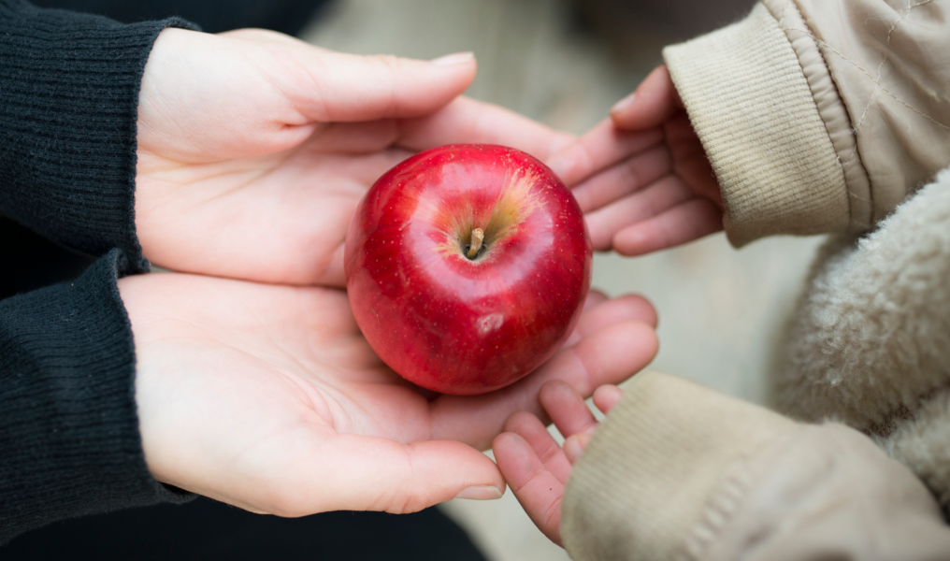
The Synoptic Problem
In Sunday’s Gospel Reading …
26th September 2021 :
In the Gospel of Mark, Jesus says :
“Anyone who gives you a cup of water to drink because you belong to Christ, will surely not lose his reward.”
BDES

Slide 4
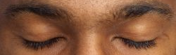
Reflection
Silently, in the privacy of your heart … make a little list of little things that you can do for others.
BDES

Slide 5
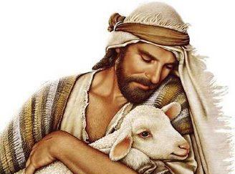
Reflection
Jesus said :
I AM
the
Good Shepherd
BDES

Slide 6
Preparing as communities for World Youth Day 2023
“Dream freely and make good decisions.”
- Pope Francis, Christus Vivit
BDES

Slide 7
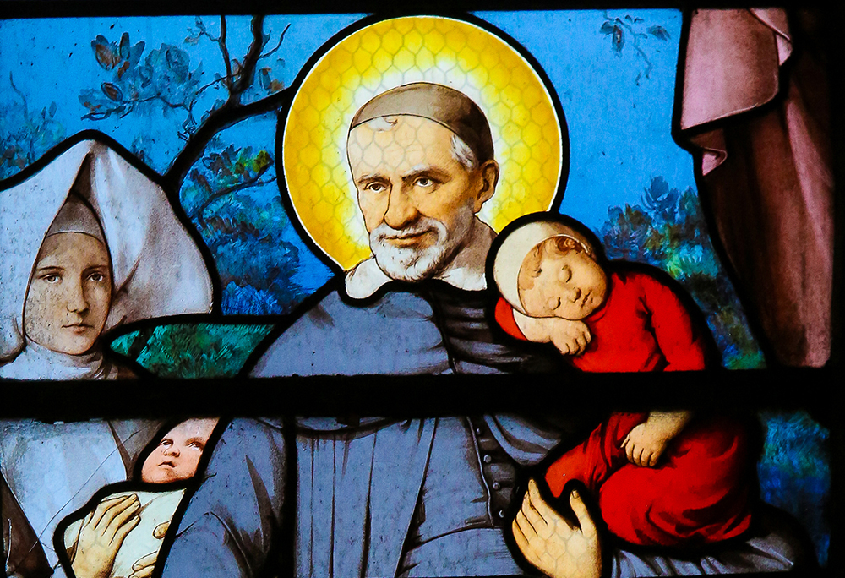
St. Vincent de Paul
Feast day :
27th September
Vincent was born in Gascony, France in 1581 and was ordained a priest in 1600. He dedicated his life to serving the poor and in 1622 was appointed as chaplain to the galleys, specifically ministering to the galley slaves imprisoned in Paris. He became the superior of a new order known as the Congregation of the Mission, which we now call the Vincentians. Priests of the order take vows of poverty and devote themselves to care for the poor. Vincent conducted retreats for priests to help them develop spiritually, established seminaries to train them and also founded the Daughters of Charity. He died in 1660 and was canonised in 1737.
BDES

Slide 8
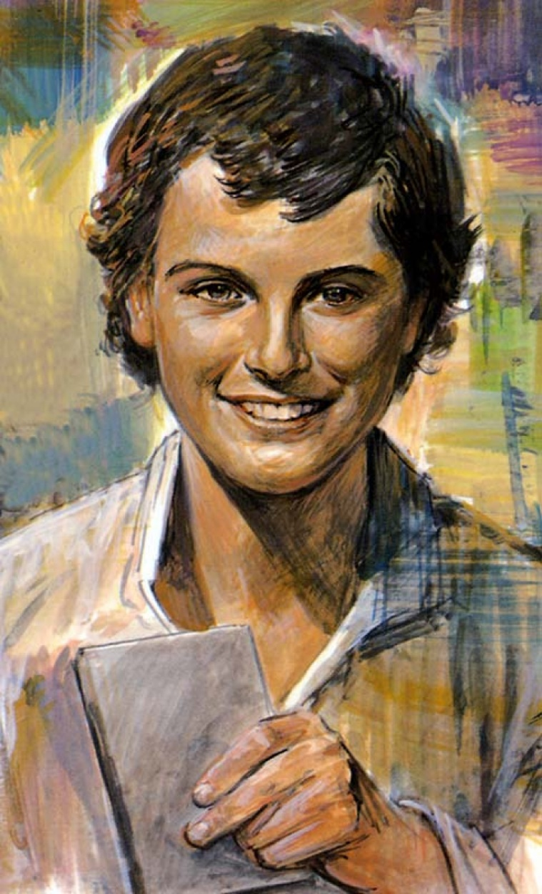
Young Saints # 5 : Saint Dominic Savio
Dominic was born in 1842 and was a student of St John Bosco. He began his studies to be a priest very early but died at the age of only 14 in 1857. St John Bosco wrote a biography of his pupil, who was a pious young man and devoted to the Catholic faith. When he was canonised a saint by Pope Pius XII in 1954, it was on account of his personal holiness and “heroic virtue”. At the time, he was the youngest non-martyr to be made a saint.
He suffered his illness patiently and was an inspiration to others. He said : “Let me do what I can this year; if I am here next year, I'll let you know what my plans are.”
Pope Pius XI described him as “small in size, but a towering giant in spirit.”
BDES

Slide 9
Looking Forward
~ A Roadmap for Saints ~
Monday 27th September 2021
Brentwood Diocese Education Service

