Slide 1
Looking Forward
~ A Roadmap for Saints ~
Monday 4th October 2021
Brentwood Diocese Education Service

Slide 2
We are Looking Forward
~ In the Year of St Joseph ~ In the Year of the Family ~
A Roadmap for Saints
When we travel we sometimes take the wrong road.
On our journey in life we need to see that sometimes we make a wrong decision which leads us astray.
It is, however, always possible
to find our way back to Jesus.

Slide 3
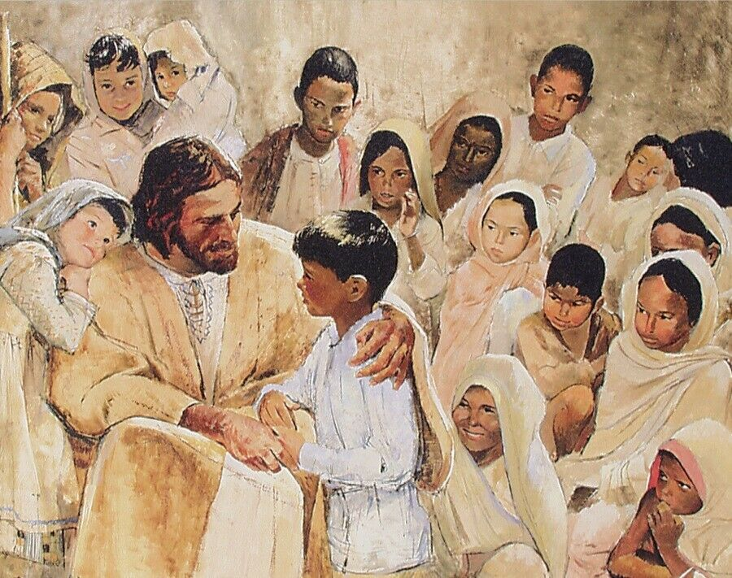
The Synoptic Problem
In Sunday’s Gospel Reading …
3rd October 2021 :
In the Gospel of Mark, Jesus says to the disciples:
“Let the children come to me.”
BDES

Slide 4
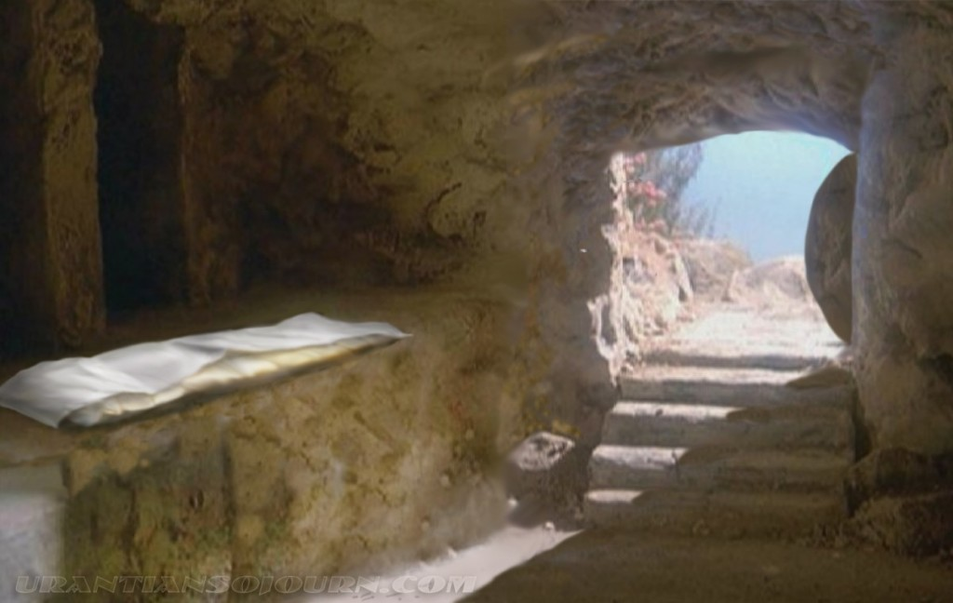
Reflection
Jesus said:
I AM
the Resurrection and the
Life
BDES

Slide 5
Preparing as communities for World Youth Day 2023
“Even if you make mistakes, you can always get up and start over, for no one has the right to rob you of hope.”
- Pope Francis, Christus Vivit
BDES

Slide 6
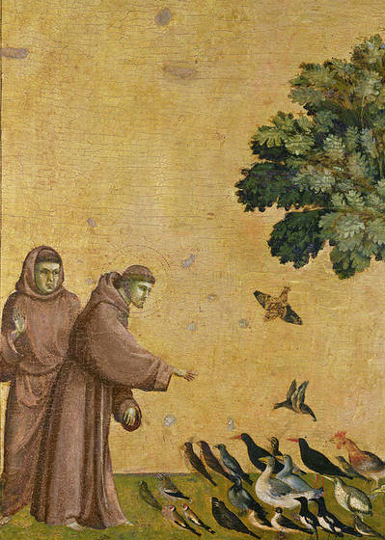
St Francis of Assisi
Feast day : 4th October
St Francis is one of the most recognised and revered saints. He founded the Order of the Friars Minor (Franciscans) and the Order of St Clare, as well as an order for lay people.
He was born in the late 12th century in Italy of wealthy parents, living a good life, becoming a soldier and going on pilgrimage to Rome. He then chose to live a simple life, having lost interest in his former pastimes, and attracted many followers. The Pope agreed to the group being recognised by the Church. Francis travelled widely, to Egypt where he met the Sultan and to the Holy Land.
He created the first Nativity scene, using living animals. In 1224 Francis received the stigmata, dying on 3rd October 1226. He believed nature is the ‘mirror of God’ and was declared the patron saint xxxx of ecology in 1979.
BDES

Slide 7
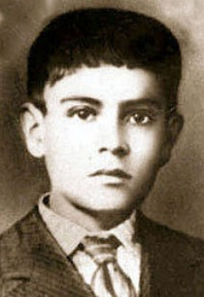
Young Saints #6 : Saint Jose Sanchez del Rio
Jose Sanchez del Rio died at the age of 15 in 1928.
He was a Mexican Cristero who was put to death because he refused to give up the Catholic faith.
He fought against the government, who wanted to destroy the Catholic church and was captured.
He was tortured and his parents who had tried to get him released had to watch him die.
He refused to give up his faith shouting “Viva Christo Rei!” (“Long live Christ the King!” and as a result, following his martyrdom, the cause for his sainthood began in 1996.
He was made a saint in 2016 when Pope Francis canonised him on 16th October.
He has a seminary named after him in Minnesota in the USA.
BDES

Slide 8
Looking Forward
~ A Roadmap for Saints ~
Monday 4th October 2021
Brentwood Diocese Education Service

