Slide 1
Looking Forward
~ A Roadmap for Saints ~
Monday 11th October 2021
Brentwood Diocese Education Service

Slide 2
We are Looking Forward
~ In the Year of St Joseph ~ In the Year of the Family ~
What do we need to follow the road to sainthood?
Consider what St Paul teaches us about love :
Love is patient. Love is kind. Love does not delight in evil but rejoices in the truth. Love never fails. These three things remain : faith, hope and love. But the greatest of these is love.
Wishing you the blessings to be found in patience, kindness, truth, faith, hope and love.

Slide 3
The Synoptic Problem
In Sunday’s Gospel Reading …
10th October 2021 :
In the Gospel of Mark, Jesus says :
“All things are possible for God.”
BDES

Slide 4
Reflection
“May the God of hope fill you with all the joy and peace in your faith, so that in the power of the Holy Spirit you may be rich in hope.” xxxxxxx
– Romans, 15 : 13
BDES

Slide 5
Reflection
Jesus said :
I AM
the
True Vine
BDES

Slide 6
Preparing as communities for World Youth Day 2023
“Don’t go through life anaesthetized or approach the world like tourists.”
- Pope Francis, Christus Vivit
BDES

Slide 7
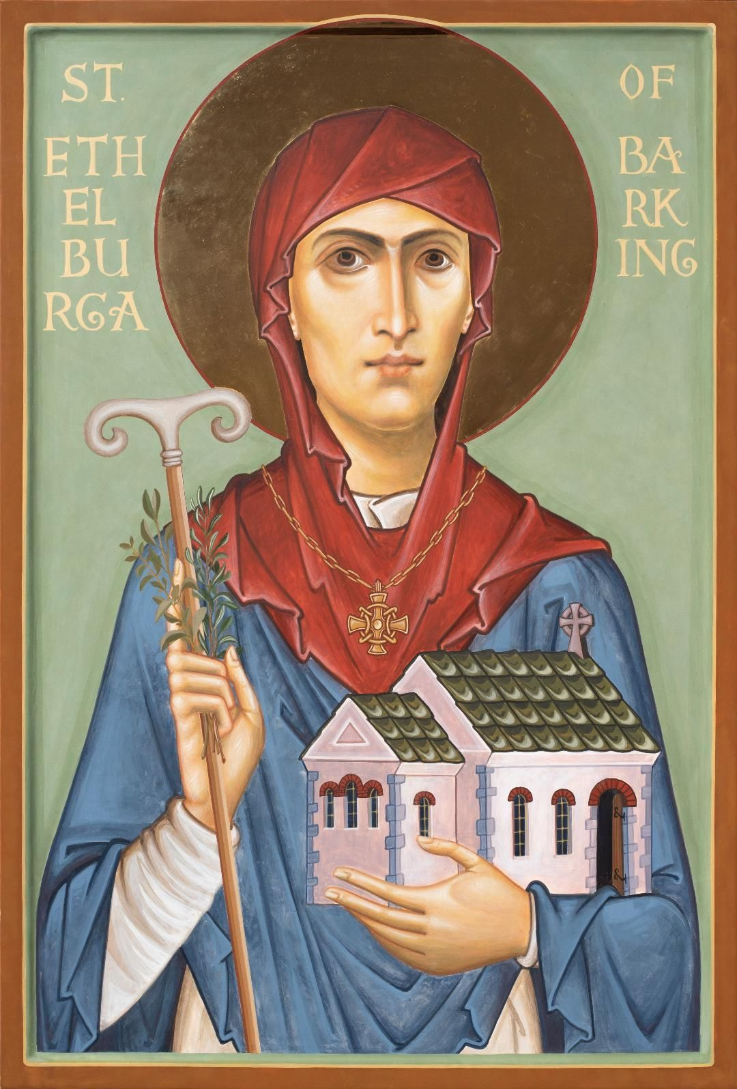
St. Ethelburga of Barking
Feast day :
11th October
A local saint of our diocese, St Ethelburga (Aethelburh) was the sister of St Erconwald, a 7th-century bishop of London, and abbess of a monastery for both men and women in Barking. The Anglo-Saxon historian Saint Bede describes her as “upright in life and constantly planning for the needs of her community.”
BDES

Slide 8
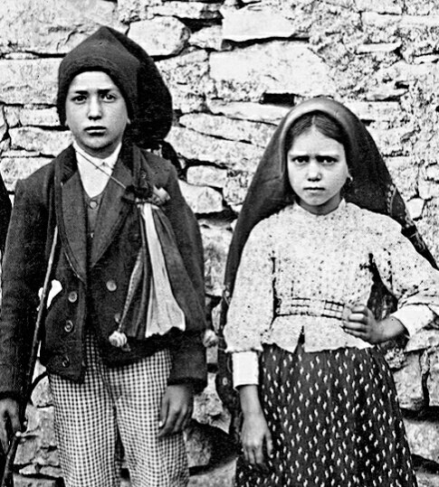
Young Saints # 7 : SS Francisco and Jacinta Marto
(Francisco de Jesus Marto (1908 – 1919) and Jacinta de Jesus Marto (1910 –1920) were a brother and sister from a small village near Fátima in Portugal. With their cousin Lucia they witnessed three apparitions of the Angel of Peace in 1916 and a number of apparitions of the Blessed Virgin Mary in 1917. As a result of this, Our Lady is also known as Our Lady of Fátima, which is now a major pilgrimage destination.
The two children were canonised by Pope Francis in 2017, on the 100th anniversary of the first apparition of Our Lady. They are among the youngest Catholic saints, with Jacinta being the youngest saint who did xxxxxxxx not die a martyr’s death.
BDES

Slide 9
Looking Forward
~ A Roadmap for Saints ~
Monday 11th October 2021
Brentwood Diocese Education Service

