Slide 1
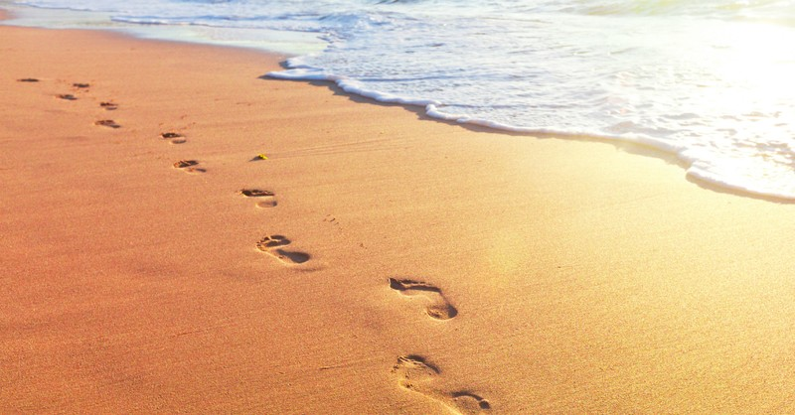
Looking Forward
~ A Roadmap for Saints ~
Monday 18th October 2021
Brentwood Diocese Education Service

Slide 2
We are Looking Forward
~ In the Year of St Joseph ~ In the Year of the Family ~
A Roadmap for Saints
We all travel at different speeds on our journey in life.
We need sometimes to slow down and contemplate both the world around us and the infinite mercy of God.
Are you too busy hurrying onwards?
How can you find time to reflect on God’s love?

Slide 3
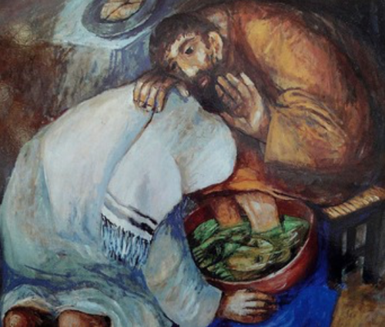
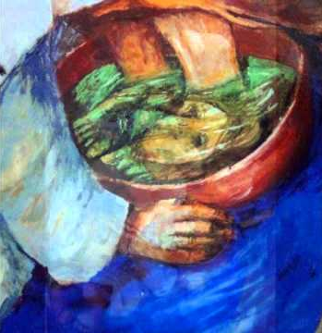
The Synoptic Problem
In Sunday’s Gospel Reading …
17th October 2021 :
In the Gospel of Mark,
Jesus teaches:
“The Son of Man did not come to be served but to serve.”
BDES

Slide 4
Time to reflect
BDES

Slide 5
Preparing as communities for World Youth Day 2023
“The Saints next door :
in their daily perseverance I see the holiness of the Church … it is a holiness found in our next-door neighbours, those who, living in our midst, reflect God’s presence.”
- Pope Francis, Gaudete et Exscultate
BDES

Slide 6
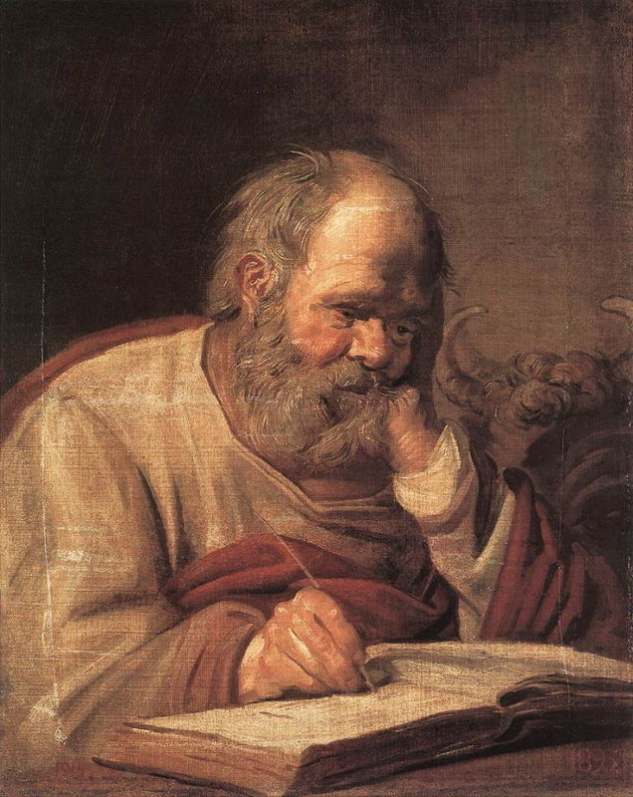
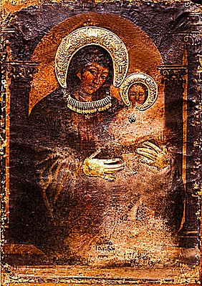
St Luke
Feast day : 18th October
One of the four Evangelists, the Gospel writers, Saint Luke was a follower of St Paul and by tradition a physician.
He is thought to have written both the Gospel that bears his name and the Acts of the Apostles, found in the New Testament.
As well as being the patron saint of doctors he is also the patron saint of artists as according to an ancient story he was the painter of an icon of the Madonna and Christ Child.
BDES

Slide 7
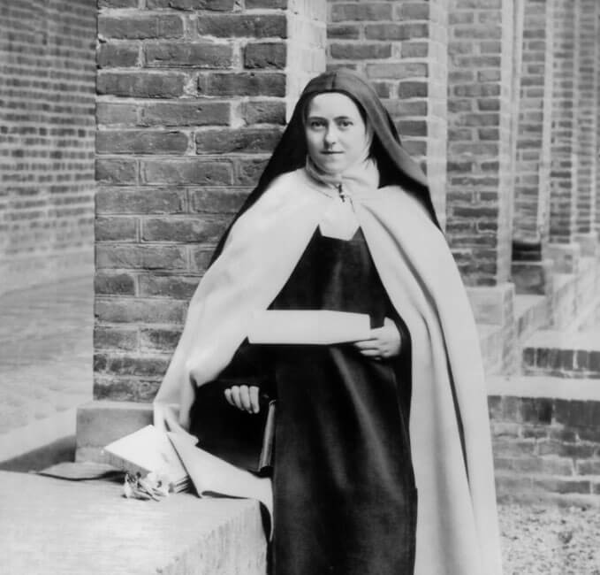
Young Saints # 8 : Saint Therese of Lisieux
Saint Therese of Lisieux is know as the Little Flower of Jesus.
She was described by Pope Pius X as the greatest saint of modern times.
She died at the age of 24 of tuberculosis having become a nun at the age of 15. Both her parents were made saints by Pope Francis in 2015 and all 4 of her sisters became nuns
She was a member of the order of discalced Carmelites, which was an enclosed order devoted to prayer. She felt great peace in the convent.
She had a talent for explaining doctrine to others who were not as well educated as she was and was a very good teacher using ideas from the modern world to help her in this.
She described the path to heaven as the ‘little way’ imploring Jesus to be the ‘lift by which I may be raised up to God.’
Her image is available because of the photographs her sister took both before she joined and whilst she was in the convent.
BDES

Slide 8
Looking Forward
~ A Roadmap for Saints ~
Monday 18th October 2021
Brentwood Diocese Education Service

