Slide 1
Looking Forward
~ A Church That Looks Forward ~
Monday 1st November 2021
Brentwood Diocese Education Service

Slide 2
We are Looking Forward
~ In the Year of St Joseph ~ In the Year of the Family ~
After the October half-term holiday,
families often begin to look forward to Christmas.
It’s not quite Advent yet, but let’s consider
what we’re ultimately looking forward to celebrating.
The late Cardinal Archbishop of Westminster Basil Hume was once asked :
“What does Christmas meant to you?”
The Cardinal replied :
“The great and awesome God became man for me, that’s what Christmas means to me.”
Let us begin to look forward to the celebration with this awesome Good News in mind.
BDES

Slide 3
The Synoptic Problem
In Sunday’s Gospel Reading …
31st October 2021 :
In the Gospel of Mark, Jesus says :
“Love your neighbour as yourself.”
BDES

Slide 4
Reflection
“Lord, make me an instrument of your peace.” x – Prayer of St Francis
BDES

Slide 5
Preparing as communities for World Youth Day 2023
“I thank God that many families, which are far from considering themselves perfect, live in love, fulfil their calling and keep moving forward.”
- Pope Francis, Amoris Laetitia
BDES

Slide 6
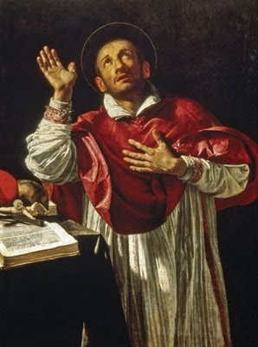
St. Charles Borromeo
Feast day :
4th November
Carlo Borromeo (1538–1584) was Archbishop of Milan and a cardinal of the Catholic Church. He was responsible for important Church reforms, including the founding of seminaries for the education of priests. He was a great help to English Catholics in Italy who had fled persecution at home under Elizabeth I, and carried on his person a picture of the martyred English bishop John Fisher.
BDES

Slide 7
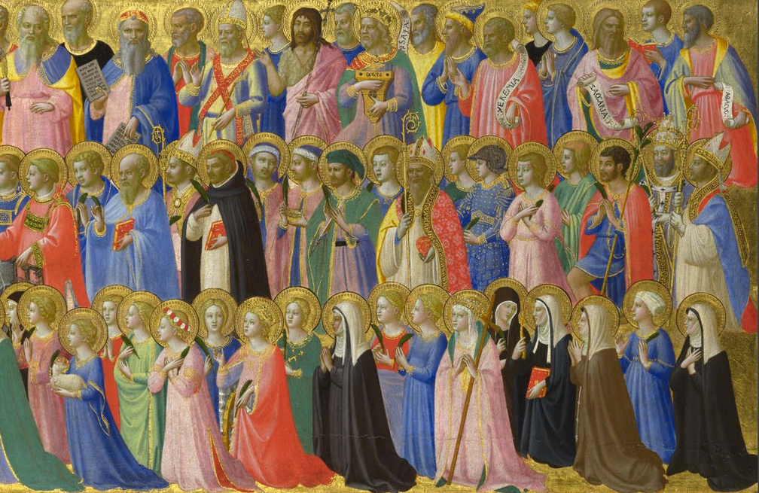
Saints and schools # 1 : All Saints
On 1st November each year, the Solemnity of All Saints celebrates all the saints of the Church, known and unknown.
After this I had a vision of a great multitude, which no one could count, from every nation, race, people, and tongue. They stood before the throne and before the Lamb, wearing white robes and holding palm branches in their hands. – Revelation, 7-9
All Saints Catholic School in Dagenham was created in 1989 by a merger of Bishop Ward and Sacred Heart schools.
BDES

Slide 8
Looking Forward
~ A Church That Looks Forward ~
Monday 1st November 2021
Brentwood Diocese Education Service

