Slide 1
Looking Forward
~ A Church That Looks Forward ~
Monday 8th November 2021
Brentwood Diocese Education Service

Slide 2
We are Looking Forward
~ In the Year of St Joseph ~ In the Year of the Family ~
As the clocks change and winter draws near, we reflect on and often long for the days of summer.
There are however things to look forward to, including the forthcoming season of Advent
when we prepare for the Nativity.
We can take time to reflect using the example of
the ‘silent saint’ St Joseph
who was quietly present in the life of his family.
BDES

Slide 3
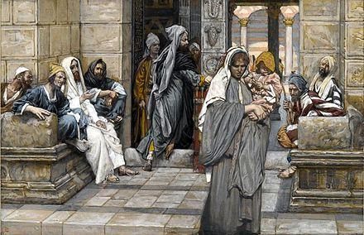
The Synoptic Problem
In Sunday’s Gospel Reading …
7th November 2021 :
In the Gospel of Mark, Jesus points out :
“She gave all she had.”
BDES

Slide 4
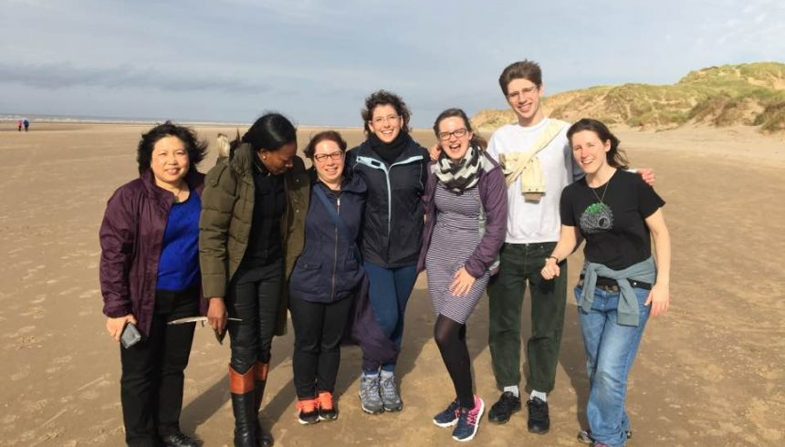
Reflection
“Lord, where there is hatred let me sow love.” x – Prayer of St Francis
BDES

Slide 5
Preparing as communities for World Youth Day 2023
“Join in daily prayer,
read the word of God
and
grow in love.”
- Pope Francis, Amoris Laetitia
BDES

Slide 6
St. Martin of Tours
Feast day :
8th November
Martin of Tours was a former soldier in the Roman army and Bishop of Tours in France. He had become a monk and was made Bishop where he challenged the pagan traditions. There is a story about him giving half his cloak to a beggar; Martin’s cloak was then miraculously became whole again. He is the patron saint of beggars and many other groups as well as being a patron saint of France.
BDES

Slide 7
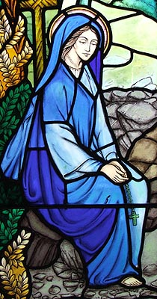
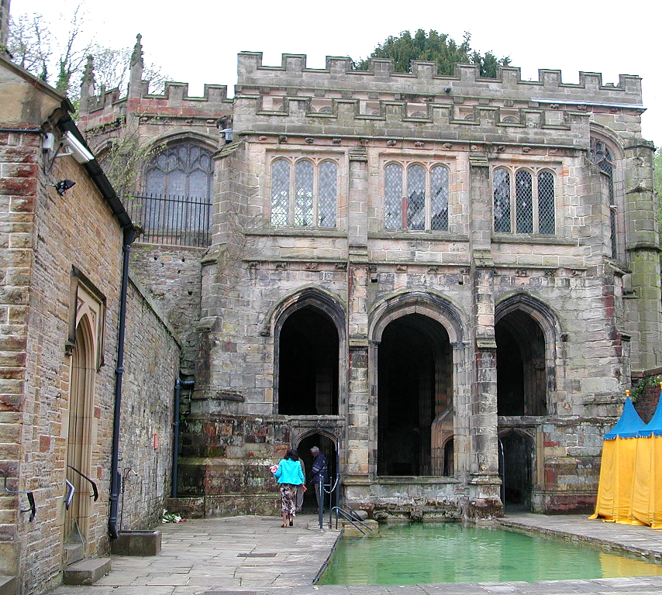
Saints and schools # 2 :
St Winefride’s
St Winefride was a Welsh saint whose feast day is 3rd November. She was killed, by beheading, because of her refusal to marry as she wished to become a nun. Where her head fell a healing spring arose and is still in existence in Holywell, North Wales today. It is still a place of pilgrimage.
St Winefride’s School in Manor Park celebrates God’s love for everyone. It is a place where pupils enjoy learning and growing together, in their caring and welcoming school family.
BDES

Slide 8
Looking Forward
~ A Church That Looks Forward ~
Monday 8th November 2021
Brentwood Diocese Education Service

