Slide 1
Looking Forward
~ A Church That Looks Forward ~
Monday 15th November 2021
Brentwood Diocese Education Service

Slide 2
We are Looking Forward
~ In the Year of St Joseph ~ In the Year of the Family ~
In Anti-Bullying Week, we think of the victims of bullying.
And we speak out against bullying.
Bullying is the exact opposite of the message of the Good News.
Bullying is the exact opposite of our Gospel Values.
Christ was bullied by the soldiers who mocked and tormented Him.
Veronica wiped His face of the blood and the sweat and the tears.
Simon of Cyrene supported Christ in bearing His burden.
Let us be like Veronica and Simon, supporters of the oppressed.
Let us always say NO! to bullying.
BDES

Slide 3
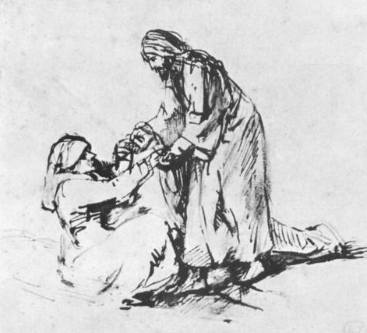
The Synoptic Problem
In Sunday’s Gospel Reading …
14th November 2021 :
In the Gospel of Mark, Jesus says :
“My words will not pass away.”
BDES

Slide 4
Reflection
“Where there is injury, let me bring your pardon, Lord.” x – Prayer of St Francis
BDES

Slide 5
Preparing as communities for World Youth Day 2023
“Unless we cultivate patience, we will always find excuses for responding angrily.”
- Pope Francis, Amoris Laetitia
BDES

Slide 6
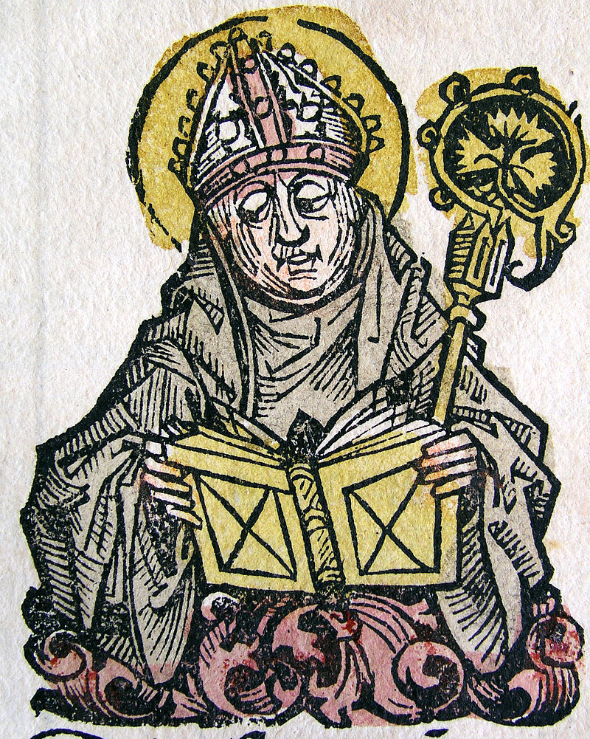
St. Edmund of Canterbury
Feast day :
16th November
St Edmund, along with Our Lady of Lourdes, St Erconwald and St Cedd, is one of the patrons of the Diocese of Brentwood. He was a renowned scholar of the universities of Paris and Oxford and was appointed as Archbishop of Canterbury in 1233. St Edmund’s Hall, one
of the colleges of the University of Oxford, is named after him.
BDES

Slide 7
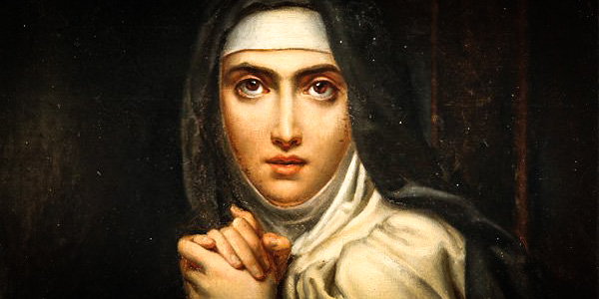
Saints and schools # 3 : St Teresa of Avila
Prayer of St Teresa
Let nothing disturb you. Let nothing frighten you. All things pass. God does not change. Patience achieves everything. Whoever has God lacks nothing. God alone suffices.
Christ has no body now on earth but yours; no hands but yours; no feet but yours. Yours are the eyes through which the compassion of Christ must look out on the world. Yours are the feet with which He is to go about doing good. Yours are the hands with which He is to bless His people.
St Teresa was a Spanish Carmelite nun in the 16th century who is regarded as one of the Doctors of the Church.
St Teresa’s Catholic Primary School in Basildon and The St Teresa Catholic Primary School in Dagenham are named in her honour.
BDES

Slide 8
Looking Forward
~ A Church That Looks Forward ~
Monday 15th November 2021
Brentwood Diocese Education Service

