Slide 1
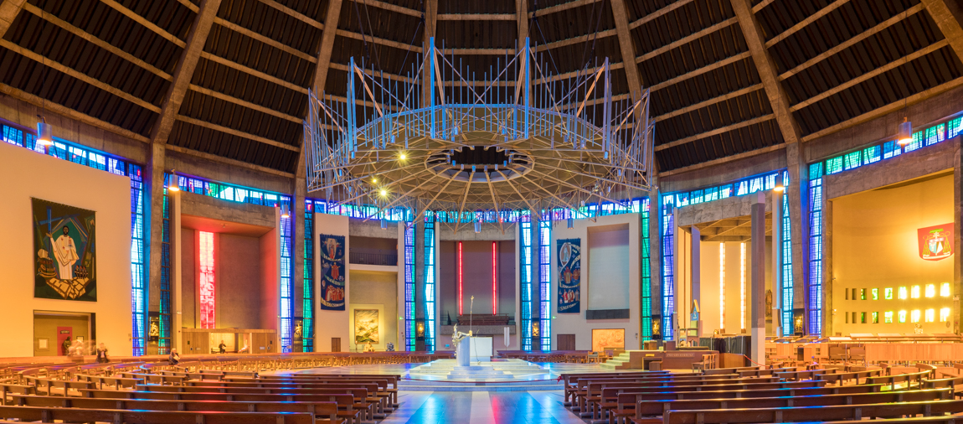
Looking Forward
~ A Church That Looks Forward ~
Monday 22nd November 2021
Brentwood Diocese Education Service

Slide 2
We are Looking Forward
~ In the Year of St Joseph ~ In the Year of the Family ~
As we come to the end of the Liturgical Year and celebrate the feast of Christ the King, Jesus says “Hear my voice”.
It is not enough simply to hear Jesus’ voice.
We also need to act upon His Word.
How have we followed Jesus?
What are we going to do to make a difference looking forward?
BDES

Slide 3
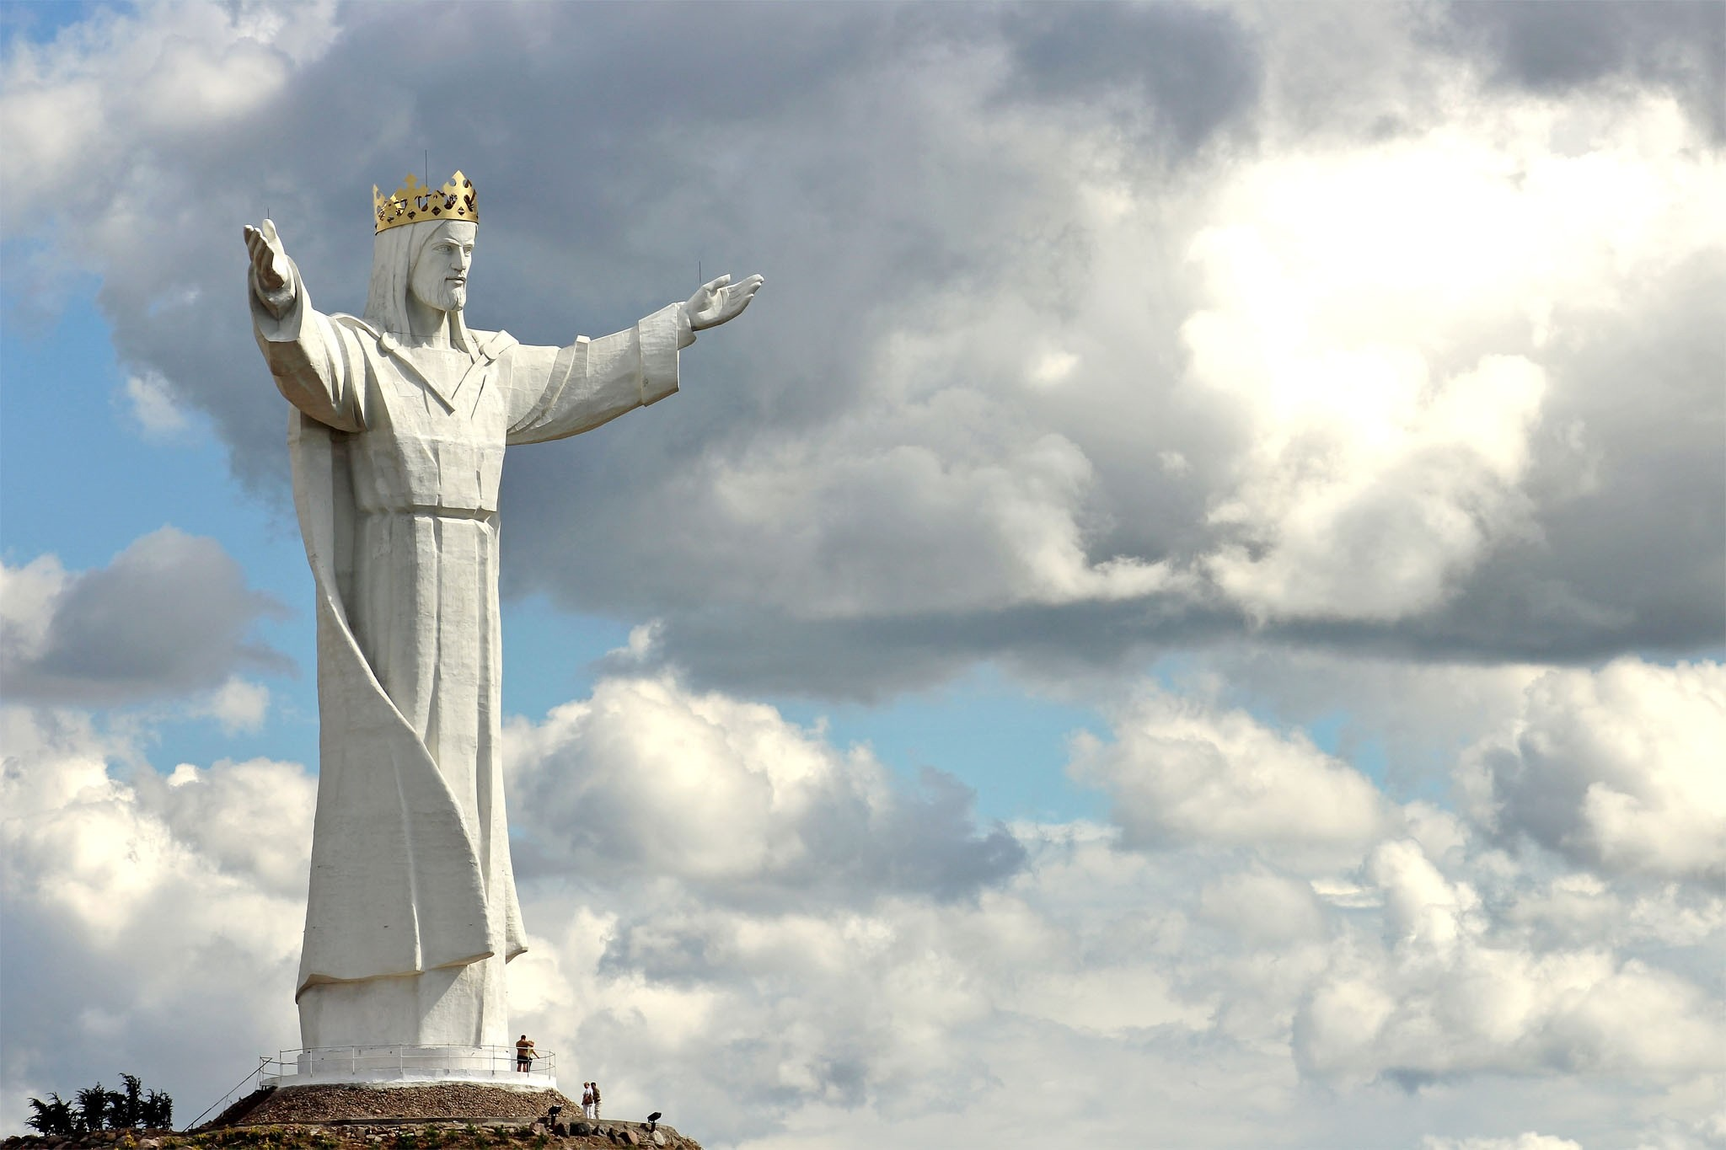
The Synoptic Problem
In Sunday’s Gospel Reading …
21st November 2021 :
In the Gospel of John, Jesus says :
“Everyone that is of the truth, hear my voice.”
BDES

Slide 4
Reflection
“Lord, where there is doubt, let me sow faith.” x – Prayer of St Francis
BDES

Slide 5
Preparing as communities for World Youth Day 2023
“True love frees us from the sour taste of envy.”
- Pope Francis, Amoris Laetitia
BDES

Slide 6
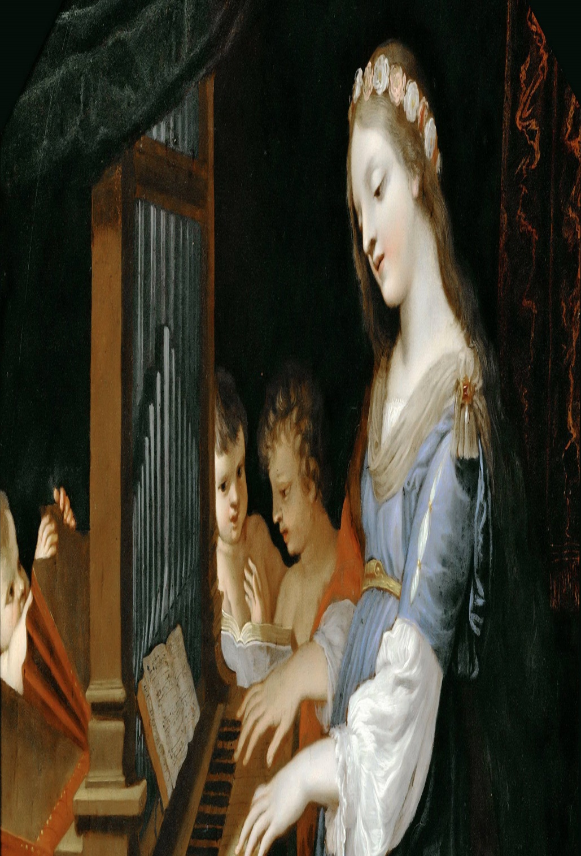
St. Cecilia
Feast day :
22nd November
St Cecilia is the patron saint of musicians with her feast day often being celebrated with concerts and musical events. She symbolizes the central role of music in the Liturgy of the Church.
She lived in Roman times and was executed for her beliefs. At her wedding, she was reputed to have sung her heart to God and was responsible for the conversion of her husband, who was baptized by Pope Urban I. She did good works and distributed her goods to the poor.
Her death followed that of her husband and brother-in -law, and she requested that after her death her home be converted into a church.
BDES

Slide 7
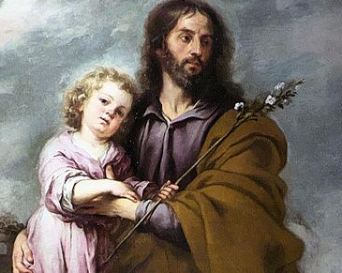
Saints and schools # 3 : St Joseph
Pope Francis describes Saint Joseph as a beloved father, a tender and loving father, an obedient father, an accepting father; a father who is creatively courageous, a working father, a father in the shadows.
There are a number of schools in the diocese dedicated to the Patron of the Universal Church St Joseph. These are the primary schools at Barking, Dagenham, Canvey, Harwich, Upminster, South Woodham Ferrers, and Stanford-le-Hope, the infants and junior schools at Leyton and St Joseph the Worker in Brentwood, which highlight these different aspects.
BDES

Slide 8
Looking Forward
~ A Church That Looks Forward ~
Monday 22nd November 2021
Brentwood Diocese Education Service

