Slide 1
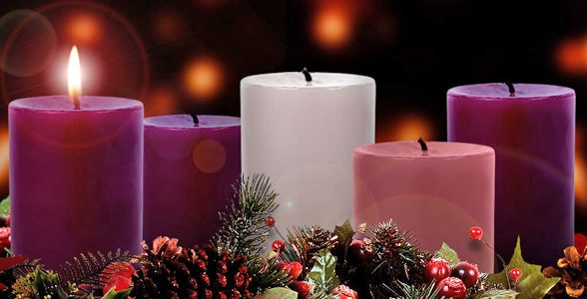
Looking Forward
~ A Church That Looks Forward ~
Monday 29th November 2021
Brentwood Diocese Education Service

Slide 2
We are Looking Forward
~ In the Year of St Joseph ~ In the Year of the Family ~
We are looking forward –
to seeing a new star appear in the sky, prompting those far off to draw near to you. Lord Jesus, draw us to you.
We are looking forward –
to the familiar stable scenes, their mangers standing empty, waiting to receive you. Lord Jesus, come to us anew.
We are looking forward –
to hearing again the angels singing "Glory to God and Peace to all the earth". Lord Jesus, let us take up their song.
We are Looking Forward
~ In Advent ~
BDES

Slide 3
We are Looking Forward
~ In the Year of St Joseph ~ In the Year of the Family ~
We are looking forward –
to seeing shepherds and kings, poor and humble, noble and wealthy, all bowing before you. Lord Jesus, unite us in worship.
We are looking forward –
to remembering a girl from an ordinary background, chosen to bring your hope into the world. Lord Jesus, bring new hope through us.
We are looking forward –
to a small child, wrapped in linen, lying in a manger, weak and helpless, small and reliant on others. Lord Jesus, teach us to depend on you.
We are Looking Forward
~ In Advent ~
BDES

Slide 4
We are Looking Forward
~ In the Year of St Joseph ~ In the Year of the Family ~
We are looking forward –
to seeing, hearing and knowing afresh how you,
the infinite and incomprehensible God,
freely entered Your creation,
becoming humble and tangible
so that we might freely enter your presence. Lord Jesus, we look, we wonder, and we worship. Amen
We are Looking Forward
~ In Advent ~
BDES

Slide 5
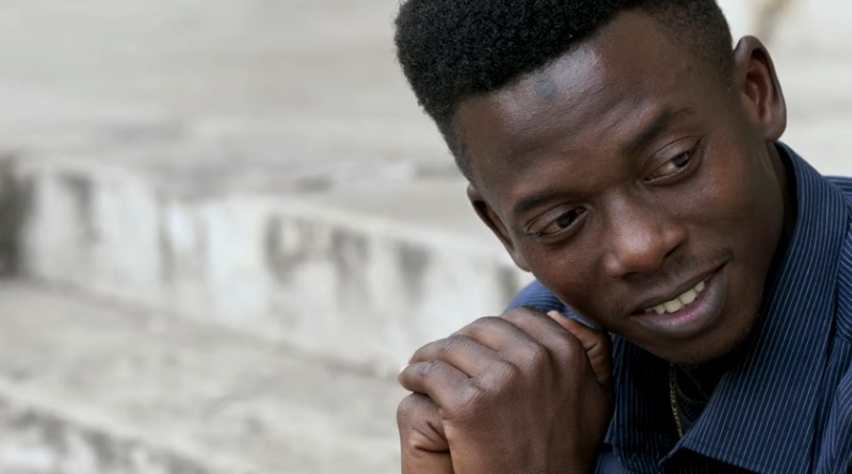
The Synoptic Problem
In Sunday’s Gospel Reading …
28th November 2021 :
In the Gospel of Luke, Jesus says :
“Watch therefore, praying at all times.”
BDES

Slide 6
Reflection
“Where there is despair, let me bring hope.” x – Prayer of St Francis
BDES

Slide 7
Preparing as communities for World Youth Day 2023
“True love values the other person’s achievements.”
- Pope Francis, Amoris Laetitia
BDES

Slide 8
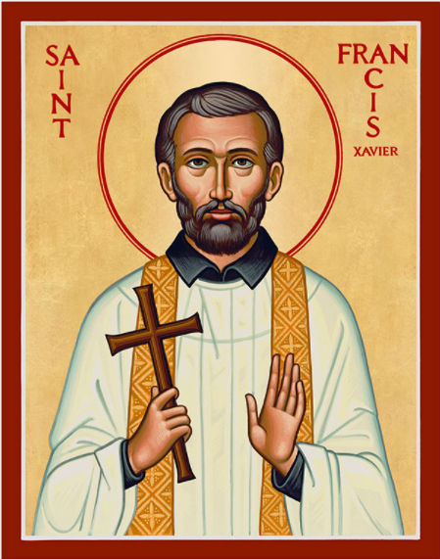
St. Francis Xavier Feast day :
3rd December
St Francis Xavier was a companion of Ignatius of Loyola and in 1534 one of the first seven Jesuits to take vows of poverty and chastity. He led a mission into Asia, evangelised in India, and was the first Christian missionary to enter Japan. He learned the local languages but faced more opposition than he had in India. Francis planned to extend his missionary preaching to China when he died on the island of Shangchuan on 3rd December 1552, aged 46. He was beatified by Pope Paul V in 1619 and canonised by Pope Gregory XV in 1622.
BDES

Slide 9
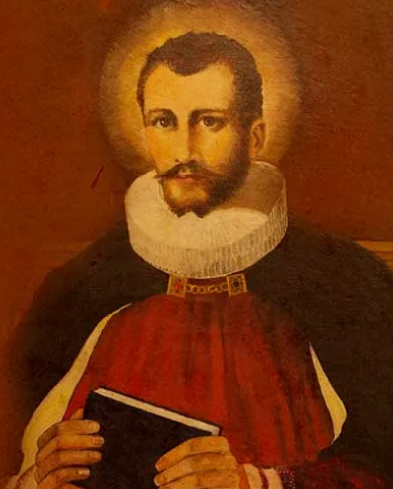
Saints and schools # 5 : St Edmund Campion
Edmund Campion (1540- 1581) was such an accomplished scholar that he was made a fellow of St John’s College, Oxford, at the age of only 17. His Catholic faith led him to walk barefoot to Rome, where he joined the Society of Jesus.
He returned to England as a priest where he ministered to Catholics secretly until he was betrayed. He was imprisoned in the Tower of London, and sentenced to death by hanging, drawing and quartering. He was martyred at Tyburn on 1st December 1581 and canonised by Pope Paul VI in 1970.
In 1962 The Campion School in Hornchurch was founded in his honour and memory by the Society of Jesus.
The school celebrates its 60th anniversary next year.
BDES

Slide 10
Looking Forward
~ A Church That Looks Forward ~
Monday 29th November 2021
Brentwood Diocese Education Service

