Slide 1
About this Powerpoint
To celebrate the Solemnity of the Immaculate Conception, this Powerpoint shows beautiful and thought-provoking images of Our Lady from the crypt of the Basilica of the National Shrine of the Immaculate Conception in Washington, DC.
The images are set to a prayer based on Pope Francis’ Prayer to the Immaculate, an act of veneration to the Blessed Virgin Mary at the Spanish Steps on the occasion of the Solemnity of the Immaculate Conception in 2013.
BDES

Slide 2
How to use this Powerpoint
The Powerpoint can be used, edited, enhanced or adapted according to the needs and wishes of each individual school.
You may wish to augment these slides with images which better reflect the culture, charism, mission, location, concerns, needs or current prayer intentions of the school community or groups or individuals within it.
Similarly, you may wish to adapt and edit the language used as you feel appropriate to your context.
God bless you all on this special day in the Church’s calendar.
BDES

Slide 3
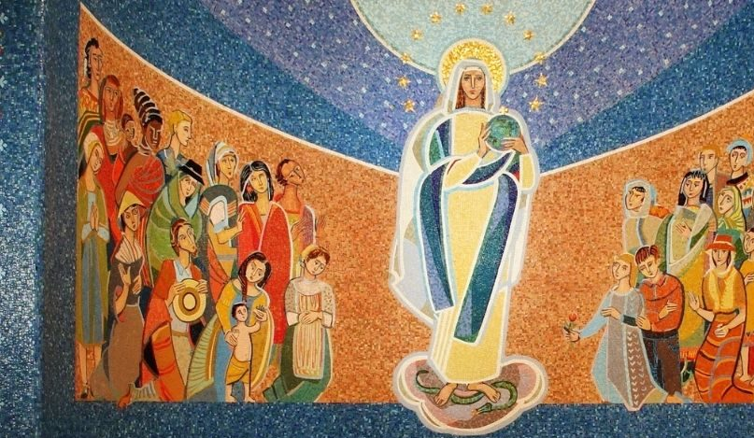
Feast of the Immaculate Conception
Our Lady of the Missions
8th December 2021
BDES

Slide 4
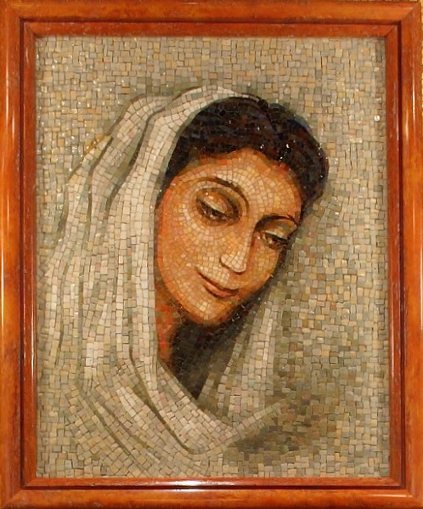
Virgin most holy and immaculate, to you, our honour and protector, do we turn with loving trust.
Our Lady of Ephesus
BDES

Slide 5
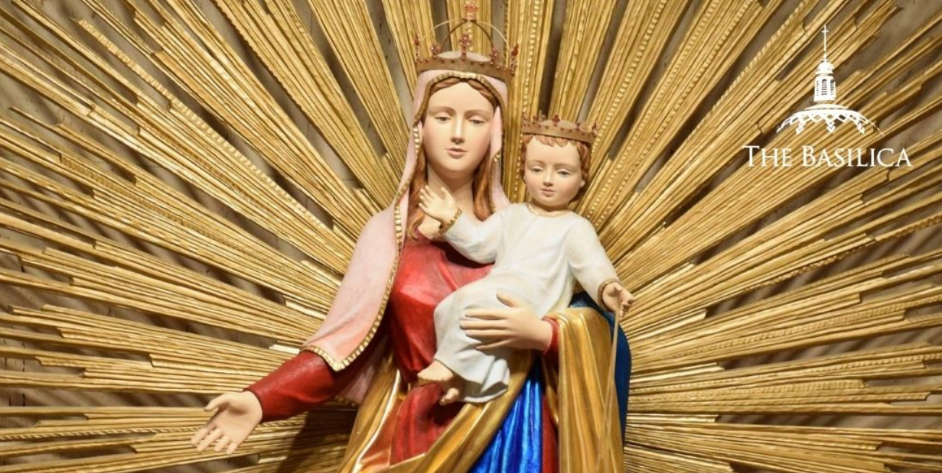
You are all-beautiful, O Mary! In you there is no sin.
Our Lady of Hostyn
BDES

Slide 6
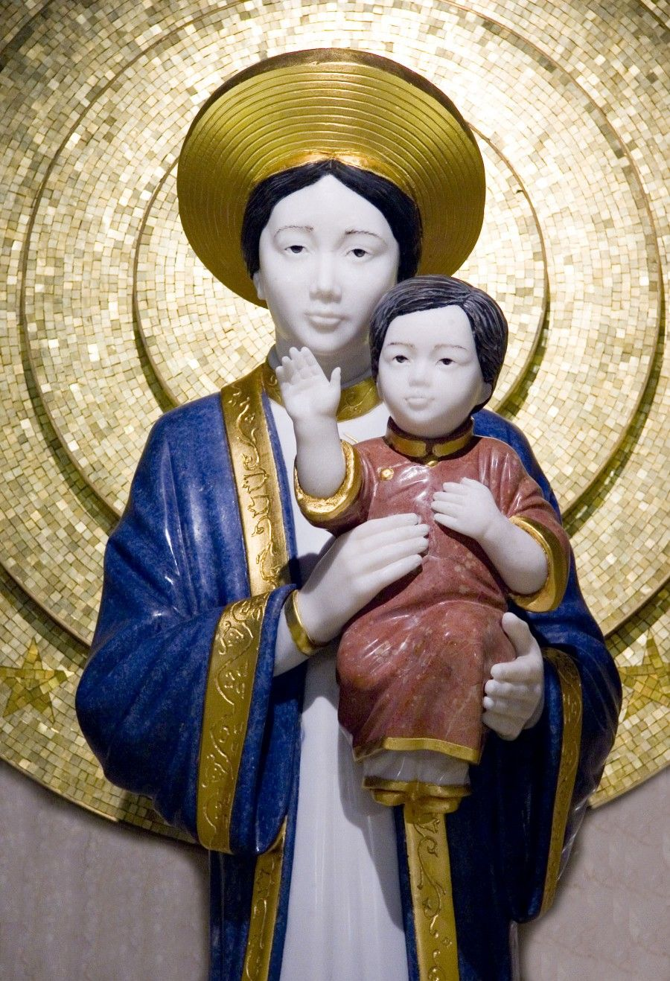
Awaken in all of us a renewed desire for holiness: May the splendour of truth shine forth in our words, the song of charity resound in our works, purity and chastity abide in our hearts and bodies, and the full beauty of the Gospel be evident in our lives.
Our Lady of La Vang
BDES

Slide 7
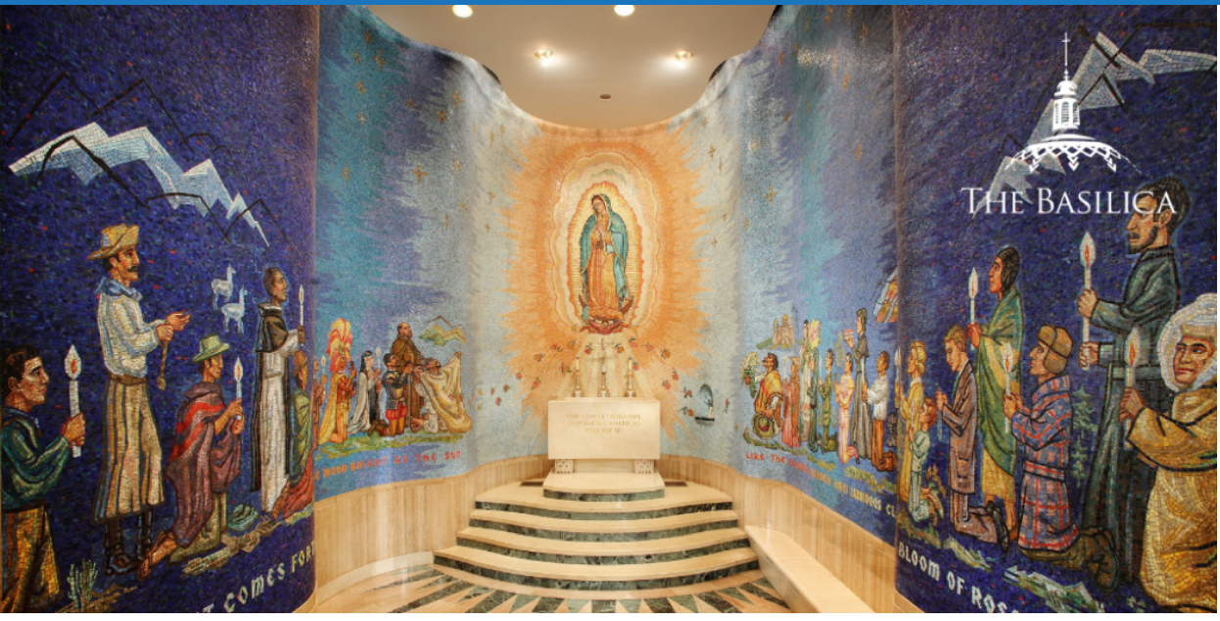
You are all-beautiful, O Mary! In you the Word of God became flesh.
Our Lady of Guadeloupe
BDES

Slide 8
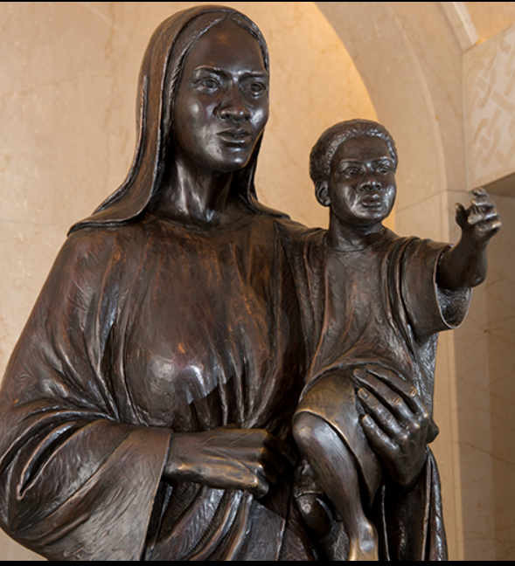
Help us always to heed the Lord’s voice: May we never be indifferent to the cry of the poor, or untouched by the sufferings of the sick and those in need; may we be sensitive to the loneliness of the elderly and the vulnerability of children, and always love and cherish the life of every human being.
Our Mother of Africa
BDES

Slide 9
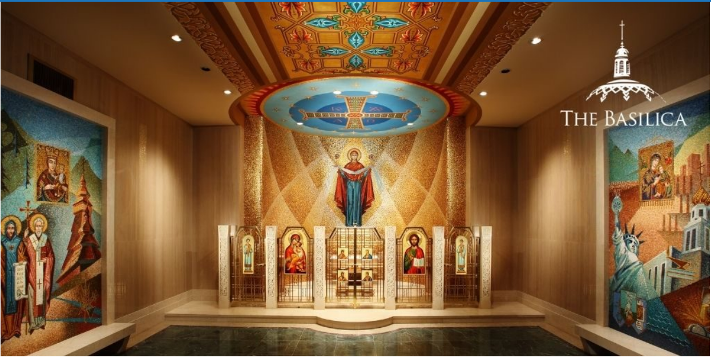
You are all-beautiful, O Mary! In you is the
fullness of joy
born of life
with God.
Mary the Mother of God
BDES

Slide 10
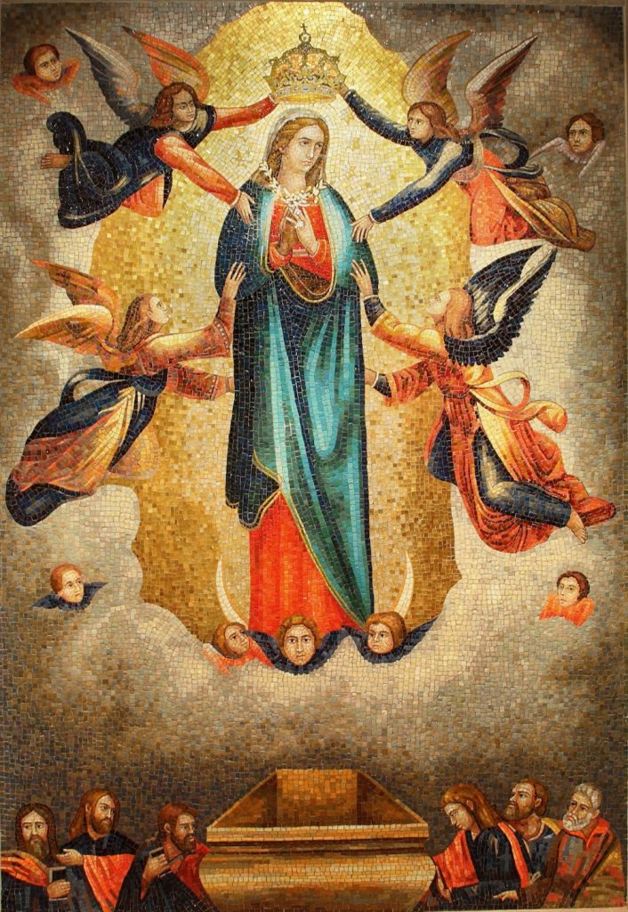
Help us never to forget the meaning of our earthly journey: May the kindly light of faith illumine our days, the comforting power of hope direct our steps, the contagious warmth of love stir our hearts; and may our gaze be fixed on God, in whom true joy is found.
Our Lady of Ta’ Pinu
BDES

Slide 11
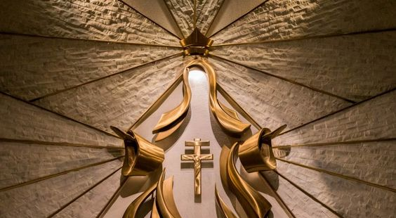
You are all-beautiful, O Mary! Hear our prayer, graciously hear our plea: May the beauty of God’s merciful love
in Jesus
abide in our hearts, and may this divine beauty save us,
and the entire world.
Our Lady of Hope
BDES

