Slide 1
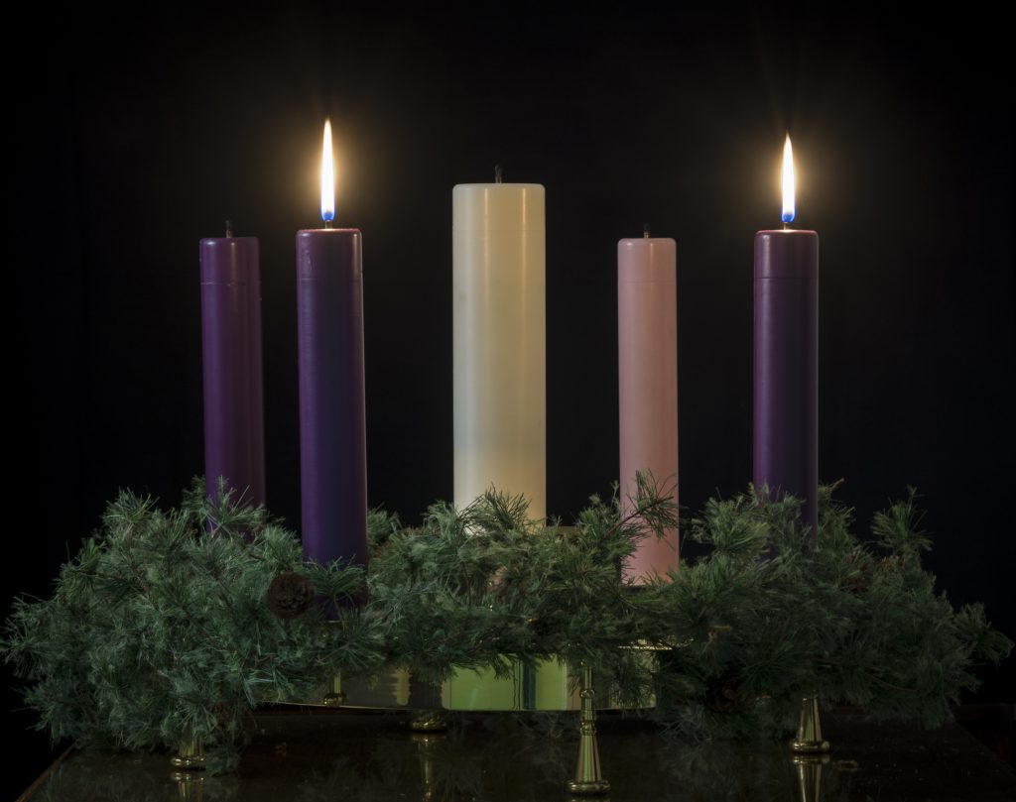
Looking Forward
~ A Church That Looks Forward ~
Monday 6th December 2021
Brentwood Diocese Education Service

Slide 2
We are Looking Forward
~ In the Year of St Joseph ~ In the Year of the Family ~
In Advent we are preparing the way of the Lord.
John the Baptist was seen as the voice crying in the wilderness, many responded.
How have you listened, how have you been asked to respond?
We have the opportunity to follow Jesus in word and deeds.
What are you going to do?
BDES

Slide 3
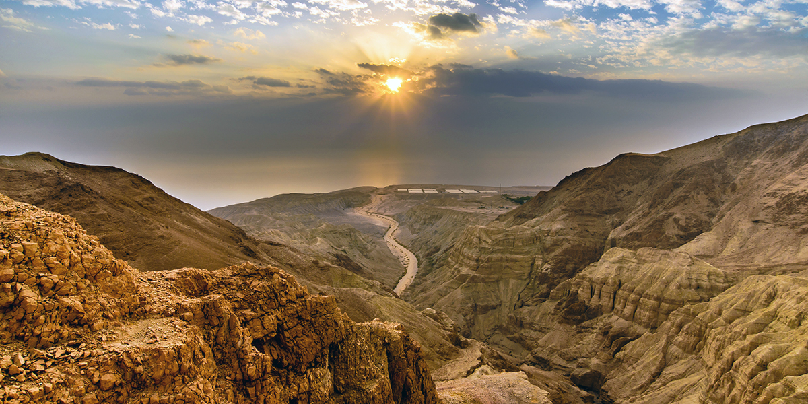
The Synoptic Problem
In Sunday’s Gospel Reading …
6th December 2021 :
In the Gospel of Luke,
we are asked to:
“Prepare the way of the Lord.”
BDES

Slide 4
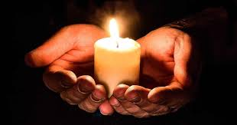
Reflection
“Lord, where there is darkness, let me bring light.” x – Prayer of St Francis
BDES

Slide 5
Preparing as communities for World Youth Day 2023
“True love recognises that everyone has different gifts and a unique path in life.”
- Pope Francis, Amoris Laetitia
BDES

Slide 6
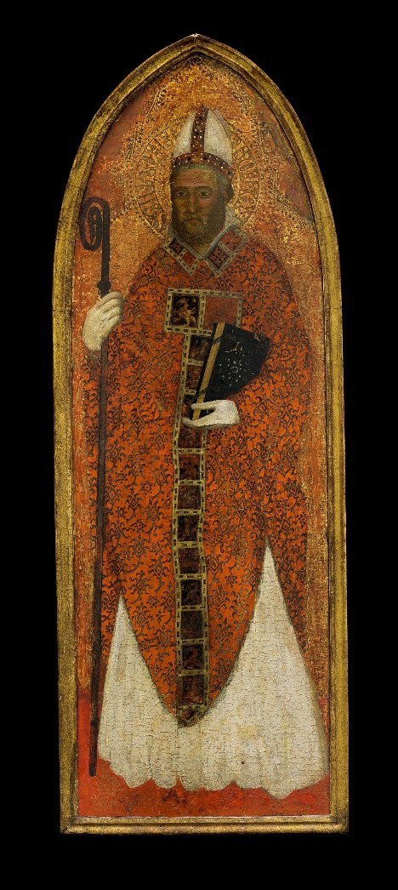
St. Nicholas
Feast day : 6th December
St Nicholas was a 4th century Bishop who is the patron saint of many groups including students.
There were many miracles granted through his intervention. Due to the story of him calming a storm he is also the patron saint of seafarers, and there are many churches dedicated to him in seaports around the world.
It is difficult to find historical records but the story of him providing gifts of money, in secret, to a poor family appears in many pictures across Europe. He is seen as a great gift giver.
BDES

Slide 7
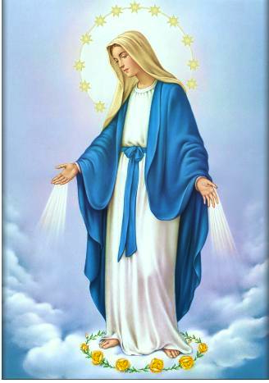
Saints and schools # 6 :Our Lady Immaculate
The feast of the Immaculate Conception of Our Lady is celebrated on December 8th.
This day is one of the most important celebrations of the pure and sinless conception and life of the Virgin Mary and as such is celebrated throughout the world.
There are many images associated with the feast throughout history.
In the Diocese of Brentwood there are a number of schools dedicated to Our Lady but only one called Our Lady Immaculate, which is to be found in Chelmsford. The school seeks to inspire the children to be excellent for themselves but also for the glory of God, which is a true reflection of the life of Our Lady Immaculate.
BDES

Slide 8
Looking Forward
~ A Church That Looks Forward ~
Monday 6th December 2021
Brentwood Diocese Education Service

