Slide 1
Looking Forward
~ A Church That Looks Forward ~
Monday 13th December 2021
Brentwood Diocese Education Service

Slide 2
We are Looking Forward
~ In the Year of the Family ~
Rejoice and be glad!
Last Sunday was Gaudete Sunday.
Gaudete is Latin, and means “Rejoice!”
Why the joy?
Because we are looking forward to Christmas.
We are Looking Forward
~ In Advent ~
BDES

Slide 3
We are Looking Forward
~ In the Year of the Family ~
Because Christmas brings wholeness.
Because Christmas brings generosity of spirit and generosity of heart.
Because we think of the poor, the homeless, the needy.
Because we respond to their needs with charity.
We are Looking Forward
~ In Advent ~
BDES

Slide 4
We are Looking Forward
~ In the Year of the Family ~
Because we spend time with people important to us.
Because we take time out of the busy, bustling business of life to relax.
Because of the calmness.
Because of the stillness.
We are Looking Forward
~ In Advent ~
BDES

Slide 5
We are Looking Forward
~ In the Year of the Family ~
Because of the love we have for each other.
Because of the love God has for us.
Because, in the words of Cardinal Hume :
“The great and awesome God became man for me.”
We are Looking Forward
~ In Advent ~
BDES

Slide 6
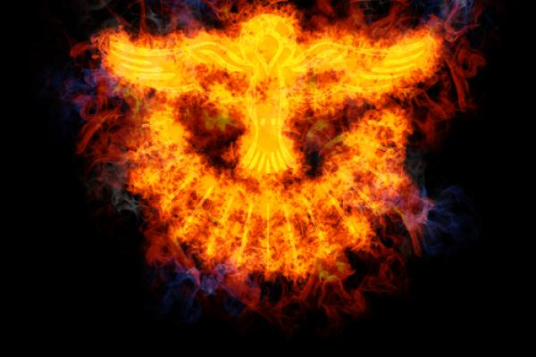
The Synoptic Problem
In Sunday’s Gospel Reading …
12th December 2021 :
In the Gospel of Luke, we are told :
“He shall baptise you with the Holy Spirit.”
BDES

Slide 7
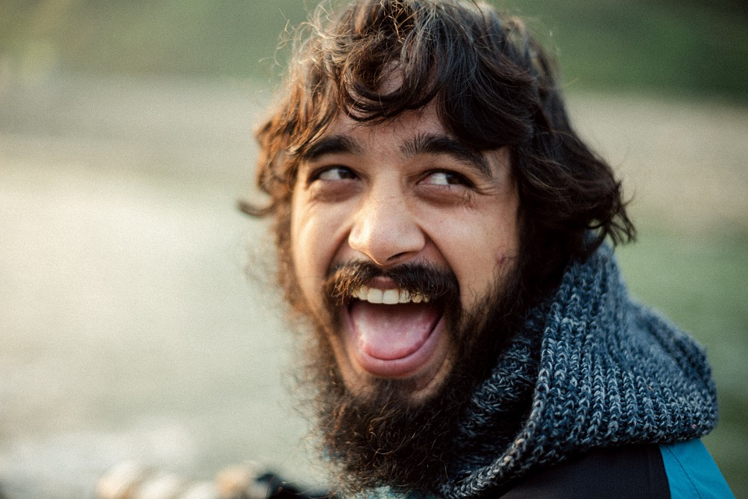
Reflection
“Where there is sadness, let me bring joy.” x – Prayer of St Francis
BDES

Slide 8
Preparing as communities for World Youth Day 2023
“True love strives to discover its own road to happiness,
while allowing others
to find theirs.”
- Pope Francis, Amoris Laetitia
BDES

Slide 9
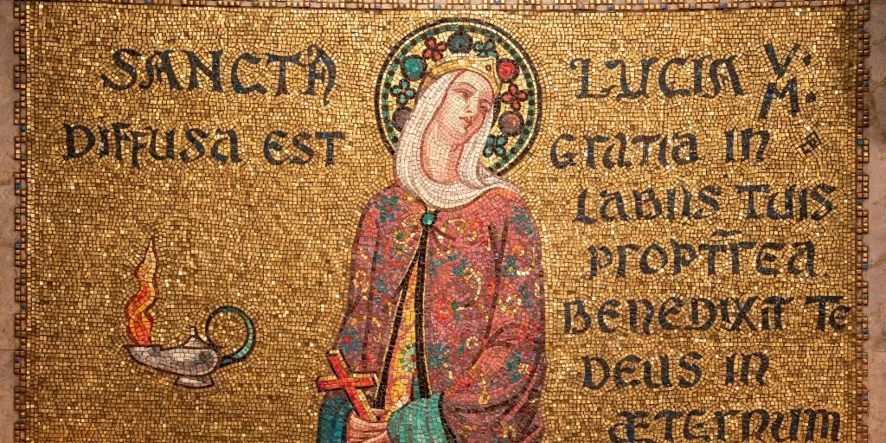
St. Lucy
Feast day :
13th December
Born in Sicily, St. Lucy converted to Christianity after her blind mother recovered her eyesight. She was martyred at a young age under the persecution of the Emperor Diocletian. The exact reason is uncertain, but tradition holds that a spurned suitor reported her to the governor, who had her killed for her faith. Another tradition holds that, as part of her torture, she was blinded, but her eyesight was miraculously restored. For this reason, she is the patron saint for eyesight. Her feast day marks the beginning of the Christmas season in Scandinavian countries.
BDES

Slide 10
Saints and schools # 7 : Holy Family
In 1988, Holy Family Catholic School and Sixth Form was founded in Walthamstow. The school’s mission statement contains the wisdom that “we are a family of many cultures sharing one faith.”
In his book on love and the family, Amoris Laetitia, Pope Francis has a prayer to the Holy Family which includes these lines :
Jesus, Mary and Joseph,
in you we contemplate
the splendour of true love; to you we turn with trust. Holy Family of Nazareth, grant that our families too may be places of communion and prayer, authentic schools of the Gospel
and small domestic churches.
BDES

Slide 11
Looking Forward
~ A Church That Looks Forward ~
Monday 13th December 2021
Brentwood Diocese Education Service

