Slide 1
Looking Forward
~ New Year Good News ~
Monday 3rd January 2022
Brentwood Diocese Education Service

Slide 2
We are Looking Forward
~ In the Year of the Family ~
In Advent we prepared the way of the Lord.
At Christmas we celebrated the birth of Jesus.
We are now looking forward to what the new year brings.
The new year gives us an opportunity to make changes in our lives.
What are you going to do?
BDES

Slide 3
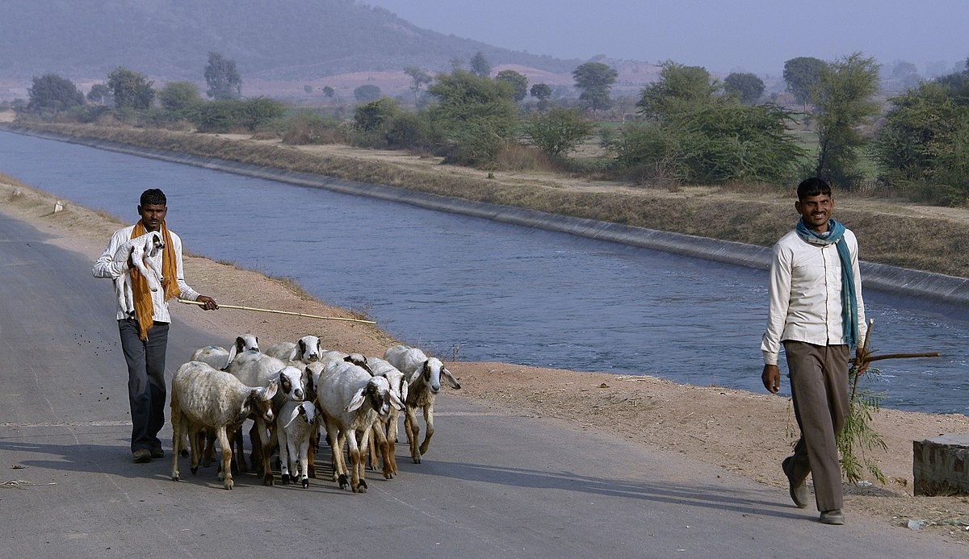
The Synoptic Problem
In the Gospel Reading …
6th January 2022 :
The Gospel of Matthew points out that:
“From you, Bethlehem … shall come a ruler who is to shepherd my people.”
BDES

Slide 4
Reflection
“O divine Master, grant that I may never seek so much to be consoled as to console.” x – Prayer of St Francis
BDES

Slide 5
Preparing as communities for World Youth Day 2023
“The final word on our life will belong to Jesus”
- Pope Francis, Youth Sunday Mass 2021
BDES

Slide 6
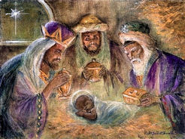
Epiphany : 6th January
The feast of the Epiphany is celebrated on 6th January and marks the end of the twelve days of Christmas.
It celebrates the revelation that Jesus Christ was the Son of God, focussing on the fact that this was revealed to the Three Wise Men.
The gifts they brought of Gold, Frankincense and Myrrh were deeply symbolic. Gold was the sign of kingship, showing Jesus reigns forever, Frankincense was used in worship showing Jesus was God and Myrrh was a herb used to anoint the dead which foreshadowed Jesus’ death and resurrection.
In many cultures Epiphany is celebrated with gift giving and other ceremonies.
BDES

Slide 7
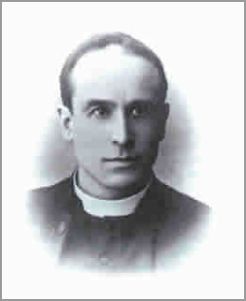
Schools and founders # 8 :The Palmer Catholic Academy
The Palmer Catholic Academy is the only school in the Diocese of Brentwood named after a local priest.
Canon Patrick Palmer spent 50 years between 1896 and 1946 helping transform the Catholic faith and churches in Ilford.
He was responsible for the building of the first permanent church on Ilford High Road in 1899. He was also responsible for the building of the churches in Manor Park and Barkingside. He built the first Catholic school in Ilford on the High Street opening in 1900, later followed by St Winefride’s School in Manor Park.
Truly an inspiration.
BDES

Slide 8
Looking Forward
~ New Year Good News ~
Monday 3rd January 2022
Brentwood Diocese Education Service

