Slide 1
Looking Forward
~ New Year, Good News ~
Monday 10th January 2022
Brentwood Diocese Education Service

Slide 2
We are Looking Forward
~ In the Year of the Family ~
This week’s Gospel reading tells us how people were filled with expectation
for the Messiah and the Good News he would bring.
We are people of the Good News.
A people of expectation and hope.
A people of understanding for others.
A people of friendship.
A people who know that Christ is with us in the storms of life.
BDES

Slide 3
The Synoptic Problem
In Sunday’s Gospel Reading …
9th January 2022 :
In the Gospel of Luke, we are told :
“The people were filled with expectation.”
BDES

Slide 4
Reflection
“O divine Master, grant that I may never seek so much to be to be understood as to understand.” x – Prayer of St Francis
BDES

Slide 5
Preparing for World Youth Day 2023
“Jesus reassures us :
‘I will not leave you alone when storms gather over your life’.”
- Pope Francis, Youth Sunday Mass 2021
BDES

Slide 6
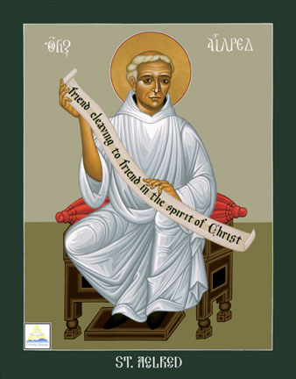
St. Aelred of Rievaulx
Feast day :
12th January
Aelred (1109 – 1167) was born in Hexham and eventually became abbot of the Cistercian abbey of Rievaulx, the imposing ruins of which can still be visited in North Yorkshire. He is the patron saint of friendship. In one of his many writings, the treatise On Spiritual Friendship, he wrote that “God is friendship … he who lives in friendship, lives in God, and God in him” - in this he consciously echoes John 4 : 16, where Jesus says “God is love. Whoever lives in love, lives in God, and God in them.” Aelred viewed Christ as the source of spiritual friendship. Today is a good day to celebrate friendship!
BDES

Slide 7
Schools and founders # 9 :
Canonesses of the Holy Sepulchre
The Canonesses Regular of the Holy Sepulchre (CRHS) were a religious order which dates back to at least 1300. In 1642 they established a convent for English women in Liège and fled the French Revolution to England in 1798 to found a school at the old Tudor palace of New Hall, near Chelmsford.
New Hall School still retains as its emblem a patriarchal cross. An old
tradition associates the Order of the Holy Sepulchre with the Empress Helena, who discovered the True Cross, and whom Bishop Macarius of Jerusalem xxxxx invested with the habit of a canoness.
BDES

Slide 8
Looking Forward
~ New Year, Good News ~
Monday 10th January 2022
Brentwood Diocese Education Service

